Slide 1
The effect of nonlocality on material stability
Stewart Silling
July 18, 2022
Theoretical and Applied Aspects for Nonlocal Models
Banff International Research Station
SAND2022-9623 C

Slide 2
Outline
The nonlocal length scale affects all aspects of material stability.
Failure kinetics: “Imaginary wave speeds” are useful.
Material and structural instability are related, leading to models for:
Kink bands in composites.
Self-shaping of fibers.
Phase boundaries contain an unstable core.
Their motion lowers the energy in a polycrystal by reshaping and merging grains.

Slide 3
Some concepts of stability (local theory)
Real wave speeds (Hadamard stability, strong ellipticity)
Minimum potential energy
Bifurcations
Well-posedness*
Discontinuity in gradient (Ordinary ellipticity)
*Summary of well-posedness result for nonlocal theories: see:
Qiang Du, "Nonlocal calculus of variations and well-posedness of peridynamics." Handbook of peridynamic modeling. (2016)
R. Lipton’s papers on nonconvex strain energy in crack nucleation.

Slide 4
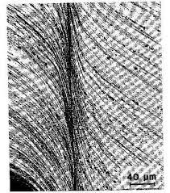
Material vs. structural stability (local theory)
Material instability:
Happens at a material point, triggered by local conditions
Not directly related to the geometry of the body
Example: Adiabatic shear band
Structural instability:
Happens to the entire body collectively
Example: Buckling of a beam
We’ll see that this distinction becomes less useful in a nonlocal model.
Adiabatic shear band in aluminum
image: Baxevanis et al.,
www.ima.umn.edu/materials/2008-2009/SP7.13-31.09/8186/ima.pdf
Buckling of a column
image: Klimchik
www.researchgate.net/figure/Examples-of-buckling-in-column-www-civildb-www-highline_fig11_281183936

Slide 5
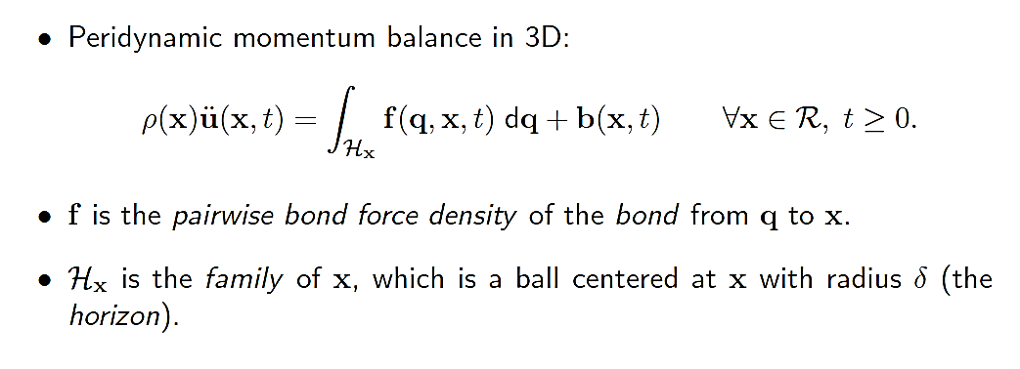
Peridynamics background
$$q$$
$$y(q,t)$$
Bond $ξ$
$$x$$
$$f$$
$$ℛ$$
$$δ$$
$$y(x,t)$$
$$x$$
$$ℋ_{x}$$
$$ℋ_{x}$$
Time $0$
Time $t$

Slide 6
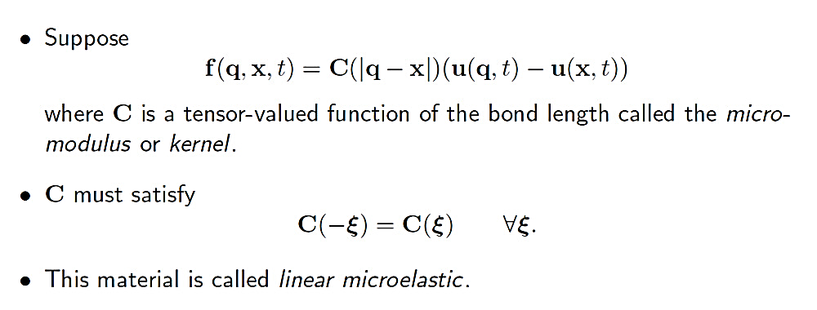
Linear bond force model

Slide 7
An intuitive notion of stability… and a mysterious tensor
$$f$$
$$u_{0}$$
Comparable statement in the local theory:

Slide 8
Simplify further to 1D, linear microelastic
$$C(ξ)$$
$$δ$$
$$ξ$$
Some possible micromodulus curves

Slide 9
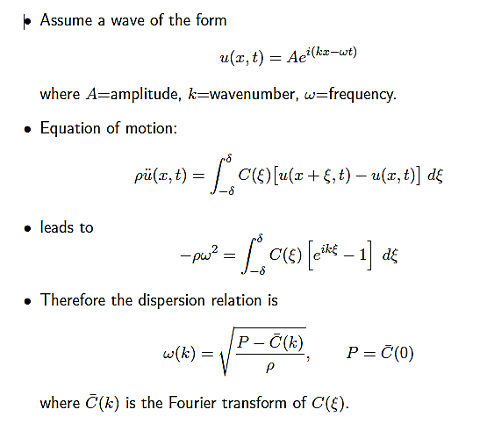
Linear waves: Dispersion curves
$${ρω}^{2}(k)$$
$$P$$
$$k$$
Some possible dispersion curves
We’ve seen this before!

Slide 10
Dispersion and material stability
Purple and red materials have “imaginary wave speeds” $c=ω/k$.
Red: all wavenumbers are unstable.
Purple: only some wavenumbers are unstable.
$C\left(ξ\right)>0 ∀ξ$ is not required for real wave speeds*
$$C(ξ)$$
$${ρω}^{2}(k)$$
Stable
$$δ$$
$$ξ$$
$$k$$
Unstable
Micromodulus curves
Dispersion curves
*T. Mengesha, and Q. Du., Discrete & Continuous Dynamical Systems-B (2013).

Slide 11
Example: A material with a narrow band of unstable wavenumbers
Material model
Dispersion curve
0
Frequency squared $ω^{2}(k)$
Micromodulus $C(ξ)$
Stable
0
Unstable
Unstable wavelength
Wavelength = 0.5
0
0.5
1.0
1.5
0
10
20
Bond length $ξ$
Wave number $k$

Slide 12
This material is stable in some geometries but unstable in others
$$u(x,t)$$
VIDEOS
Long bar (length = 2.0)
Short bar (length = 1.0)
Unstable wavelength
Unstable wavelength

Slide 13
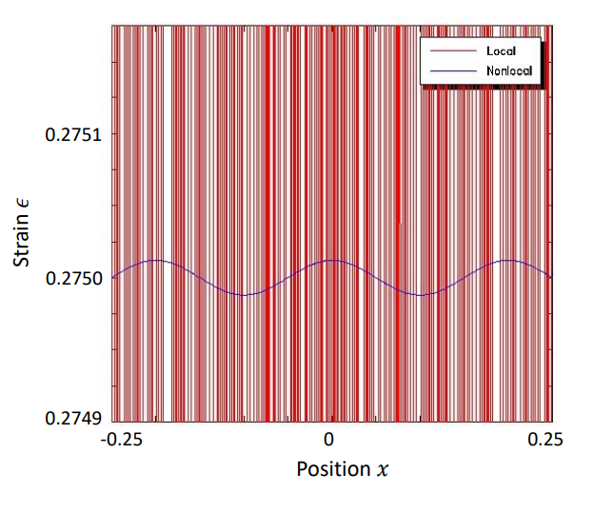
Similar problem in the local theory blows up immediately
We can’t “do mechanics” in an unstable material in the local theory.
Stress
Strain

Slide 14
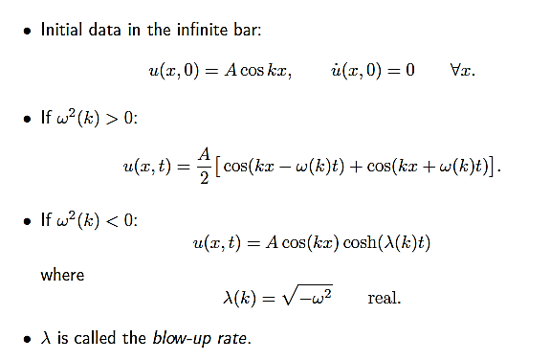
Failure kinetics: Unstable waveforms grow exponentially but at a finite rate
$$u$$
$$x$$

Slide 15
How much time does it take for an unstable waveform to grow?
Suppose the material “fails” when the local strain $u_{x}$exceeds some given value $ε_{∗}$ .
Peridynamic material model
Growth of a perturbation for different wavelengths $Λ$
Bond force $f$
0.2
$$Λ=δ/5$$
$$Λ=3δ$$
$$ε_{∗}$$
$$Λ=5δ$$
Bond strain $s$
$$ε_{∗}$$
Strain
0.1
0
0
1
$$t_{fail}$$
2
Time

Slide 16
Failure kinetics: How much time does it take for material to fail?
Example: Stretching of a bar with an unstable material model.
Bar is stretched from the ends at a constant rate.
The bond force vs. strain curve has a descending branch.
What happens?
Numerical simulation results
Strain rate
Stress at center
Weak spot
Failure time
Bond force $f$
Material model
Strain at center
$s_{1}$
$s_{0}$
Bond strain $s$
Time

Slide 17
Self-shaping of a fiber
String made of microelastic material
Constant long-range forces between material points
Allow rotations (unlike true 1D)
Study transverse waves and their stability
Area $a$
Fiber
$$x_{2}$$
Wave velocity $V$
Fiber
$$σ_{0}$$
Internal force $f_{i}(ξ)$
$$σ_{0}$$
$$u_{2}$$
$$x_{1}$$

Slide 18
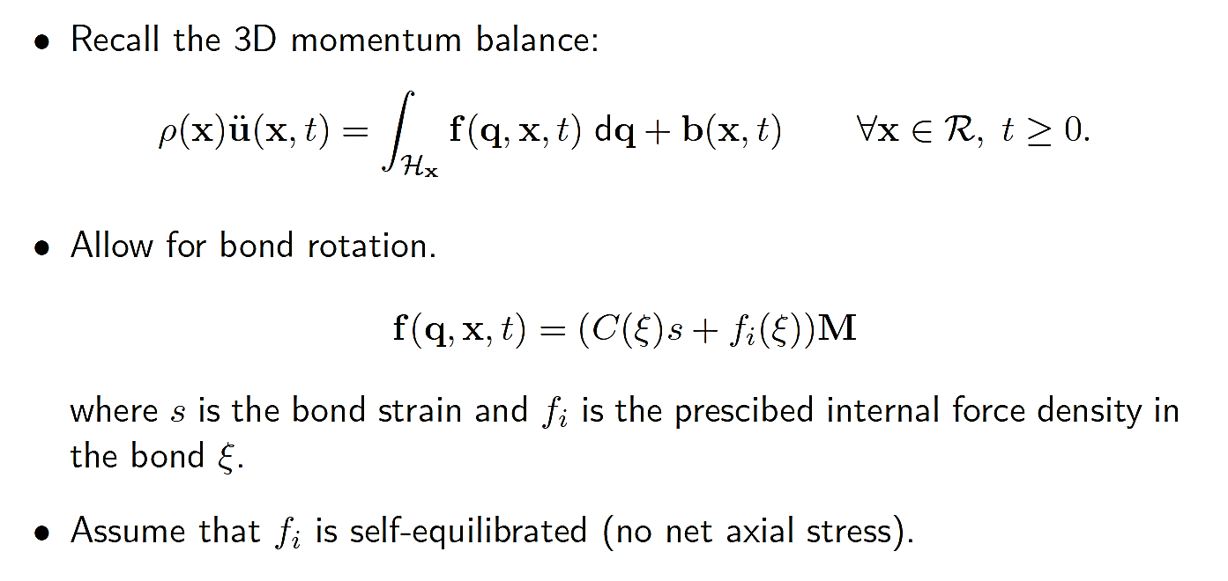
Internal loading in a fiber accounting for bond rotations
Internal loading as a function of bond length
$$f_{i}$$
$$δ$$
$$ξ$$

Slide 19
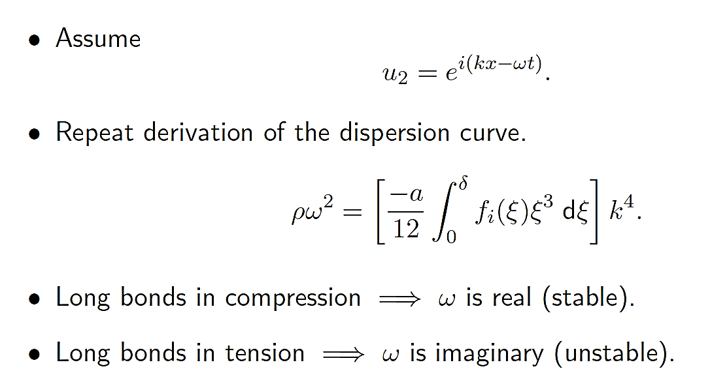
Transverse waves
$$f_{i}$$
Stable
$$δ$$
$$ξ$$
$$f_{i}$$
Unstable
$$ξ$$
$$δ$$

Slide 20
If a straight fiber is unstable, what does equilibrium look like?
We can compute* the curvature of a fiber in equilibrium.
Result:
Curvature
$$f_{i}$$
Slope = $β$
Straight is stable
Straight is unstable
$$ξ$$
$$δ$$
$$β$$
* SS, “Self-induced curvature in an internally loading peridynamic fiber,” technical report SAND2022-5539

Slide 21
Emu simulation of an internally loaded fiber
Internal loading is turned on suddenly.
VIDEO
Initial
Final
Colors show strain
(red = 0.01)

Slide 22
Homogenized model of many fibers: Kink bands in a fiber-reinforced composite
$$σ_{0}$$
$$u_{2}$$
$$σ_{0}$$
$$q$$
$$x$$
Fibers in a matrix
Remote loading in fibers is $σ_{0}$
Bonds can be either stiff or soft
Transverse wave

Slide 23
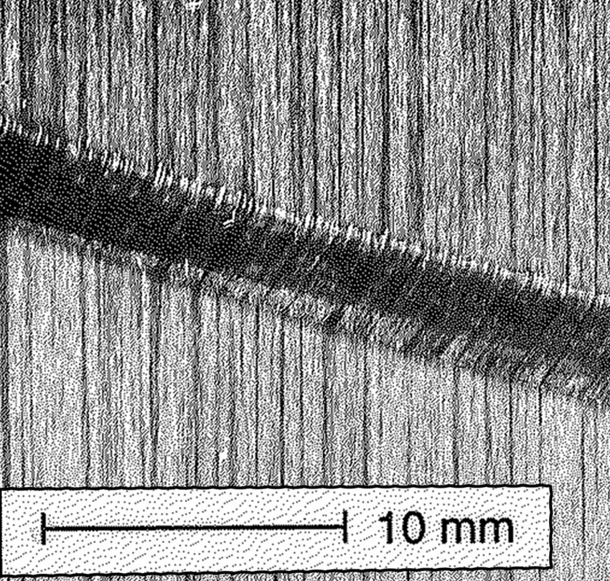
Emu simulation of instability in compression in a composite
Bonds in the horizontal direction are more stiff than the others.
Anisotropic, microelastic material model.
There is no damage (bond breakage) in the peridynamic model.
Compressive failure
Load in x-direction
Final
Colors show displacement magnitude
Initial
Time
Kink band in a composite
Image: S.P.H. Skovsgard, thesis, 2019

Slide 24
Mechanically induced phase transformation
Bond force $f$
Here’s another type of nonconvex microelastic material:
Low strain phase
High strain phase
Bond strain $s$
$$σ$$
$$σ$$
$$s^{−}$$
$$s^{∗}$$
$$s^{+}$$
Phase boundary (thickness $≈δ$)
There are multiple bond strains for the same bond force.
This creates the possibility of multiple phases in a bar in equilibrium.
Within the phase boundary, there are always some bonds in the unstable part of the material model.
K. Dayal & K. Bhattacharya. J. Mechanics & Physics of Solids (2006).

Slide 25
What conditions permit coexistent phases?
In equilibrium, energy conservation implies
$$W^{+}−W^{−}=\left({ε^{+}−ε}^{−}\right)σ$$
which is formally the same as in the local theory.
Compare Weierstrass corner condition, Maxwell condition in the calculus of variations.
$$W^{−},ε^{−}$$
$$W^{+},ε^{+}$$
$$σ$$
$$σ$$
Phase boundary (thickness $≈δ$)

Slide 26
Microstructure evolution
The system evolves over time to reduce the total surface area of phase boundaries.
We can use this to simulate microstructure evolution.
Both these grains if isolated have zero stress, energy
Bond force
density $f$
Strain = 0
Strain = $ε_{0}$
But it they share an edge, they distort and their energy increases.
$$ε_{0}$$
Bond strain $s$

Slide 27
Circular grain evolution
Initialize a displacement field to have zero strain inside a circle, $ε_{0}$ outside.
VIDEOS
Colors show bond strain
Bond force
density $f$
$$ε_{0}$$
Bond strain $s$
Either all purple or all yellow would be a global minimizer

Slide 28
Microstructure evolution over time
Voronoi cells (grains) have random initial strain.
Mismatch of strains at grain boundaries causes strain energy.
Total energy is reduced by merging small grains to form larger grains.
VIDEO
Colors show bond strain

Slide 29
Summary
Nonlocality changes everything about material stability.
We can do meaningful continuum mechanics within an unstable material.
We can use this to simulate real phenomena:
Rate of crack nucleation in response to a suddenly applied load
Self shaping of a long molecule
Compressive failure modes in composites
Microstructure evolution
Special thanks to our IT specialist

Slide 30
Extra slides

Slide 31
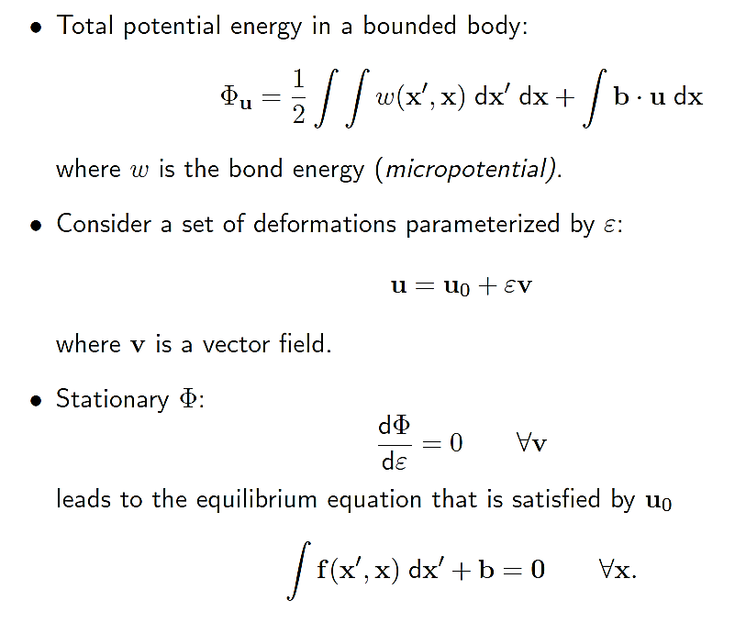
Minimum potential energy is related to wave speed

Slide 32
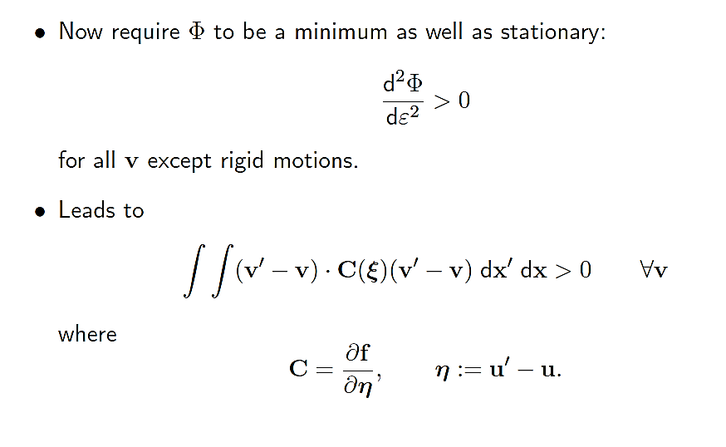
Minimum potential energy is related to wave speed, ctd.

Slide 33
Minimum energy implies real wave speeds

Slide 34
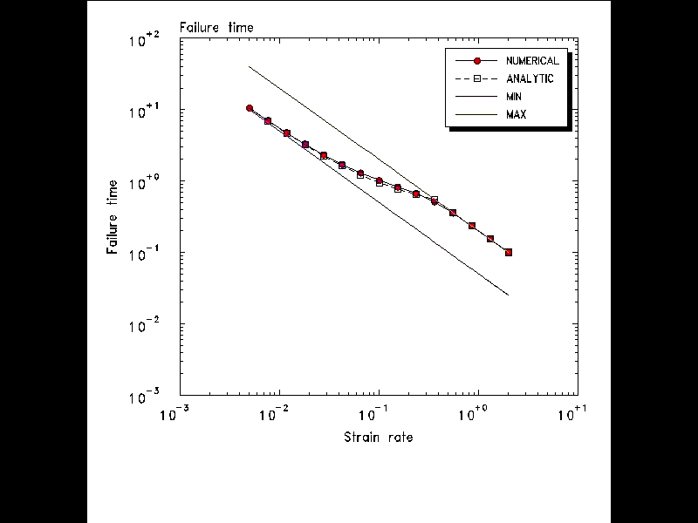
Stretching of a bar: Compute the time to failure
$$λ_{∞}=\sqrt{ \frac{−P }{ρ}}$$
Strain rate
Weak spot
Failure time
100
$$s_{0}/r_{0}$$
10
1
Bond force $f$
Failure time $t_{fail}$
0.1
Bond strain $s$
$$s_{1}/r_{0}$$
0.01
$s_{1}$
$s_{0}$
0.001
0.01
0.1
1
10
Strain rate $r_{0}$

Slide 35
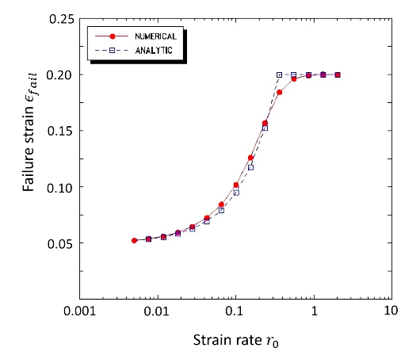
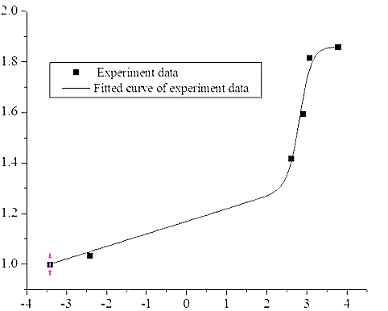
Stretching of a bar: We arrive at a macroscopic rate effect
It takes time for the bar to fail even after some bonds have crossed the peak.
Meanwhile, the remote strain is still increasing.
Result is that higher strain rates lead to higher macroscopic failure strain
$ε_{fail}=r_{0}t_{fail}$
Many real materials show a similar trend.
Remote strain at time of failure
Rate effect on the strength of polyethylene
(Yu, Lu, & Cai, 2013)
Strength
$$\log_{10}{(strain rate)}$$
SS, Journal of Peridynamics & Nonlocal Modeling (2021)

Slide 36
Crack nucleation as a material instability
A body is initially continuous.
At some later time there is a discontinuity.
What mathematical conditions need to exist for this to happen?
This question is not addressed by fracture mechanics, which assumes a pre-existing defect.
SS, O. Weckner, E. Askari & F. Bobaru, Int. J. Fracture (2010)
R.P. Lipton, R.B. Lehoucq & P.K. Jha, J. Peridynamics & Nonlocal Modeling (2019)

Slide 37
Perturbation by a jump
Suppose a small virtual discontinuity is inserted into a body under load.
Does the discontinuity grow or close up?
Analyze the evolution of the jump $[u]$.
$$x$$
$$x^{−}$$
$$x^{+}$$
$$ℋ_{x}$$
$$[u]$$

Slide 38
Perturbation by a jump

Slide 39
A nonlocal model of fracture can be well-posed (!)
Nonconvex elastic peridynamic material.
Points entering the unstable branch lead to creation of a jump in displacement.
This discontinuity can grow through the body.
As it grows, it consumes a definite amount of potential energy per unit crack area (Griffith crack).
The whole problem can be well-posed.
These results hold for both static and dynamic cases.
Bond force $f$
Bond strain $s$
R.P. Lipton, J. Elasticity (2014)
R.P. Lipton, J. Elasticity (2016)
P.K. Jha & R.P. Lipton, SIAM J. Numerical Analysis (2018)
R. Lipton, E. Said & P.K. Jha - Handbook of nonlocal continuum mechanics for materials and structures (2018)
R.P. Lipton, R.B. Lehoucq & P.K. Jha, J. Peridynamics & Nonlocal Modeling (2019)
P.K. Jha & R.P. Lipton, Computer Methods in Applied Mechanics & Engineering (2019)
R.P. Lipton & P.K. Jha, Nonlinear Differential Equations and Applications (2021)

Slide 40
$Z<0$at the crack nucleation site and near a growing crack tip
There is a process zone near a growing crack tip within which $Z<0.$
$$ε$$
Material model

