Slide 1


Modern Neuroscience: An Overview of Measurement and Analysis of Neural Activity
Kristin Sellers, PhD
Department of Neurological Surgery
University of California, San Francisco

Slide 2

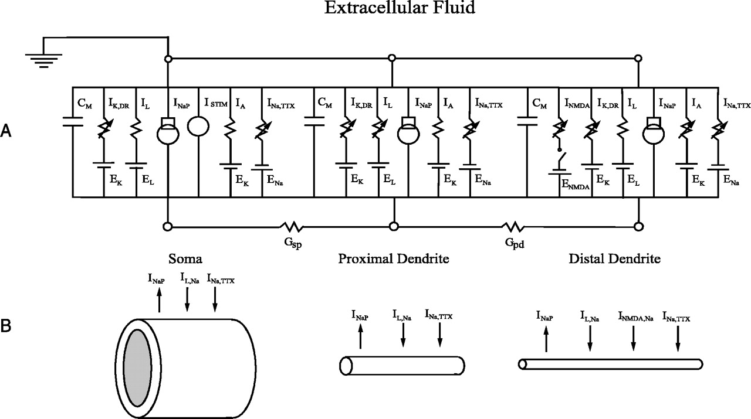
What this is:
What this is not:
All coursework for a neuroscience PhD…and some more… in 1 hour
Concepts, capabilities, and techniques
The biased perspective of an electrophysiologist
The full story
An equal explanation of all measurement capabilities
An equal discussion of all cells in the brain (sorry glia)
The nitty gritty (e.g. no circuit diagram models of neurons)
Buzsaki et al, 2012, Nature Reviews Neuroscience
Komendantov & Canavier, 2002

Slide 3
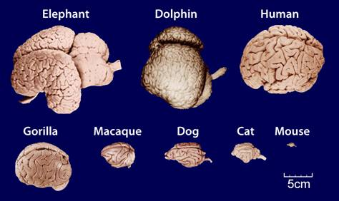

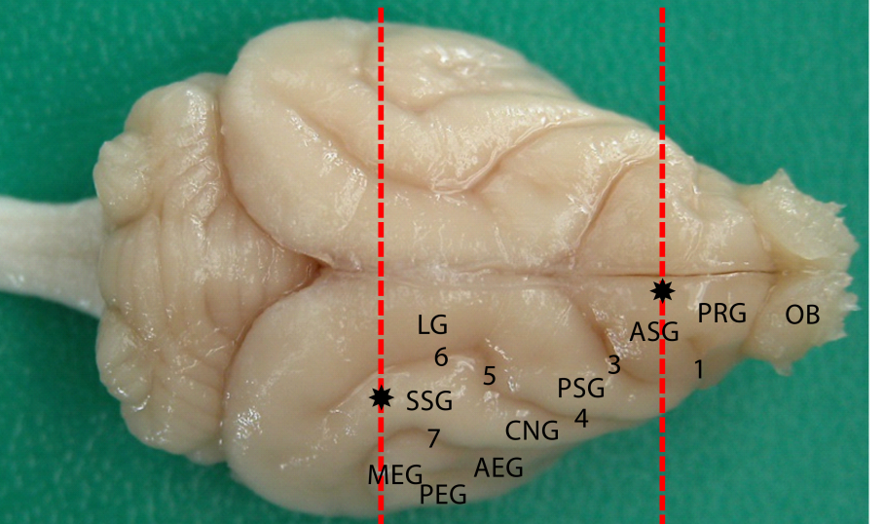
A brief aside: Model systems
Why do we use model systems?
Ethics
Cost
Convenience (e.g. animal life cycle)
Experimental manipulation
Introduction of foreign biologics (DNA from other animals, etc)
Cryan & Holmes, 2005, Nature Reviews Drug Discovery

Slide 4
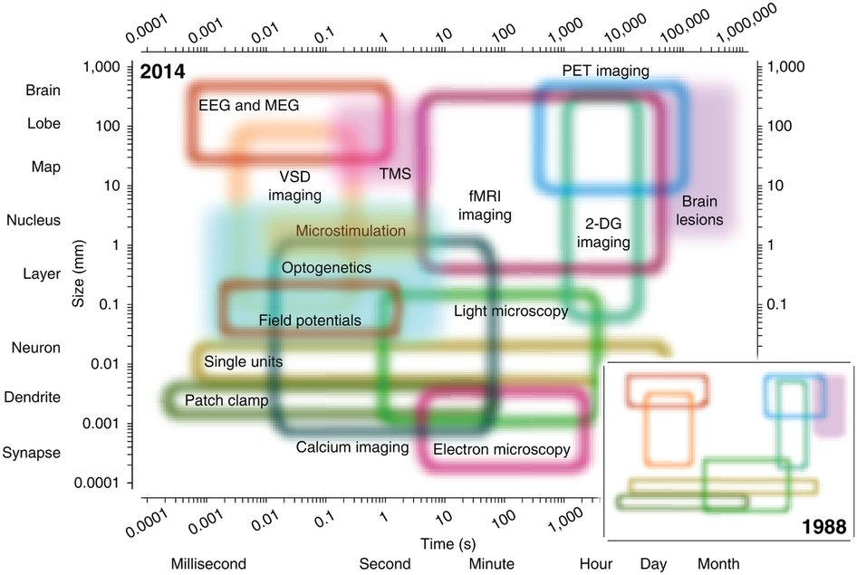
Today’s Discussion Topics:
Measuring brain structure
Measuring brain function
Physiology underlying measured brain function
True vs measured activity
Network activity

Slide 5
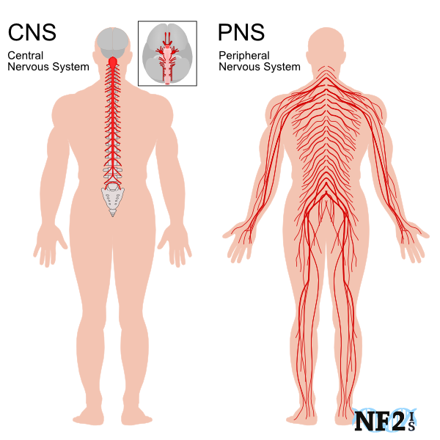
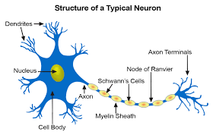
Structure
Central Nervous System (CNS): Brain and spinal cord
Peripheral Nervous System (PNS): Somatic and autonomic nervous systems
Neurons: dendrites (input), cell body, axons (output)

Slide 6
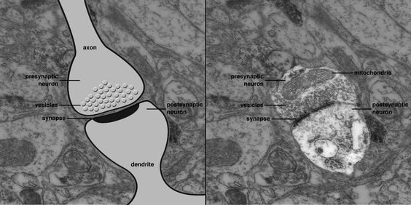
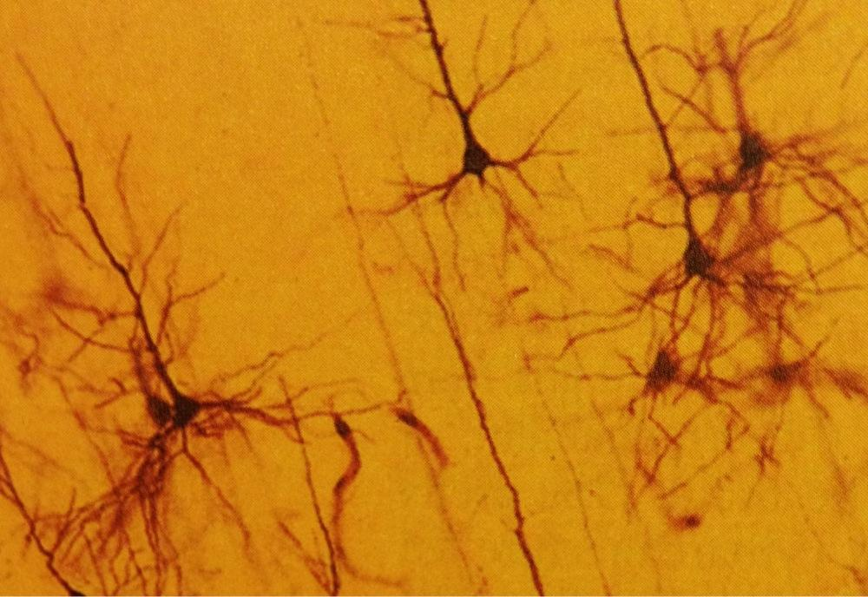
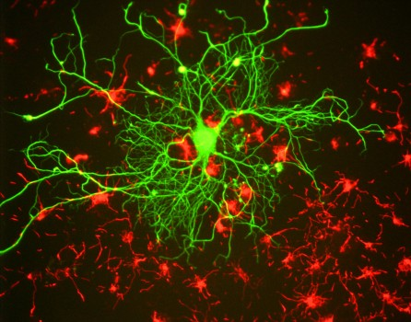
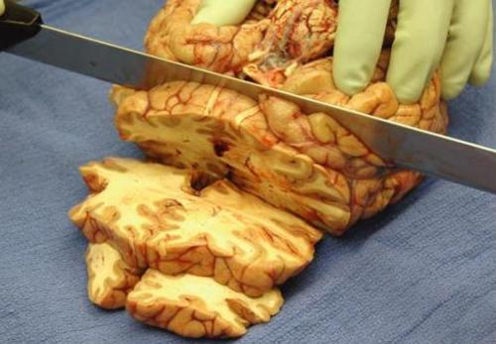
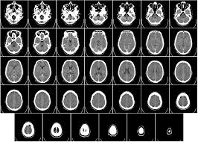
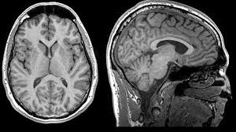
Measuring Brain Structure
Staining
(Golgi)
Staining (Immunohistochemistry fluorescence)
Electron Microscopy
Post-Mortem Dissection
CT
MRI

Slide 7
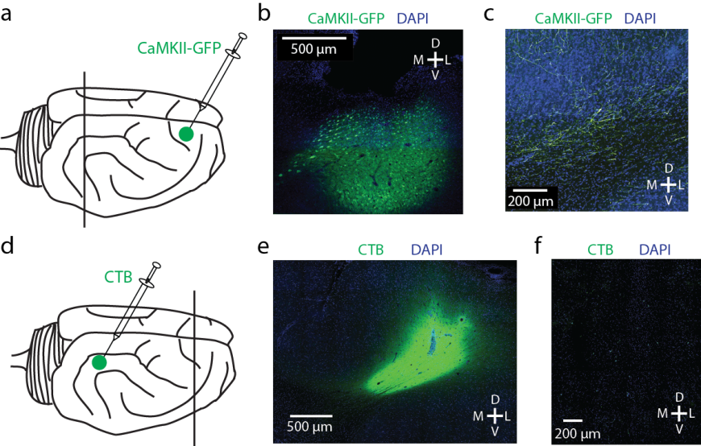
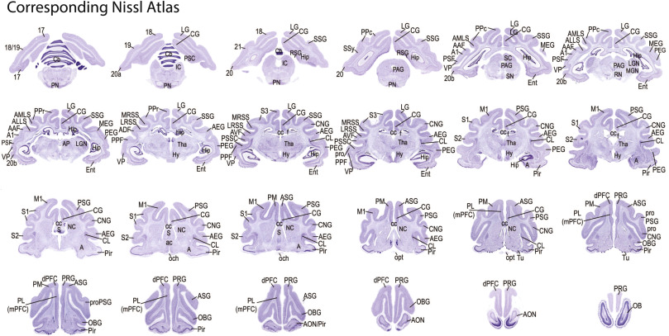
Measuring More Brain Structure
Staining (Nissl)
Tracing
Zhou et al, NeuroImage, 2016
Sellers et al, Cell Reports, 2016

Slide 8
Function
Intracellular signaling and intercellular singling
Chemical: Neurotransmitters
Electrical: Movement of charged ions across a membrane potential
Changes in membrane permeability to ions
[Here’s where “not the whole story” comes in – skipping metabotropic receptors, gap junctions, and a lot more]

Slide 9
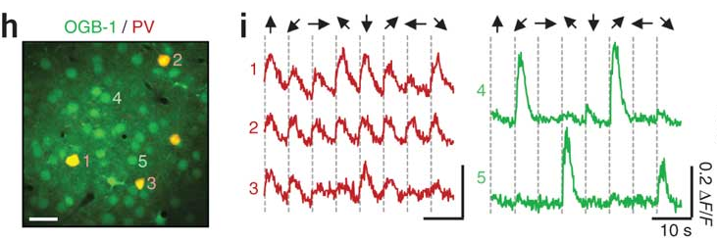
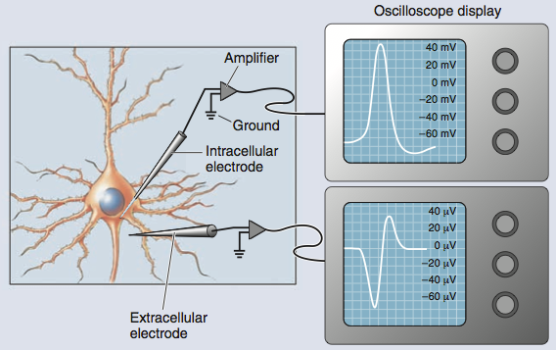
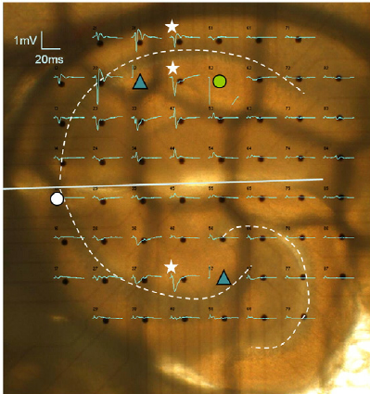
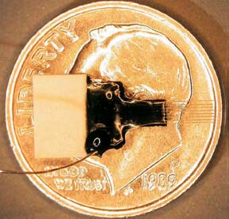
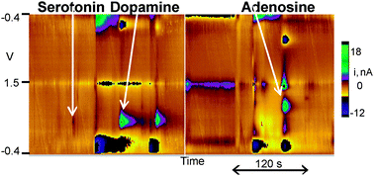
Measuring Brain Function in Animals
Intracellular and Extracellular Electrophysiology
Calcium Imaging
Hofer et al, 2011
Fast-scan cyclic voltammetry

Slide 10
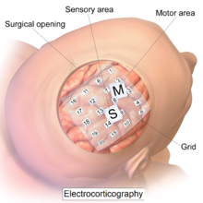
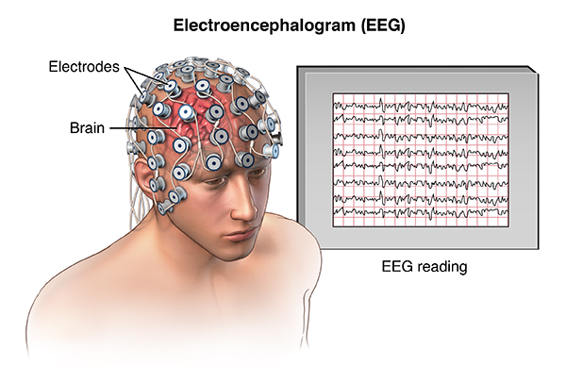
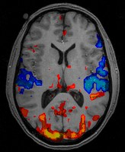
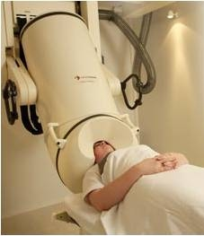
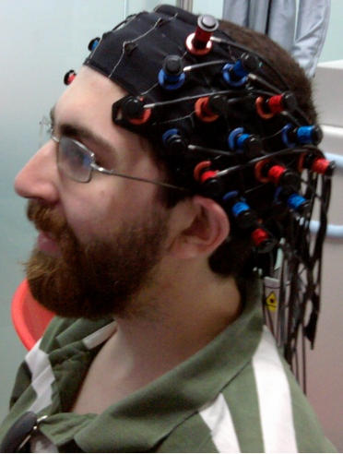
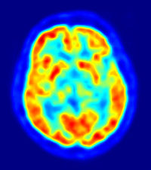
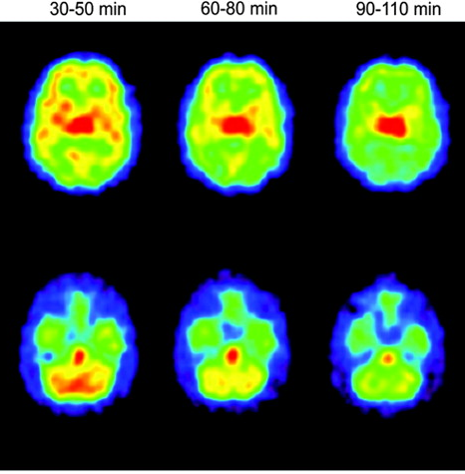
Measuring Brain Function in Humans
ECoG
EEG
fMRI
MEG
fNIRS
PET
SPECT

Slide 11
Physiology underlying measured brain function
Outside of neuron
Inside of neuron
(net negative charge)
K⁺
A⁻
Cl⁻
K⁺
Na⁺
Na⁺
A⁻
Na⁺
Na⁺
K⁺
Cl⁻
A⁻
A⁻
Na⁺
K⁺
Cl⁻
Na⁺
A⁻
K⁺
Concentration Gradients:
Na⁺
K⁺
Ca²⁺
??
Cl⁻
Notes:
Neurotransmitters and neuromodulators: acetylcholine, biogenic amines (dopamine, norepinephrine, epinephrine, serotonin, histamine); neuropeptides (opioids, oxytocin); nitric oxide; amino acids (Excitatory: Glutamate; Inhibitory: GABA, glycine)

Slide 12
Action Potentials

Slide 13
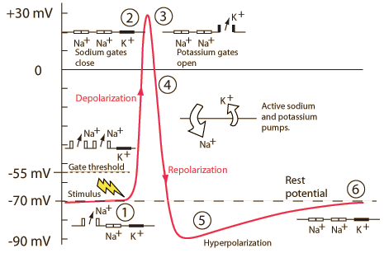
EPSP: Graded depolarization that moves the membrane potential closer to the threshold for firing an action potential
IPSP: Graded hyperpolarization that moves the membrane potential further from the threshold for firing an action potential
Neurons can receive as many as 200,000 terminals -- many EPSPs and IPSPs – relative timing can affect if an action potential occurs
Ka Xiong Charand
Notes:
1. A stimulus is received by the dendrites of a nerve cell. This causes the Na⁺ channels to open. If the opening is sufficient to drive the interior potential from -70 mV up to -55 mV, the process continues.
2. Having reached the action threshold, more Na⁺ channels (sometimes called voltage-gated channels) open. The Na⁺ influx drives the interior of the cell membrane up to about +30 mV. The process to this point is called depolarization.
3. The Na⁺ channels close and the K⁺ channels open. Since the K⁺channels are much slower to open, the depolarization has time to be completed. Having both Na⁺ and K⁺ channels open at the same time would drive the system toward neutrality and prevent the creation of the action potential.
4. With the K⁺ channels open, the membrane begins to repolarize back toward its rest potential.
5. The repolarization typically overshoots the rest potential to about -90 mV. This is called hyperpolarization and would seem to be counterproductive, but it is actually important in the transmission of information. Hyperpolarization prevents the neuron from receiving another stimulus during this time, or at least raises the threshold for any new stimulus. Part of the importance of hyperpolarization is in preventing any stimulus already sent up an axon from triggering another action potential in the opposite direction. In other words, hyperpolarization assures that the signal is proceeding in one direction.
6. After hyperpolarization, the Na⁺/K⁺ pump eventually brings the membrane back to its resting state of -70 mV .

Slide 14
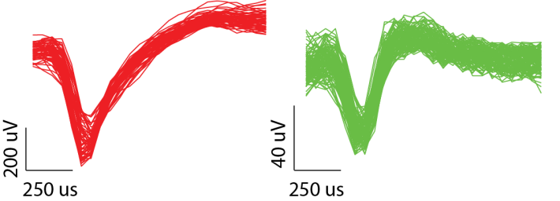
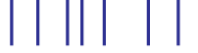

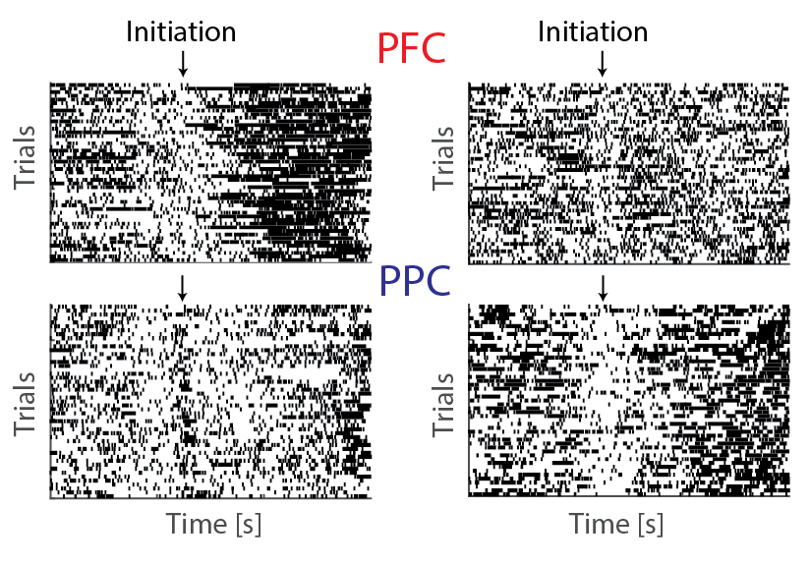
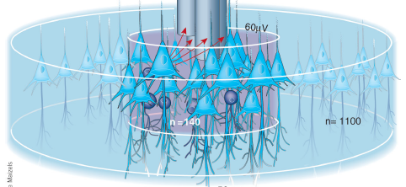
So what am I recording?
‘Spikes’ (putative action potentials)
Local Field Potential (LFP)
time

Slide 15
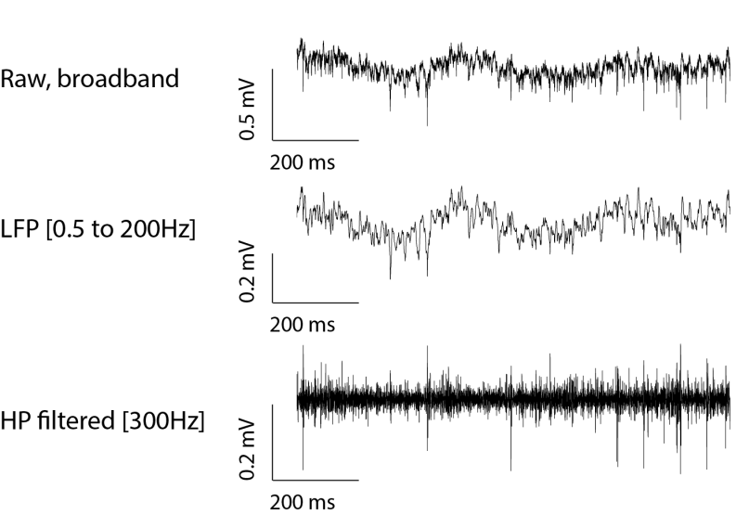
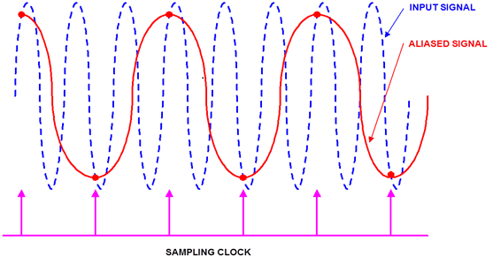
Recording parameters affect your data!
Nyquist rate = Minimum sampling rate required to prevent aliasing of a signal (2*highest frequency of interest)
In practice, better to use 5 to 10x Nyquist rate
LFP = [0.5 200Hz]
Fs > 1kHz
Spiking data
Fs > 20kHz

Slide 16
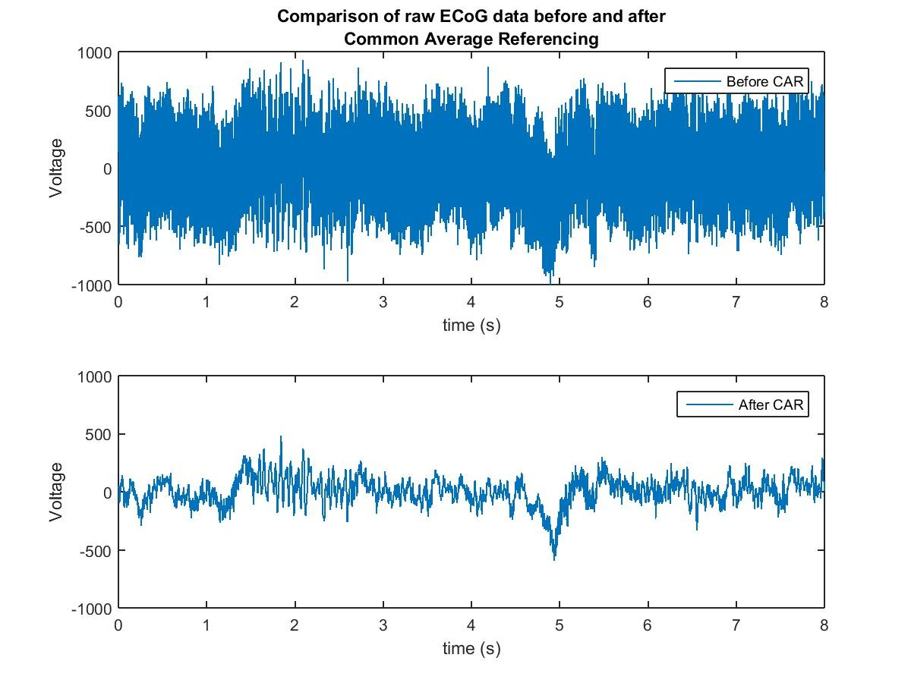
But is what I’m recording actually brain activity?
Signal vs noise
Line noise: 60Hz (US/Canada), 50Hz (Europe)
Movement artifact
Most electrophysiology is done with referential recordings – what is used as reference?

Slide 17

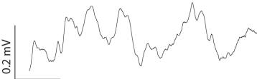
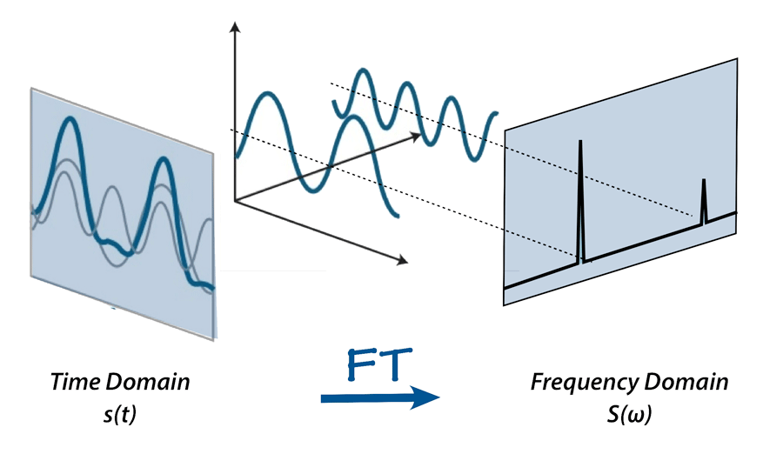

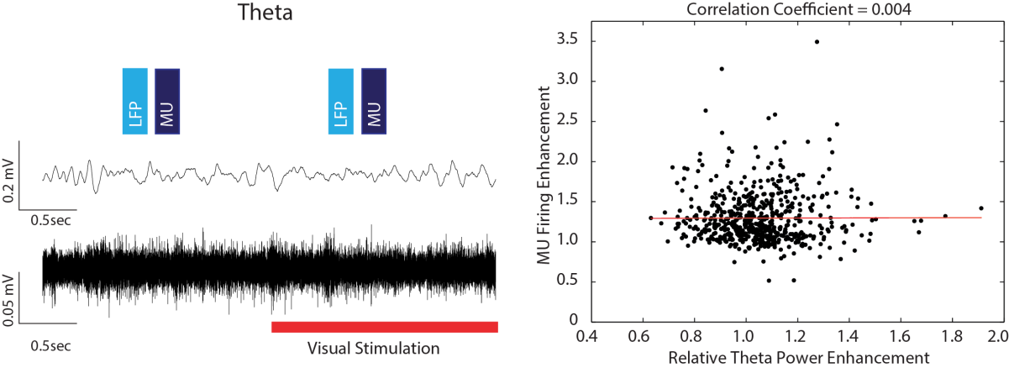
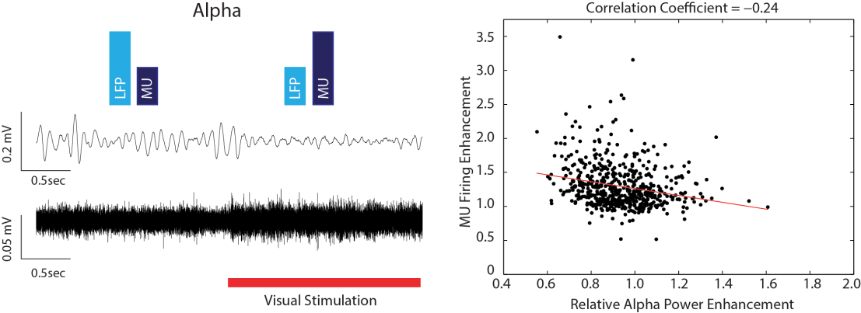
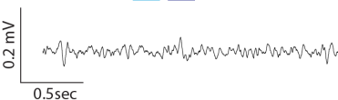
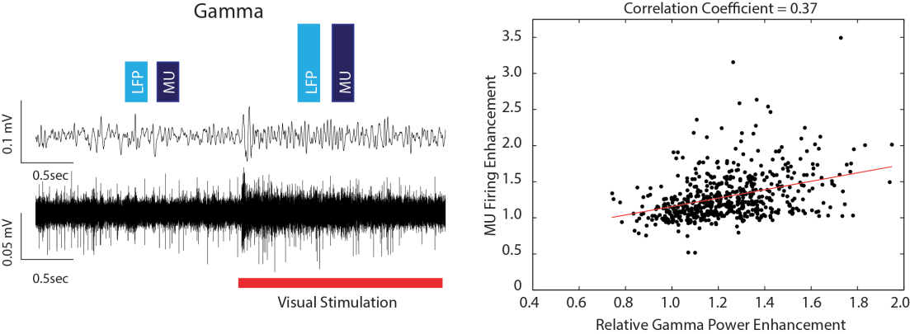
Time-Frequency Domain
Delta: 0.5 – 4 Hz
Theta: 4 – 8 Hz
Alpha: 8 – 12 Hz
Beta: 12 – 30 Hz
Fourier Transform
Bandpass filter / Hilbert Transform
Wavelet Transform
Multi-taper method
Gamma: 30 – 50 Hz
Blue = Sine waves
Black = Band-pass filtered LFP traces

Slide 18
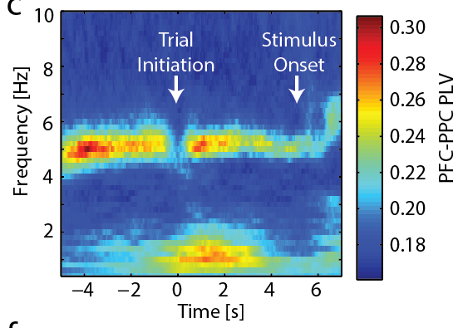
Spectral measures of interest
Spectrum (Amplitude / Power)
Phase Locking (Phase)
Spectrograms (Power across time)
Awake
Anesthetized

Slide 19
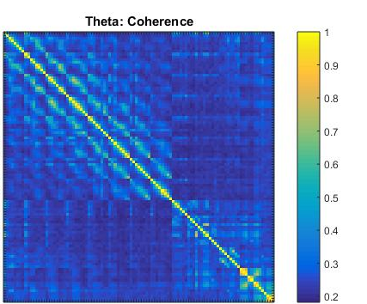
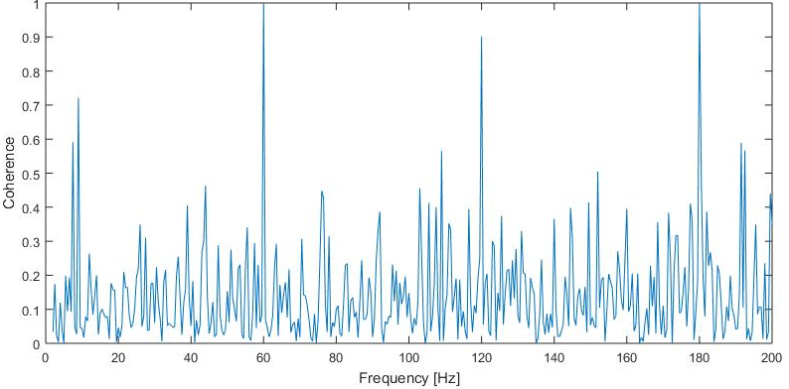
Network Dynamics: Functional Connectivity
Coherence: Analogous to frequency-specific correlation between signals
Coherence between Chan A and Chan B
60Hz noise
Noise harmonics
ECoG Channels
ECoG Channels
Physiologically
meaningful
Likely not physiologically meaningful

Slide 20
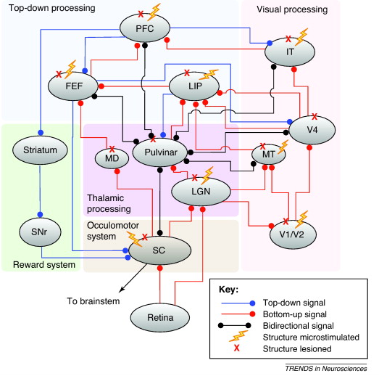
Proposed Network: Compilation from many studies
Brain structures likely involved in attentional processing.
Determined through microstimulation and lesion studies.
Summary of ~50 studies conducted in NHP.
Baluch & Itti, 2011
Notes:
Flow of attentional signals in brain structures that have been implicated as being involved in attentional studies. The flash symbol indicates that a candidate structure has been microstimulated and an X indicates that the structure has been lesioned in a previous study (see Table 1 for details). The connections show the most likely type of signal being transmitted between two areas; TD signals are shown in blue, BU signals in red and bidirectional signals in gray. Abbreviations: SC, superior colliculus; SNr, substantia nigra pars reticulata; MD, mediodorsal thalamus; LGN, lateral geniculate nucleus; IT, inferotemporal cortex; MT, middle temporal area; LIP, lateral intraparietal area; FEF, frontal eye fields; PFC, prefrontal cortex.

Slide 21
Structural and Functional Brain Networks: Graph Theory
Estimate a continuous measure of association between node (e.g. spectral coherence, mutual information, Granger causality, correlations structural metrics).
Generate an association matrix and apply a threshold to produce a binary adjacency matrix.
Compare resulting network parameters with the null distribution (equivalent parameters estimated in a random network)
Bullmore & Sporns, 2009

