Slide 1

SHAPE THEORY USING GEOMETRY OF QUOTIENT SPACES:
STORY
ANUJ SRIVASTAVA
Dept of Statistics
Florida State University

Slide 2
FRAMEWORK: WHAT CAN IT DO?
Analysis on Quotient Spaces of Manifolds
  Pairwise distances between shapes.
  Invariance to nuisance groups (re-parameterization) and result in pairwise registrations.
  Definitions of means and covariances while respecting invariance.
  Leads to probability distributions on appropriate manifolds. The probabilities can then be used to compare ensembles.
  Principled approach for multiple registration (avoids separate cost functions for registration and distance – this is suboptimal). Comes with theoretical support – consistency of estimation.

Slide 3
GENERAL RIEMANNIAN APPROACH
Riemannian metric allows us to compute
distances between points using
geodesic paths.
Geodesic lengths are proper distances,
i.e. satisfy all three requirements
including the triangle inequality
Distances are needed to define central
moments.

Slide 4
GENERAL RIEMANNIAN APPROACH
Samples determine sample statistics
(Sample statistics are random)
Estimate parameters for prob. from
samples. Geodesics help define
and compute means and covariances.
Prob. are used to classify shapes,
evaluate hypothesis, used as
priors in future inferences.
Typically, one does not use samples to
define distances…. Otherwise “distances”
will be random maps. Triangle inequality??
Question: What are type of manifolds/metrics are relevant for shape analysis of functions, curves and surfaces?

Slide 5
REPRESENTATION SPACES: LDDMM
Embed objects in background spaces
planes and volumes
Left group action of diffeos:
The problem of analysis (distances, statistics, etc) is transferred to the group G.
Solve for geodesics using the shooting method, e.g.
Planes are deformed to match curves and volumes are deformed to match surfaces.

Slide 6
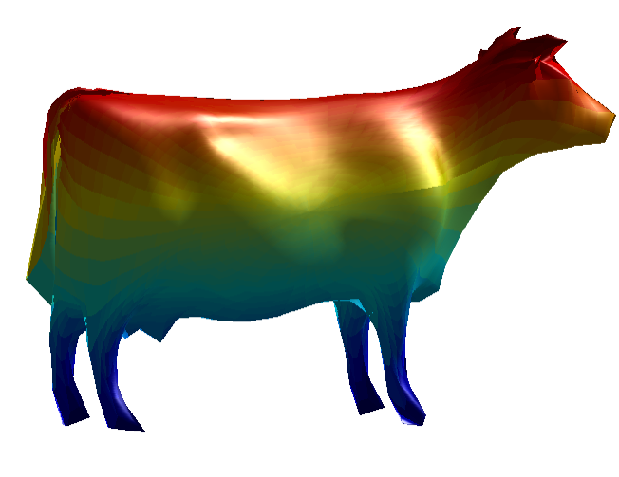
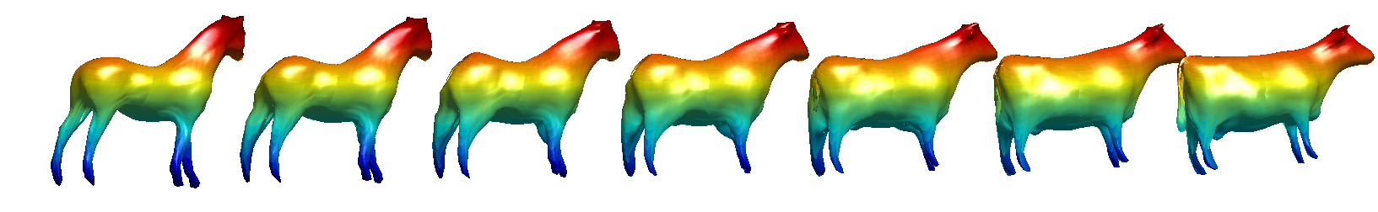
ALTERNATIVE: PARAMETRIC OBJECTS
Consider objects as parameterized curves and surfaces
Reparametrization group action of diffeos:
These actions are NOT transitive. This is a nuisance group that
needs to be removed (in addition to the usual scale and rigid motion).
Form a quotient space:
Need a Riemannian metric on the quotient space. Typically the one on the original space descends to the quotient space under certain conditions
Geodesics are computed using a shooting method or path straightening.
Registration problem is embedded in distance/geodesic calculation

Slide 7
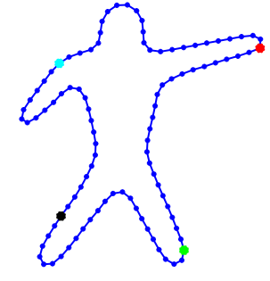
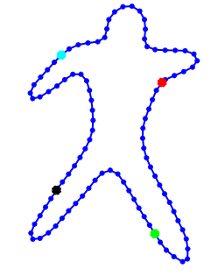
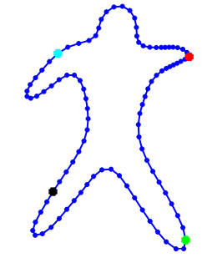
IMPORTANT STRENGTH
Registration problem is embedded in distance/geodesic calculation
Pre-determined parameterizations are not optimal, need elasticity
Shape 1
Shape 2
Shape 2
Uniformly-spaced pts
Uniformly-spaced pts
Non-uniformly spaced pts
Optimal parameterization is determined during pair-wise matching
Parameterization is effectively the registration process

Slide 8
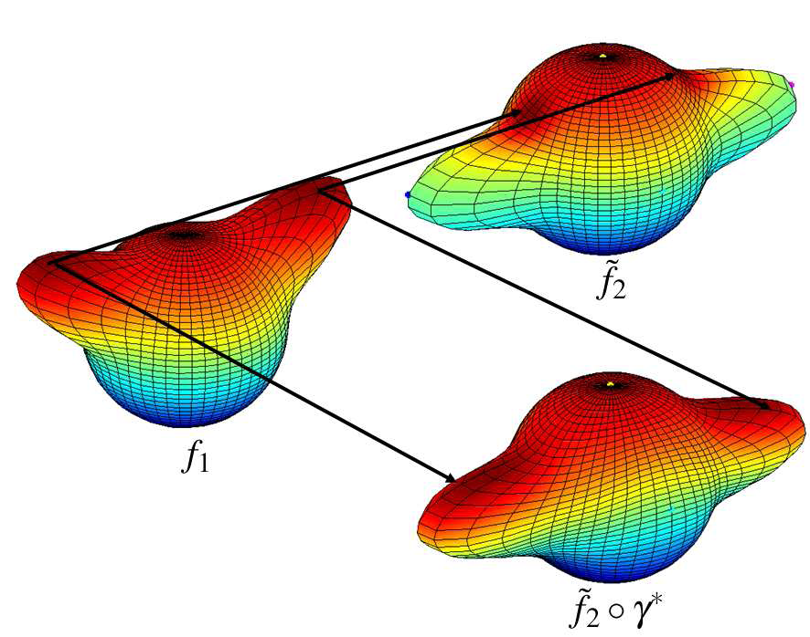
IMPORTANT STRENGTH
Registration problem is embedded in distance/geodesic calculation
Pre-determined parameterizations are not optimal, need elasticity
Shape 2
Shape 1
Shape 2, re-parameterized
Optimal parameterization is determined during pair-wise matching
Parameterization is effectively the registration process

Slide 9
SECTIONS & ORTHOGONAL SECTIONS
In cases where applicable, orthogonal sections are very useful in analysis on quotient spaces
One can identify an orthogonal section S with the quotient space M/G
In landmark-based shape analysis:
the set centered configurations in an OS for the translation group
the set of “unit norm” configurations is an OS for the scaling group. Their intersection is an OS for the joint action.
No such orthogonal section exists for rotation or re-parameterization.

Slide 10
THREE PROBLEM AREAS OF INTEREST
Shape analysis of real-valued functions on [0,1]:
primary goal: joint registration of functions in a principled way
2. Shape analysis of curves in Euclidean spaces R^{n}:
primary goals: shape analysis of planar, closed curves
shape analysis of open curves in R³
shape analysis of curves in higher dimensions
joint registration of multiple curves
3. Shape analysis of surfaces in R³:
primary goals: shape analysis of closed surfaces (medical)
shape analysis of disk-like surfaces (faces)
shape analysis of quadrilateral surfaces (images)
joint registration of multiple surfaces

Slide 11
MATHEMATICAL FRAMEWORK
The overall distance between two shapes is given by:
finding geodesics using path
straightening
registration over
rotation and parameterization

Slide 12
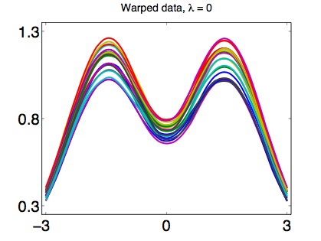
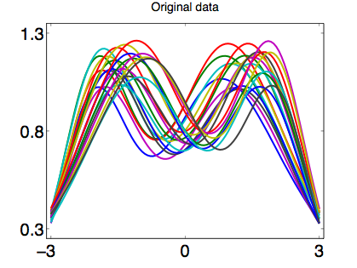
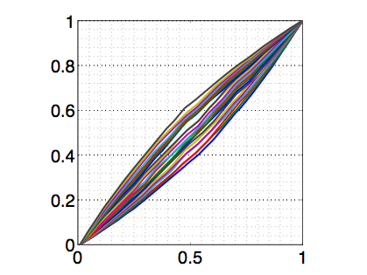
1. ANALYSIS OF REAL-VALUED FUNCTIONS
Aligned functions
“y variability”
Warping functions
“x variability”
Function data

Slide 13
1. ANALYSIS OF REAL-VALUED FUNCTIONS
  Space:
  Group:
  Interested in Quotient space
  Riemannian Metric: Fisher-Rao metric
    Since the group action is by isometries, F-R metric descends to the quotient space.
Square-Root Velocity Function (SRVF):
Under SRVF, F-R metric becomes L² metric

Slide 14
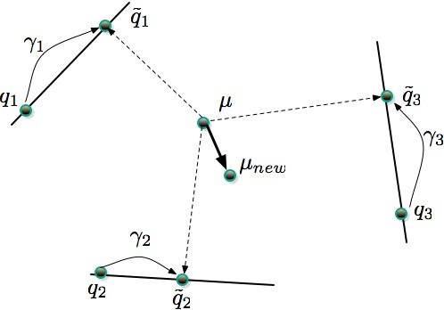
MULTIPLE REGISTRATION PROBLEM

Slide 15
COMPARISONS WITH OTHER METHODS
Simulated Datasets:
Original Data
AUTC [4]
SMR [3]
MM [7]
Our Method

Slide 16
COMPARISONS WITH OTHER METHODS
Real Datasets:
Original Data
AUTC [4]
SMR [3]
MM [7]
Our Method

Slide 17
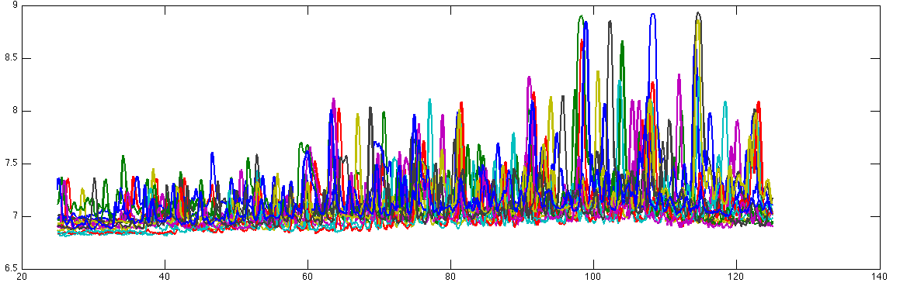
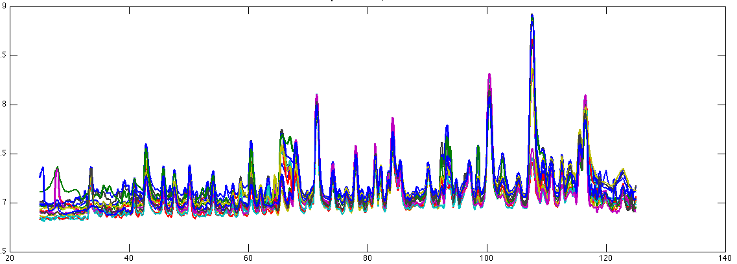
STUDIES ON DIFFICULT DATASETS
(Steve Marron and Adelaide Proteomics Group)

Slide 18
A CONSISTENT ESTIMATOR OF SIGNAL
Setup: Let
Goal: Given observed or , estimate or .
Theorem 1: Karcher mean of is within a constant.
Theorem 2: A specific element of that mean is a consistent estimator of g

Slide 19
AN EXAMPLE OF SIGNAL ESTIMATION
Original Signal
Observations
Aligned functions
Estimated Signal
Error

Slide 20
2. SHAPE ANALYSIS OF CURVES
  Space:
  Group:
  Interested in Quotient space: (and rotation)
  Riemannian Metric: Elastic metric (Mio et al. 2007)
    Since the group action is by isometries, elastic metric descends to the quotient space.
Square-Root Velocity Function (SRVF):
Under SRVF, a particular elastic metric becomes L² metric

Slide 21
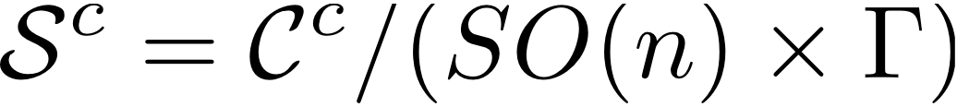
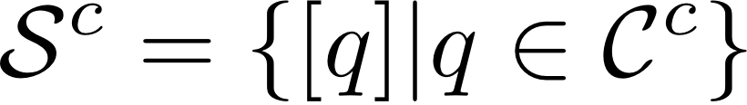
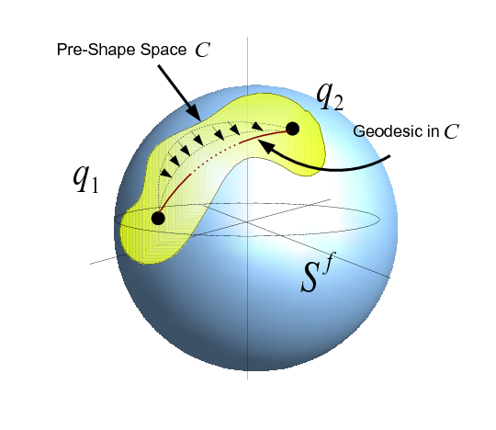
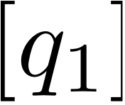
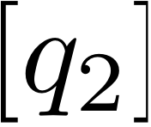
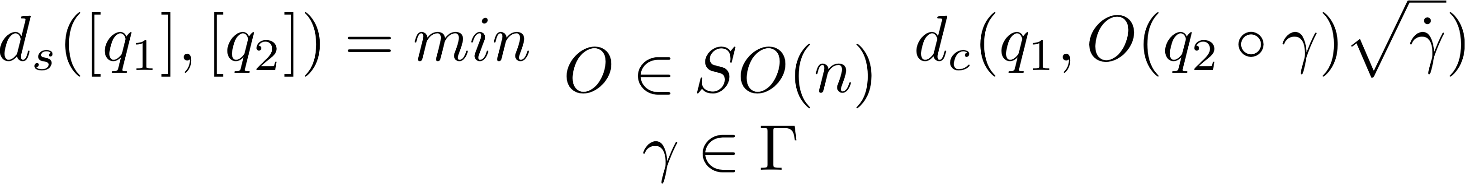
SHAPE SPACES OF CLOSED CURVES
Closed Curves:
-- The geodesics are obtained using a numerical
procedure called path straightening.
-- The distance between and is
-- The solution comes from a gradient method.
Dynamic programming is not applicable anymore.

Slide 22
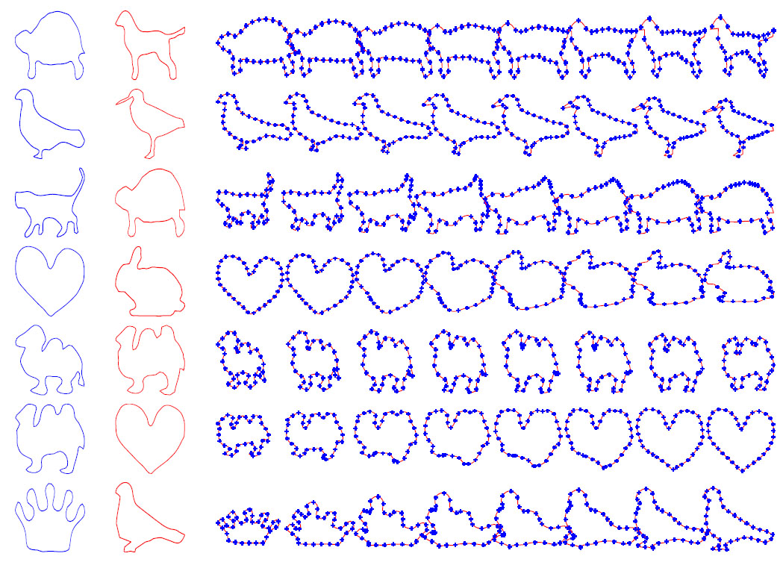
GEODESICS BETWEEN SHAPES

Slide 23
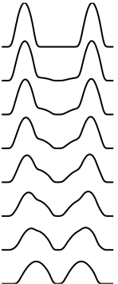
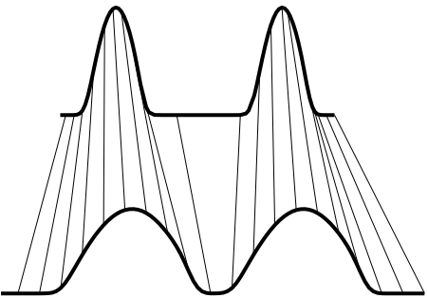
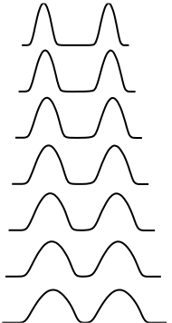
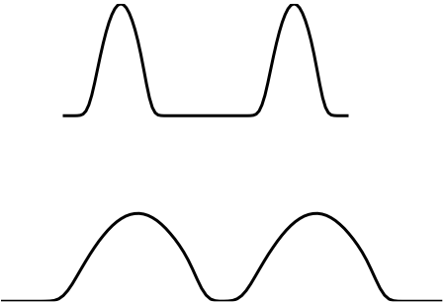
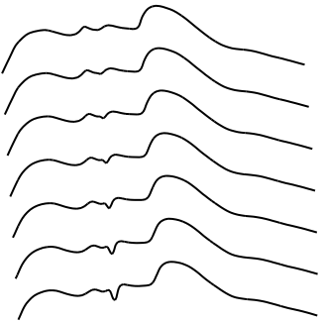
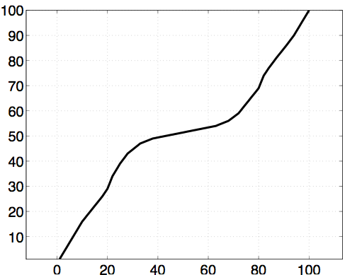
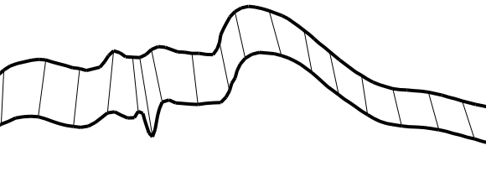


IMPORTANCE OF ELASTIC ANALYSIS
Non-Elastic
Elastic
Elastic
Non-Elastic
Elastic
Non-Elastic
Elastic

Slide 24
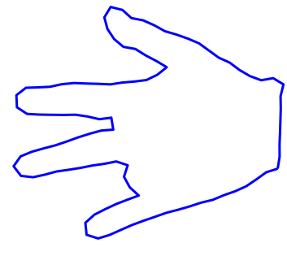
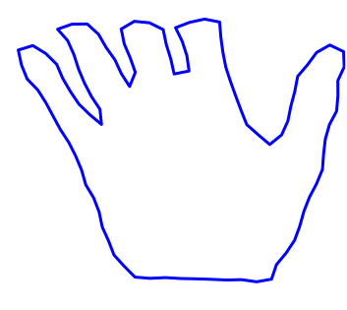
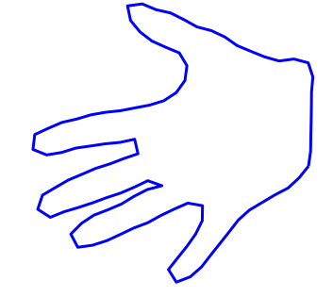
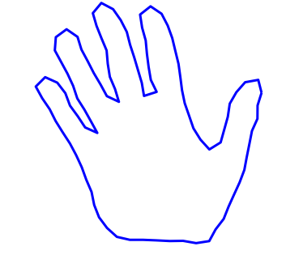
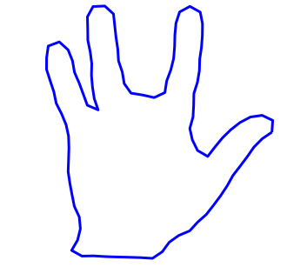
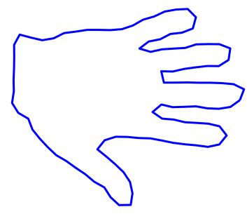
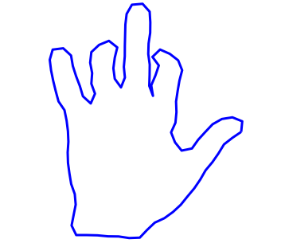
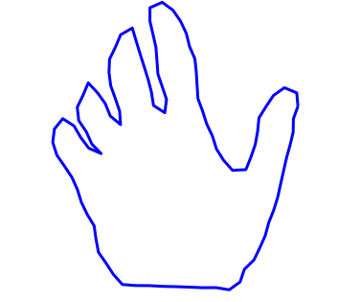
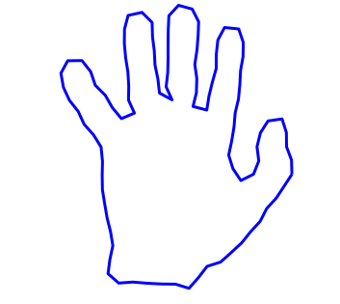
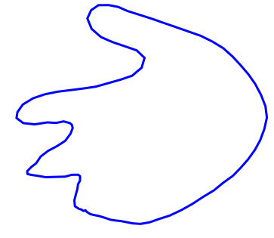
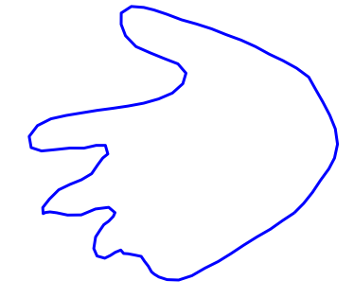

STATISTICAL SUMMARIES OF SHAPES
Sample shapes
Karcher Means: Comparisons with Other Methods
Active Shape
Models
Kendall’s Shape Analysis
Elastic Shape Analysis

Slide 25
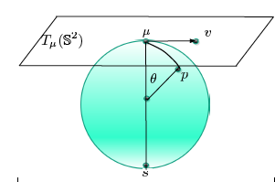
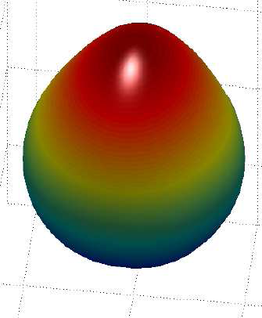
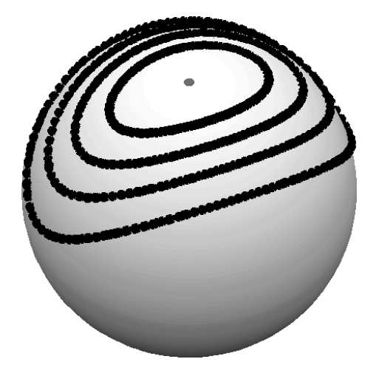
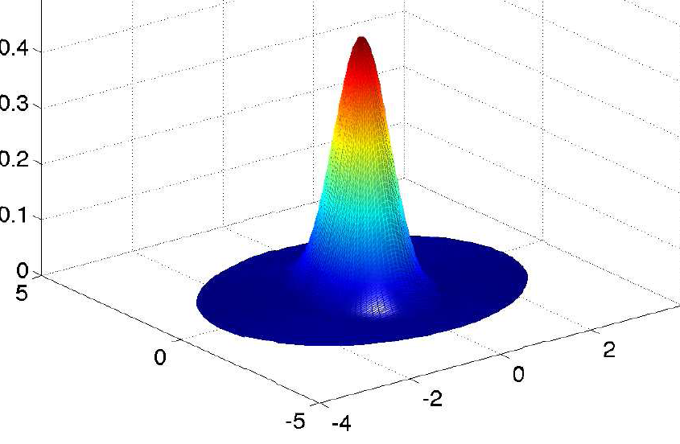
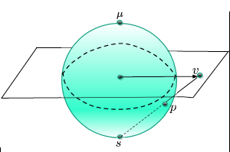
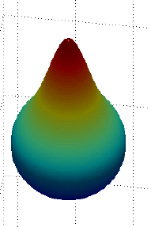
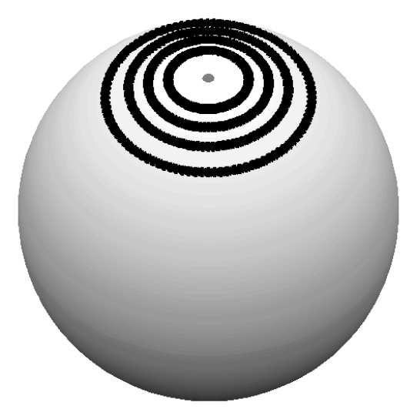
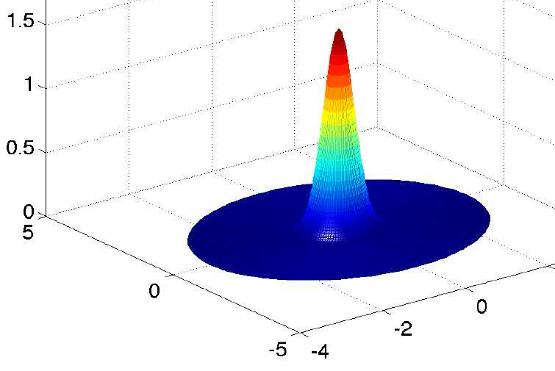
WRAPPED DISTRIBUTIONS
Choose a distribution in the tangent space and wrap it around the manifold
Analytical expressions for truncated densities on spherical manifolds
exponential
stereographic
Kurtek et al., Statistical Modeling of Curves using Shapes and Related Features, in review, JASA, 2011.

Slide 26
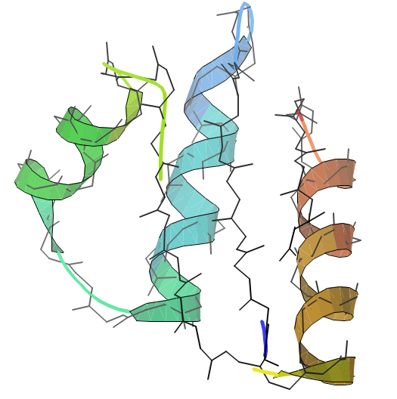
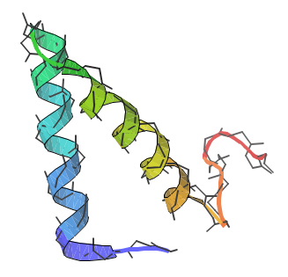
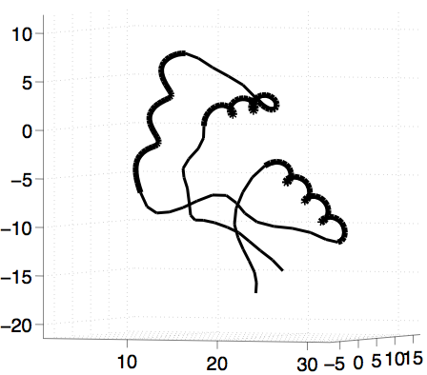
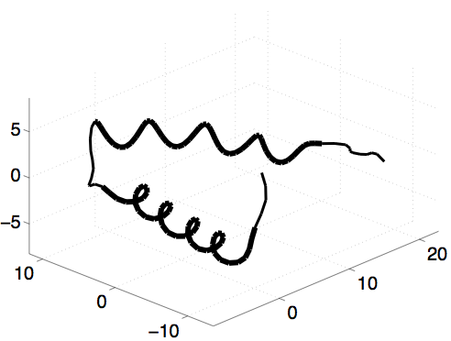

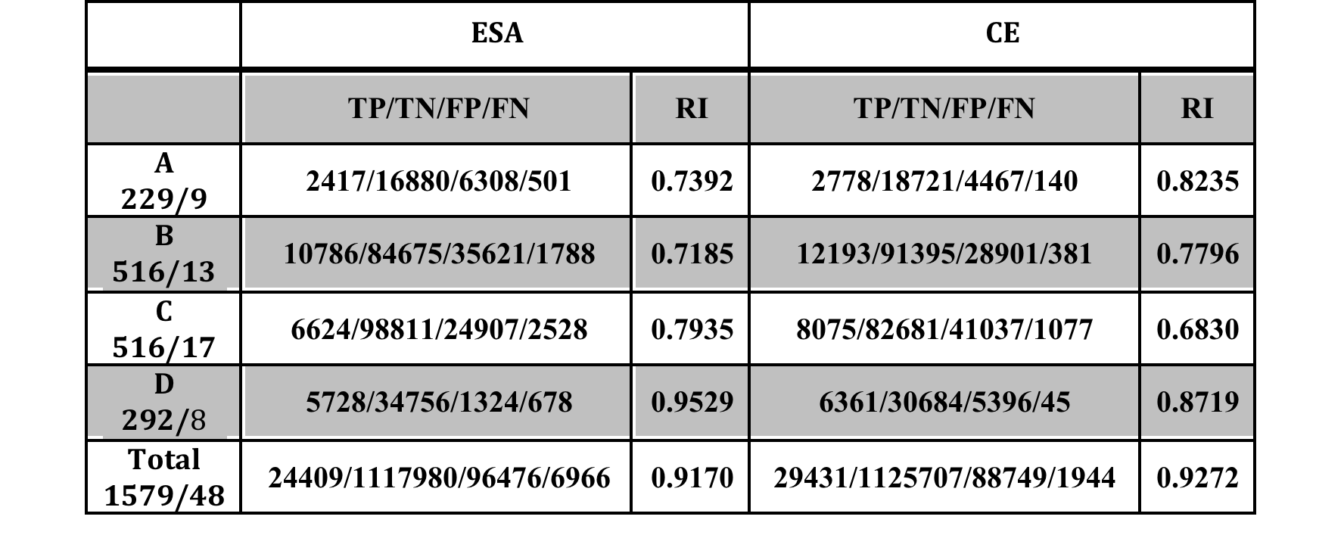
ANALYSIS OF PROTEIN BACKBONES
Clustering Performance
Liu et al., Protein Structure Alignment Using Elastic Shape Analysis, ACM Conference on Bioinformatics, 2010.

Slide 27


INFERENCES USING COVARIANCES
Wrapped Normal Distribution
Liu et al., A Mathematical Framework for Protein Structure Comparison, PLOS Computational Biology, February, 2011.

Slide 28


AUTOMATED CLUSTERING OF SHAPES
Shape, shape + orientation, shape + scale, shape + orientation + scale, …..
Mani et al., A Comprehensive Riemannian Framework for Analysis of White Matter Fiber Tracts, ISBI, Rotterdam, The Netherlands, 2010.

Slide 29
3. SHAPE ANALYSIS OF SURFACES
  Space:
  Group:
  Interested in Quotient space: (and rotation)
  Riemannian Metric: Define q-map and choose L² metric
    Since the group action is by isometries, this metric descend to the quotient space.
q-maps:

Slide 30







GEODESICS COMPUTATIONS
Preshape Space

Slide 31


GEODESICS

Slide 32


COVARIANCE AND GAUSSIAN CLASSIFICATION
Kurtek et al., Parameterization-Invariant Shape Statistics and Probabilistic Classification of Anatomical Surfaces, IPMI, 2011.

Slide 33
DISCUSSION POINTS
Different metrics and representations
One should compare deformations (geodesics), summaries (mean and covariance), etc, under different methods.
Systematic comparisons on real, annotated datasets
Organize public databases and let people have a go at them.

Slide 34
THANK YOU

