Slide 1
Computational challenges in RTP treatment planning: setting the stage
Joe Deasy, PhD
deasyj@mskcc.org

Slide 2
Overview
Treatment planning: underpinnings
  Outcomes and models
Treatment planning technology
  The desirables: what we need
  How can we get there?

Slide 3
Treatment planning: underpinnings
Outcomes and models

Slide 4
The ‘Planning Target Volume’: add margins around suspected disease for uncertainty with respect to anatomy + geometric motion + geometrical uncertainty + possible gross disease.
Give this the full dose right out to the edge.
Also stands for ‘Poor Tradeoff Volume’

Slide 5
Problems with the PTV concept
Large shifts (very unlikely) are treated the same as small shifts (very likely)
assumes that normal tissue volume effects are much less important than target volume coverage
The Gaussian dose tail will always invade the PTV; so full dose requires a big field

Slide 6
Instead…
Treatment planning needs to be driven by the impact on outcomes.
And different treatment philosophies will handle tradeoffs between local control and toxicity differently.

Slide 7
Planning objective functions
Only just emerging…
Usually numerically uncertain
Often have shallow slopes instead of sharp separations between risk and non-risk

Slide 8
NTCP models used for:
Treatment plan
review only
Guiding plan
changes
Requires:
Prognostic Models:
Risk based
on similarity to
previous data
Predictive
Models:
Effect of changes
is known
statistically easier…
…statistically harder
much relevant data today…
…usually not available

Slide 9
The NTCP/TCP development spiral
Prospective validation/
characterization
Fitting including:
New patient cohorts/
New Tx factors/
Refined models/

Slide 10
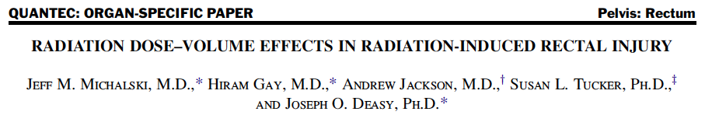

Slide 11
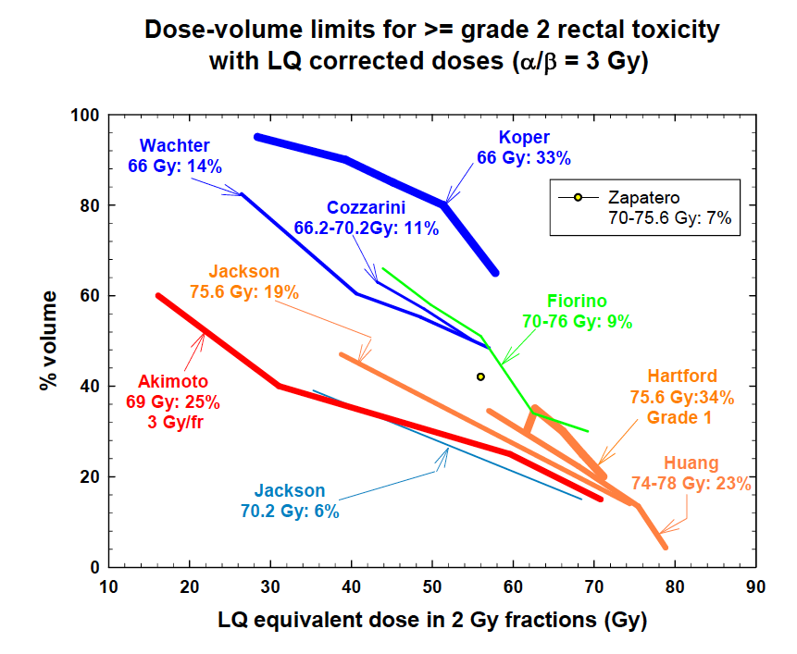

Slide 12
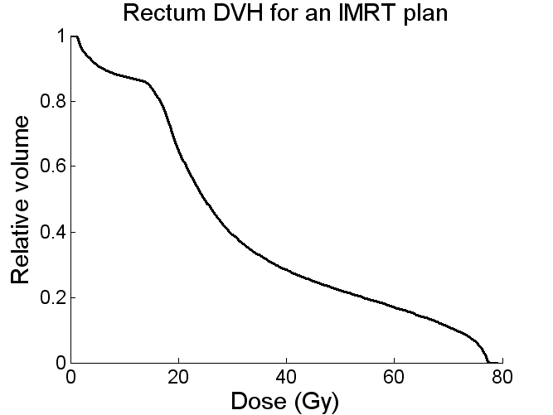
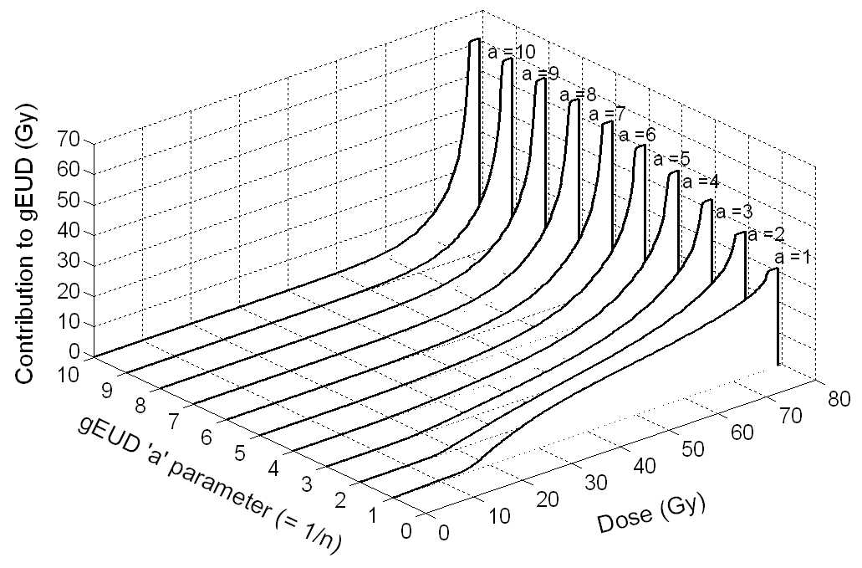
Plus:
+
Results in different relative contributions to gEUD within the DVH:

Slide 13
(Slide courtesy A. Jackson et al.)
(Note: a = 1/n)
Notes:
Note the log10 scale.

Slide 14
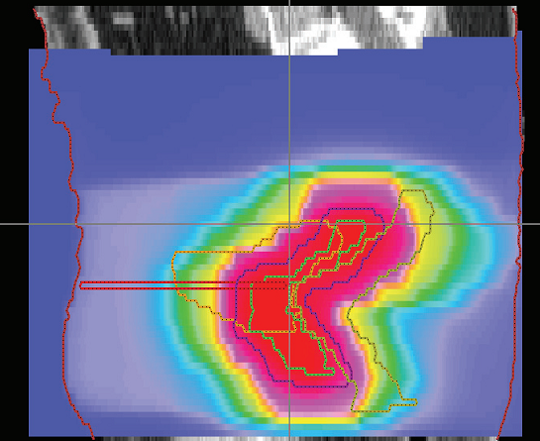
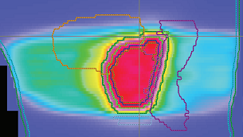
Are IMRT rectal dose-volume limits a problem?
Typical 3DCRT plan (sagittal)
Typical IMRT plan (sagittal)
Rectal gEUD = 53 Gy
(a= 10)
Rectal gEUD = 24 Gy
Notes:
Assuming

Slide 15
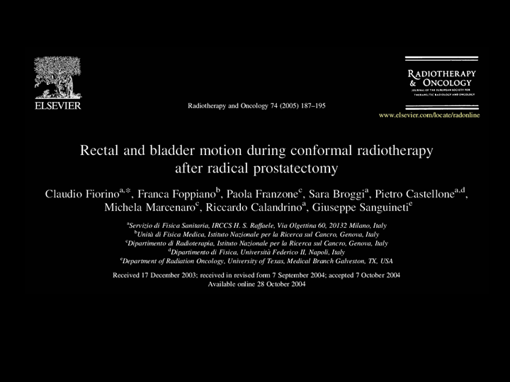
(Rad Oncol 2005)

Slide 16
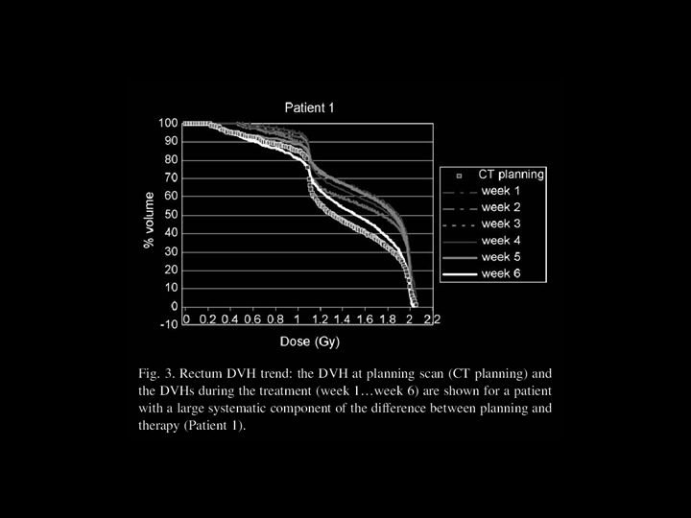
Variation in rectal DVHs for daily Fx’s

Slide 17
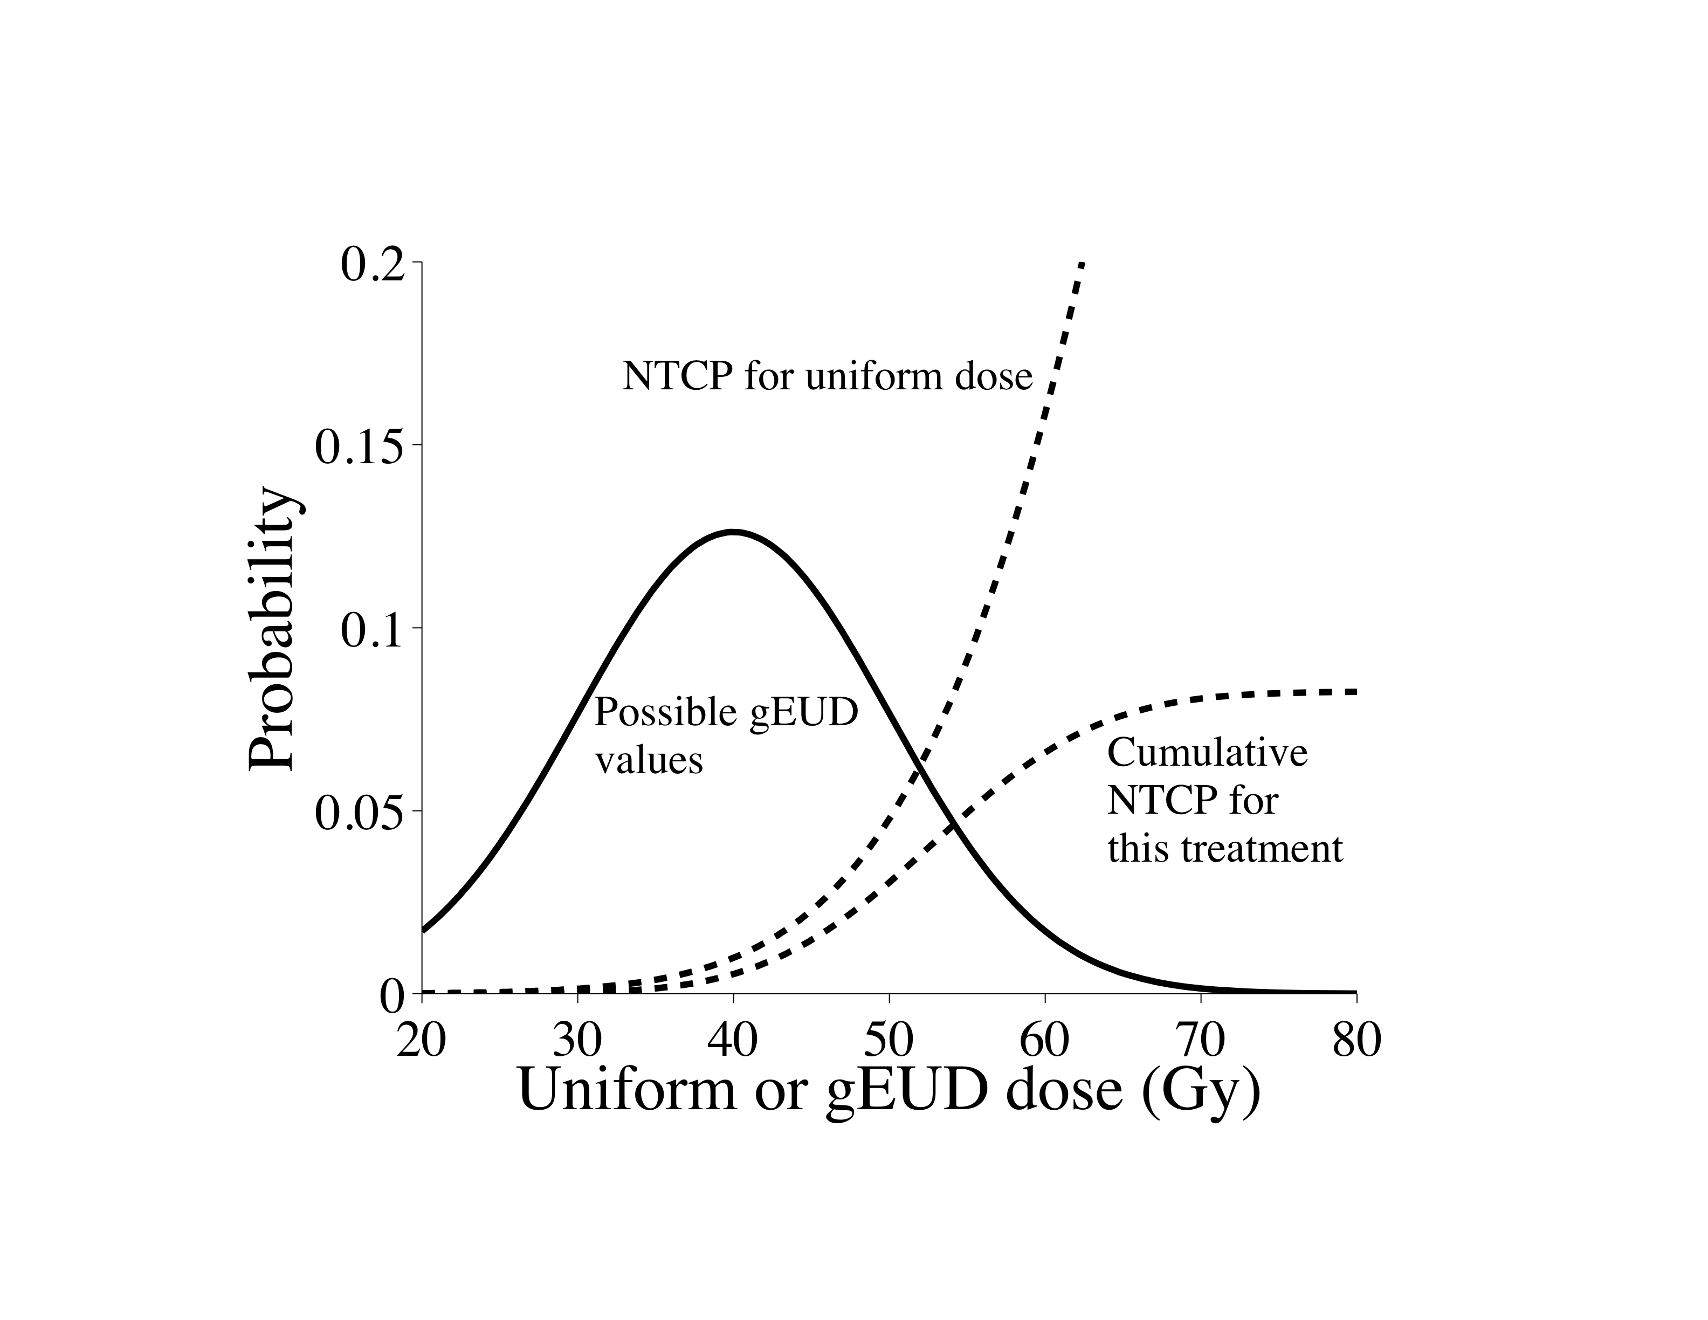
Fig. 9
Notes:
Figure gEUDDIstribution Observed complications can potentially be dominated by cases in which delivery is worse than the plan. This figure schematically shows the effect of deviation from the estimated (planned) gEUD value to the actual delivered gEUD and the potential increase in NTCP. Substantial uncertainty in the actual, delivered gEUD value may arise from anatomic variations and setup inaccuracies, resulting in the Gaussian spread in potential gEUD values, as shown. Although the NTCP probability would be expected to be very low if the delivered gEUD value is close to the delivered one, the potential for much worse (higher) gEUD’s significantly increases the potential for a complication. The ‘cumulative’ curve shows the resulting effect of the potential high values of gEUD, resulting in a best-estimate of NTCP in this hypothetical case of about 8%. NTCP model parameters were used similar to those seen for late rectal bleeding curves. The implication from this figure is that, when population based NTCP values are low, observed levels may be dominated by cases where the delivery is worse than the plan (Fenwick, Alber refs.*).

Slide 18
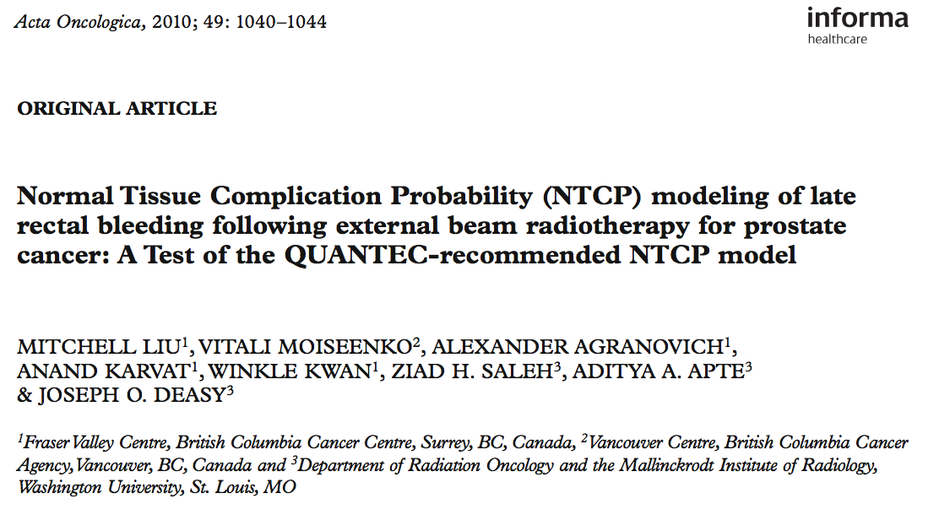

Slide 19
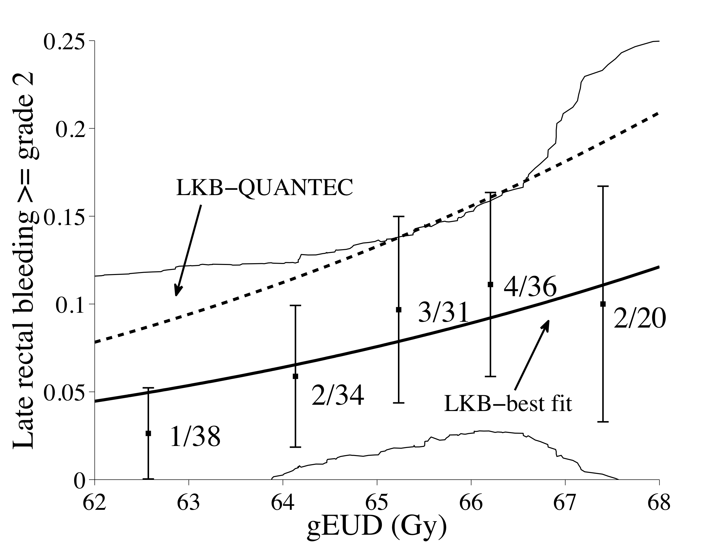

Slide 20
The impact of model parameter uncertainties on NTCP predictions

Slide 21
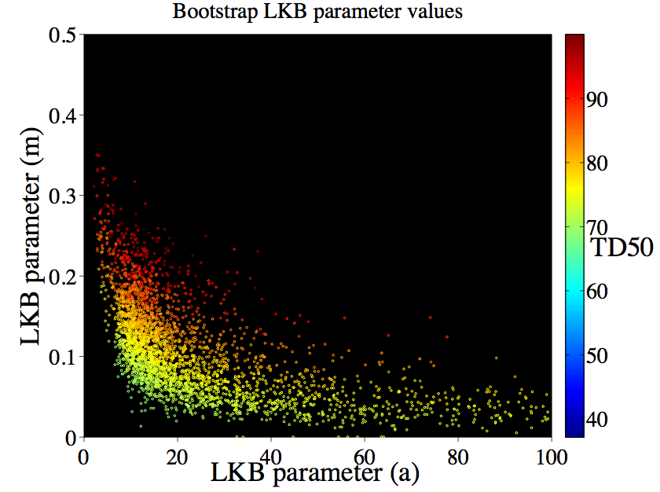

Slide 22
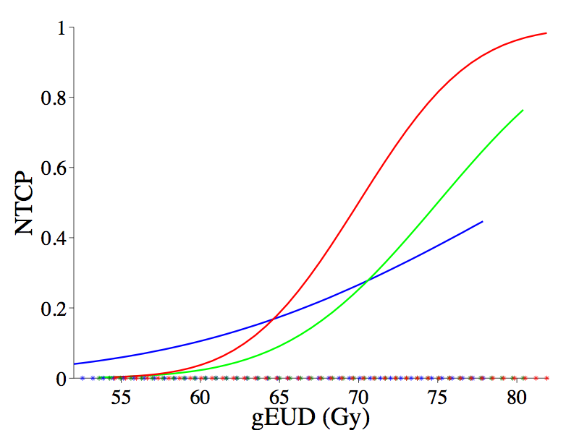
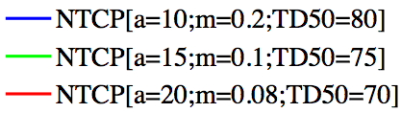
What is the true model?

Slide 23
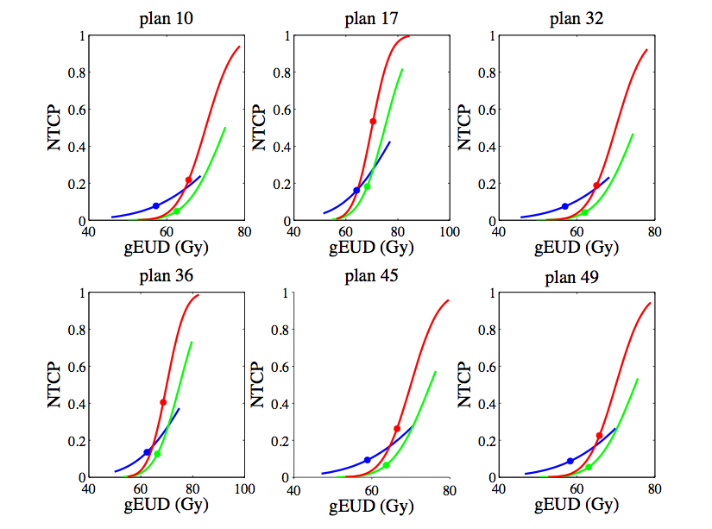

Slide 24
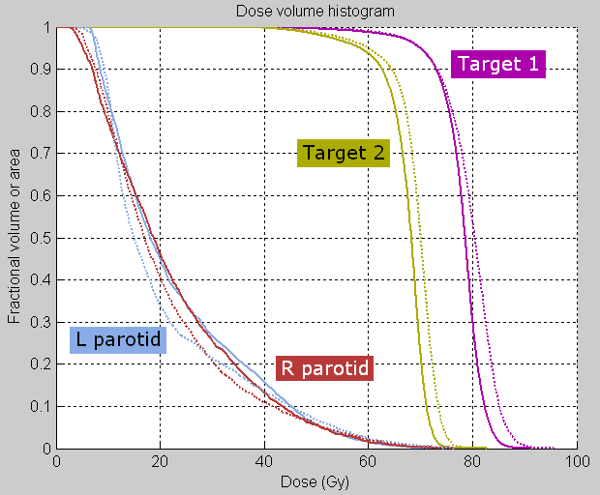
Dose-volume constraints
Dx represents the minimum dose that at least x% of the volume receives
Vx represents the minimum (percentage) volume that receives at least x Gy
D95

Slide 25
Illustration of DVH ‘warping’ by a dose-volume constraint
Solid: typical pre-IMRT DVH
Dashed: after ‘optimization’
Volume
Dose
V60
Big problem when single DVH pts used for optimization: pinned DVH
Notes:
Tend to warp DVHs
Not radiobiologically relevant

Slide 26
Additional problems with using traditional dose-volume constraints in IMRT optimization
Non-convex
  No guarantee of optimality with current solvers
  Potentially slower than linear/quadratic objectives
Difficult implementation. Must be:
  Mixed-integer programming, or
  Approximated
Notes:
The meaning of V40 means that voxels with 40 Gy are all-important, while voxels with 39 Gy are irrelevant. This is not biologically true. Not radiobiologically reasonable:
Tend to warp DVHs
Not entirely biologically relevant
‘V20’ represents that:
19 Gy causes no damage, 20 Gy causes maximal damage
60 Gy no worse than 20 Gy
This is not true!

Slide 27
Solution: mean-tail-dose
Definition
  MOHx – mean of hottest x%
  MOCx – mean of coldest x%
Potentially more biologically relevant (smoother)
Linear
Convex
  Faster
  Guaranteed to be optimal if solution is found
Found to correlate with traditional dose-volume metrics
Suggested by Romeijn et al. (2003, 2006)
Notes:
Use defn of Dx when explaining this.

Slide 28
Solution: generalized equivalent uniform dose (gEUD)
gEUD is the exponentially weighted dose value:
  d_{i} represents the dose to voxel i,
  N is the number of voxels in the structure of interest, and
  a is a variable exponent parameter.
Notes:
“p-norm”, “generalized mean”
Won’t go through whole equation, but notice variable parameter a.

Slide 29
Benefits of gEUD
Radiobiologically relevant
  Has parameter (a) which can be tuned to underlying data
  Can track high doses (a large), low doses (a negative), or some average dose (a ~1)
Convex (Choi 2002)
Correlates well to dose-volume constraints
Previously suggested (Niemierko 1998; Choi 2002; Wu 2002, 2003; Olafsson 2005; Thomas 2005; Chapet 2005)

Slide 30
Dissertation work: Determining value of replacement candidates
Datasets of clinical treatment plans were used:
  Lung cancer, 263 patients
  Prostate cancer, 291 patients
Calculated the correlation between gEUD and clinically applicable dose-volume constraints
  Tested various values of the parameter a
  Did the same for MOH/MOCx with values of x
Notes:
-Used Spearman rank correlation
Details: To address the validity of gEUD as a replacement for dose volume targets, we calculated the Spearman
rank correlation coefficient between gEUD with various values of its parameter a and clinically applicable
dose-volume constraints from clinical treatment plans. Three datasets were used: lung, esophagus, and
prostate, with 219, 263, and 291 patients respectively. We tested values of a between -10 and 10 by
intervals of 0.2, and in some cases also tested values of a as low as -40 (for target volumes). The dose-volume
constraints tested include: V10, V20, and V30 for lung, V55 for esophagus, and D95 for prostate
PTV and lung PTV.

Slide 31
Correlations between gEUD/MOH/MOC and DV metrics
Spearman correlation coefficients
  All together mean: 0.94, median: 0.97, range: 0.45 to 1.00
  gEUD mean: 0.93, median: 0.96, range: 0.45 to 1.00
  mean-tail-dose mean: 0.95, median: 0.98, range: 0.45 to 1.00
  The 0.45 coefficient is an outlier
51 of the 60 correlations tested had a Spearman correlation coefficient greater than 0.90
In general, mean-tail-dose had higher correlations than gEUD (27 of 30 correlations equal or greater), though gEUD and mean-tail-dose correlation coefficients were often similar.
Notes:
correlations between the candidate metrics and dose-volume metrics
The 0.45 coefficient is an outlier, representative of only one metric.
51 of the 60 correlations tested had a Spearman correlation coefficient greater than 0.90 (24 of 30 for gEUD, 27 of 30 for mean-tail-dose).
In general, mean-tail-dose had higher correlations than gEUD (27 of 30 correlations equal or greater), though gEUD and mean-tail-dose correlation coefficients were often similar.

Slide 32
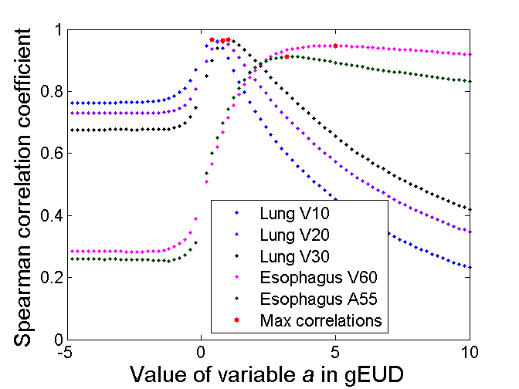
Correlation between dose-volume metrics and gEUD

Slide 33
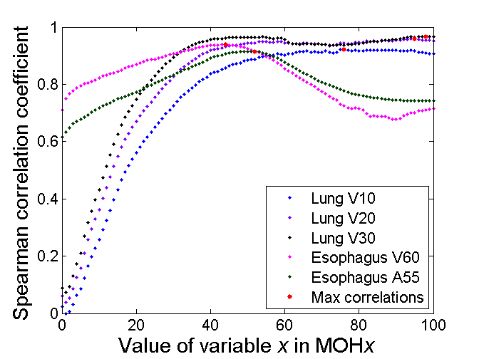
Correlation between dose-volume metrics and mean-tail-dose

Slide 34
Correlations between gEUD/MOH/MOC and DV metrics
Spearman correlation coefficients
  All together mean: 0.94, median: 0.97, range: 0.45 to 1.00
  gEUD mean: 0.93, median: 0.96, range: 0.45 to 1.00
  mean-tail-dose mean: 0.95, median: 0.98, range: 0.45 to 1.00
  The 0.45 coefficient is an outlier
51 of the 60 correlations tested had a Spearman correlation coefficient greater than 0.90
In general, mean-tail-dose had higher correlations than gEUD (27 of 30 correlations equal or greater), though gEUD and mean-tail-dose correlation coefficients were often similar.
Notes:
correlations between the candidate metrics and dose-volume metrics
The 0.45 coefficient is an outlier, representative of only one metric.
51 of the 60 correlations tested had a Spearman correlation coefficient greater than 0.90 (24 of 30 for gEUD, 27 of 30 for mean-tail-dose).
In general, mean-tail-dose had higher correlations than gEUD (27 of 30 correlations equal or greater), though gEUD and mean-tail-dose correlation coefficients were often similar.

Slide 35
Correlation between dose-volume metrics and gEUD

Slide 36
Correlation between dose-volume metrics and mean-tail-dose

Slide 37
What about tumor control probability?

Slide 38
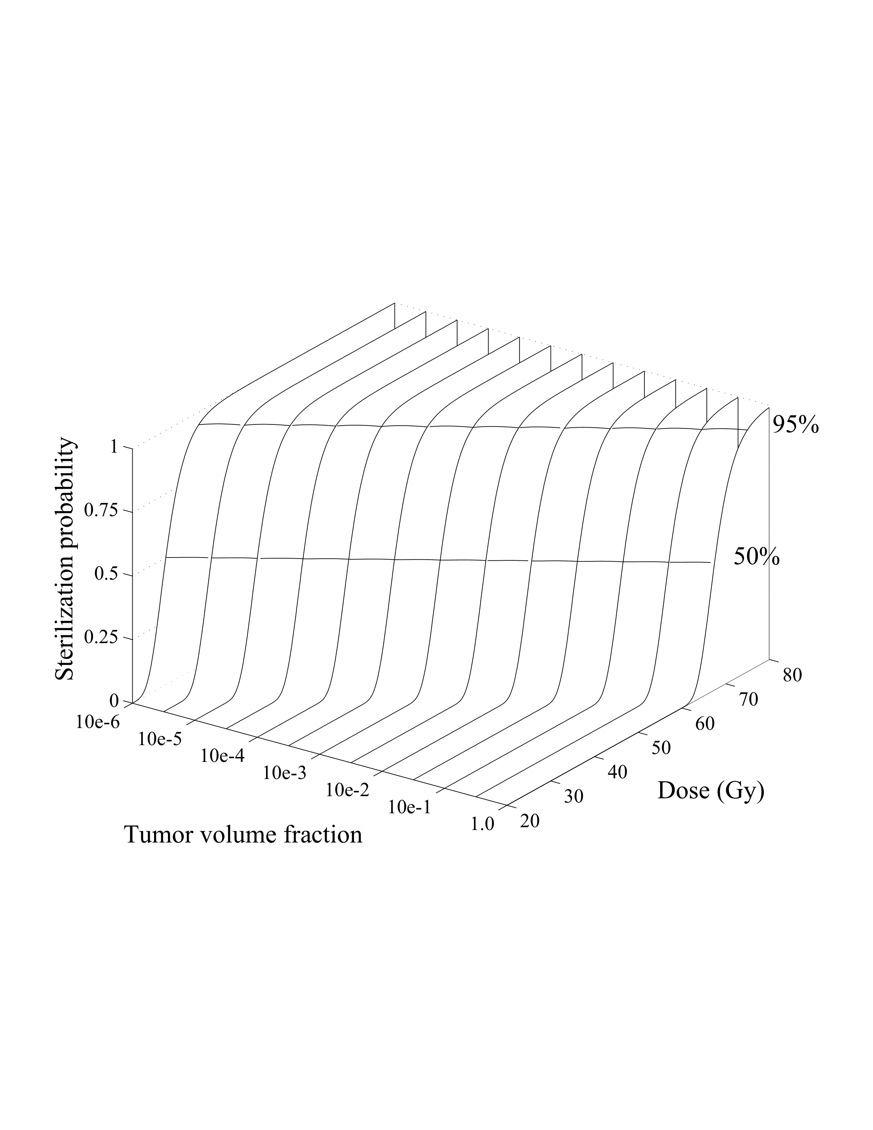
Fig. 1

Slide 39
How can we get there?
The desirables: what we need

Slide 40
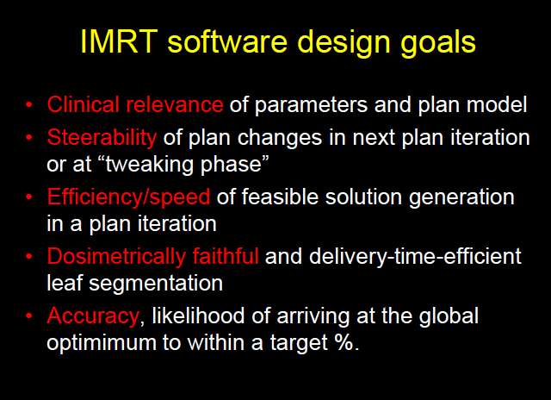

Slide 41
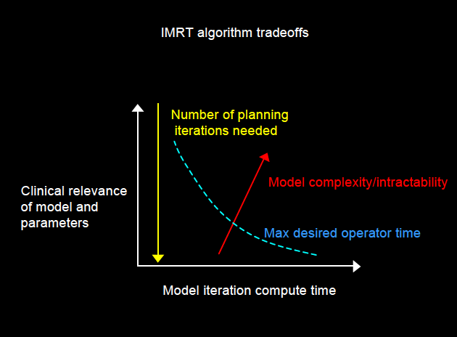

Slide 42
How can we get there?
Our approach
(many following slides from Vanessa Clark’s dissertation with supervisor Yixin Chen)

Slide 43
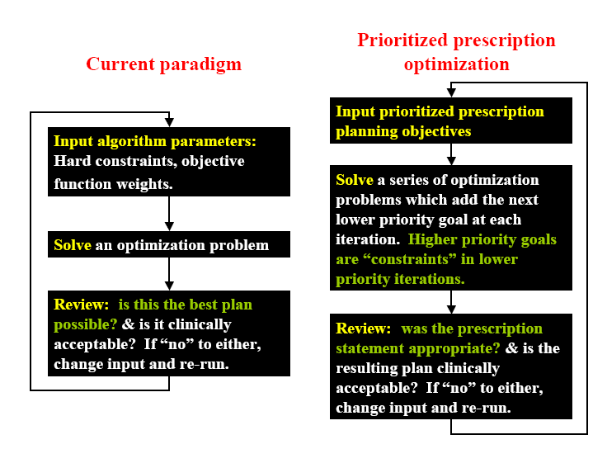

Slide 44
Previous work using hierarchical methods for IMRT optimization
Jee et al. (Michigan 2007)
  Lexicographic ordering
  Goal programming, not slip
  Nonconvex dose metrics
  2 cases (1 prostate, 1 head and neck)
  No direct clinical comparison
Spalding et al. (Michigan 2007)
  Lexicographic ordering, gEUD, IMRT
  15 pancreatic cancer cases
Wilkens et al. (WashU 2007)
  6 head and neck cases
  No direct clinical comparison
Notes:
Read quote from Jee et. al.?
“Our experiences show that this LO [lexicographic ordering] method can facilitate an efficient articulation of individual planning goal preferences (or priorities) for IMRT planning and make complex multicriteria problems manageable by explicitly prohibiting objective tradeoffs between different priority levels.”
Spalding: Unclear which factor (IMRT vs. RT) or LO/gEUD is the improvement. (Compared to clinical, though unknown whether commissioned dose calc or not.)
Say what our work is:
10, 6, and 6 prostate cases

Slide 45
This work
Hierarchical optimization
22 total prostate cases
Convex objectives and constraints (for optimality)
Direct clinical comparison (12 cases)
First successful implementation of optimization for prostate using lexicographic ordering that is completely quadratic and linear (and convex)

Slide 46
Prioritized prescription optimization
objectives
hard constraints
step I
target coverage, high-priority OARs
minimize F_{I}=Σ_{all voxels j} (D_{j} – D_{pres})² and
maximize D_{min} for PTV
● D_{max} for rectum
● W_{max} for beam weights
as in step I and
● max value for F_{I} for all targets
● D_{min} and D_{max} for target
as achieved in step I
step II
additional OARs
minimize MOHx for rectum
step III
dose falloff
minimize D_{mean} in bladder, femurs, and normal tissue
as in step II and
● MOHx for rectum
as achieved in step II
step IV
smooth dose
as in step III and
● D_{mean} for bladder, femurs,
and normal tissue as achieved in step III
minimize Σ_{all beamlets i} w_{i}²

Slide 47
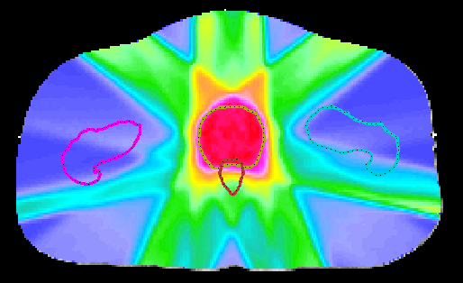
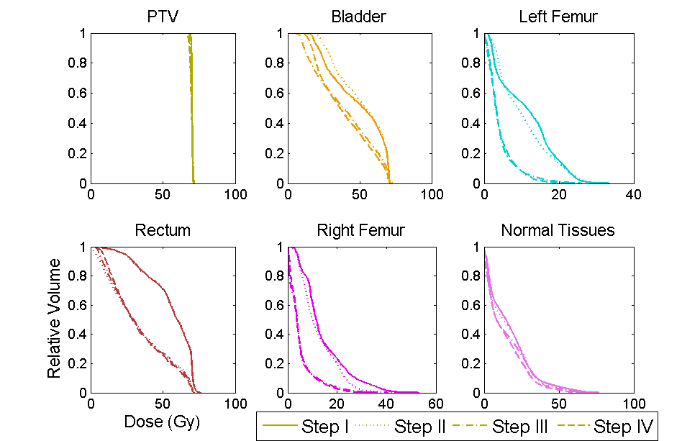
Prostate results
Notes:
Lower right: Figure 3.4. Dose volume histograms after each step of the optimization, for case 5. Note that “Normal Tissues” refers to the area outside of a 0.5 cm 3D region around the PTV, inside of the skin, and within 1.5 cm above and below the PTV. It is easy to see that the rectum is optimized on in step II, whereas the femurs and bladder are introduced in step III. Although there is some degradation in the target DVH, it is small.

Slide 48
Results summary
Results appear to be comparable to clinical quality
Average total runtime: 20 mins (prostate)
Notes:
20 minutes is ‘workable.’
50 mins (head & neck)

Slide 49
Chapter 4: Comparison of prioritized prescription optimization with current clinical results
Showed that prioritized prescription optimization is comparable to clinical methods by direct comparison

Slide 50
Background: Clinical comparisons
To translate this research to use in the clinic, comparisons with existing clinical methods are necessary
  To show validity
  To show usefulness
  To be accepted by clinicians
  To have commercial companies implement it in their clinical software
Technically challenging
No study has previously compared using prioritized optimization techniques directly to those in the clinic

Slide 51
Formulation
Based on physician preferences
Guarantees (constraints):
  Maximum PTV dose ≤ 75.6 Gy * 1.10
  Rectum V65 < 17% (MOH31 < 65)
  Rectum V40 < 35% (MOH98 < 30)
  Bladder V65 < 25% (MOH35 < 64)
  Bladder V40 < 50% (MOH100 < 40)
Objectives (optimized in the following order):
  Maximize PTV D98 (MOC10)
  Minimize Rectum V65 (MOH31) & V40 (MOH98)
  Minimize Bladder V65 (MOH35) & V40 (MOH100)
  Minimize Normal Tissues mean & max dose
  Smoothing and minimize PTV mean dose
Notes:
We did change the objectives and constraints for the postop cases.
We did it as the doctor preferred, and used mean-tail-dose instead.

Slide 52
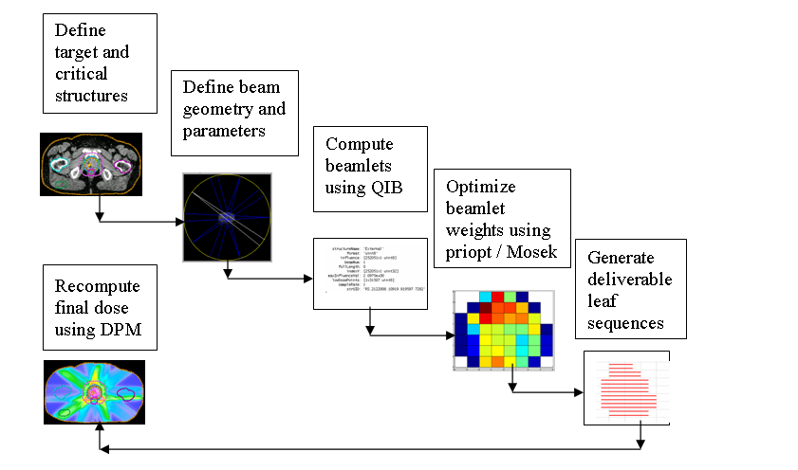
System Integration
Technically challenging
Broad potential impact
Notes:
Technically challenging
Large amount of work
Significant
Broad importance
Practically useful (put into CERR, the entire research community can now do this where they couldn’t before)

Slide 53
Experiment datasets
6 definitive prostate (3 training)
  75.6 Gy
6 postoperative prostate (2 training)
  64.8 Gy
  79.2 Gy
Anonymized
Compared to results calculated using Pinnacle during normal course of clinical operations
Notes:
using Pinnacle,

Slide 54
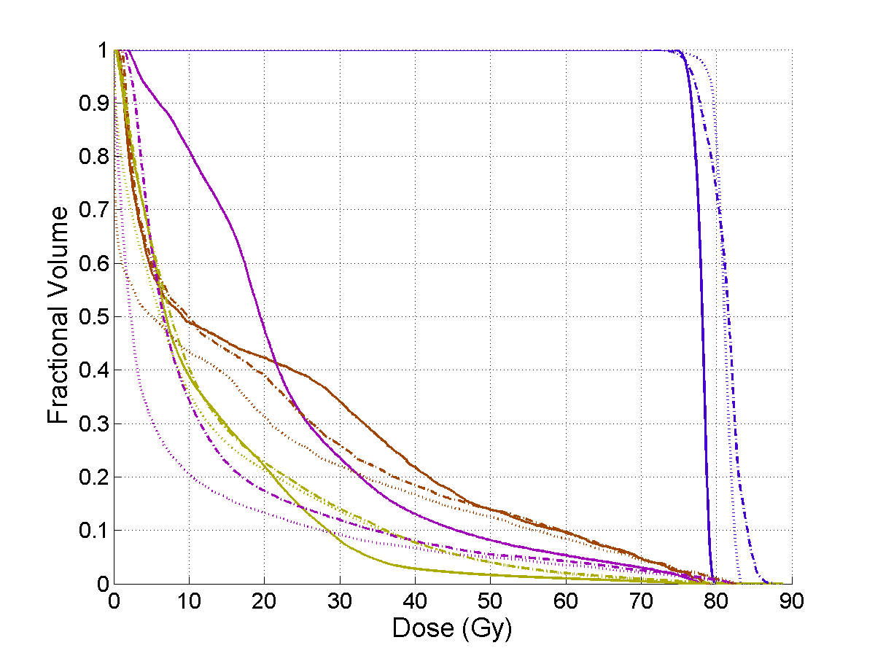
Example result
____ | Clinical
……. | Priopt QIB
- - - - | Priopt DPM
PTV (target)
Bladder
Rectum
Normal tissues
Notes:
Case 45.
Figure 4.12a. Dose-volume histogram for definitive case 5. Blue: PTV, Brown: Rectum, Purple: Bladder, Tan: Normal tissues minus PTV. Solid: Clinical dose, Dotted: Priopt QIB calculated dose, Dashed: DPM recalculated and scaled priopt dose. Apparently, the inclusion of scatter (comparing the Monte Carlo and QIB dose) affects this DVH more than is typical

Slide 55
Dose distributions for example result
Clinical
Priopt
with DPM
Notes:
Figure 4.12b. CT slices showing dose distribution for definitive case 5 of clinical (left) and priopt recalculated (right) dose through the PTV center of mass. Blue: PTV, Brown: Rectum, Purple: Bladder, Tan: Skin. In this case, priopt places much more of the dose through the three most intense fields..

Slide 56
Priopt vs. Pinnacle for one case
Pinnacle
PTV
Bladder
Rectum
Normal tissues
Priopt
--- Pinnacle
… Priopt QIB
- - Priopt DPM final
Notes:
Definitive, testing
Doses were scaled to match corresponding clinical D98
Figure 4.13b. CT slices showing dose distribution for case 6 of clinical (left) and priopt recalculated (right) dose through the PTV center of mass. Blue: PTV, Brown: Rectum, Purple: Bladder, Tan: Skin.
Figure 4.13a. Dose-volume histogram for case 6. Blue: PTV, Brown: Rectum, Purple: Bladder, Tan: Normal tissues minus PTV. Solid: Clinical dose, Dotted: Priopt QIB calculated dose, Dashed: DPM recalculated and scaled priopt dose.

Slide 57
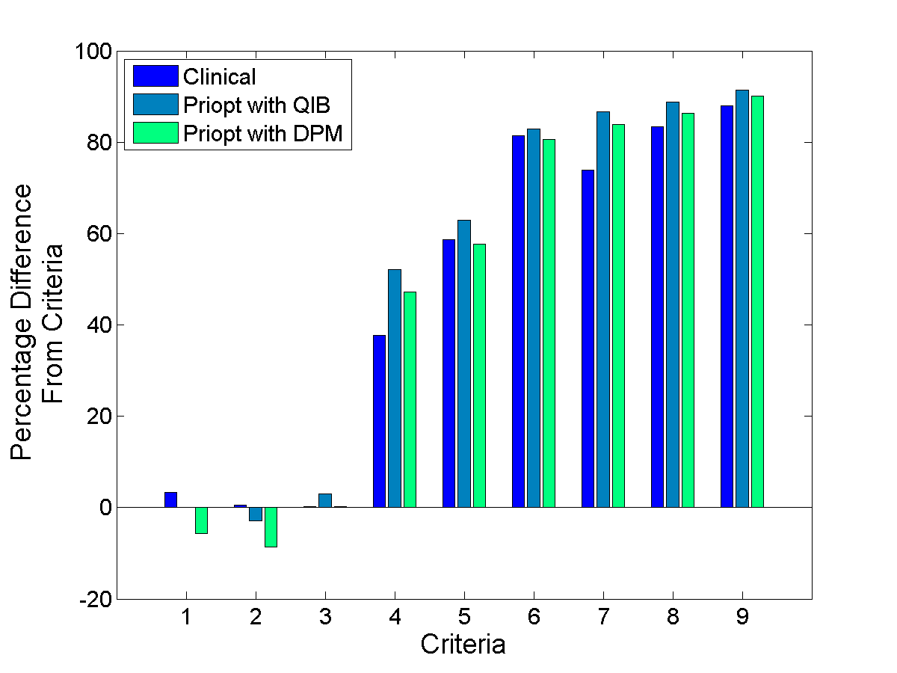
Clinical criteria comparison
Superior
7. Bladder V40 < 50%
8. Bladder V65 < 25%
9. Bladder V70 < 25%
4. Rectum V40 < 35%
5. Rectum V65 < 17%
6. Rectum V70 < 25%
1. Target max dose < 110% pres. dose
2. Target max dose < 107% pres. dose
3. Target D98 > prescription dose
Notes:
Figure 4.12c. Comparison of clinical criteria for definitive case 5 between clinical, priopt, and priopt with DPM recalculation. Bars under the 0 axis did not meet the criteria, and higher bars performed better than lower bars. The 9 criteria referenced are given in the text.

Slide 58
Difference between our method and clinical for all cases
 | Definitive |  | Postoperative
 | Difference | Std Dev | Difference | Std Dev
Target max dose < 110% pres dose | 11.0 | 4.3 | 9.4 | 2.7
Target max dose < 107% pres dose (preferred) | 11.3 | 4.4 | 9.7 | 2.8
Target D98 > prescription dose | 0.0 | 0.0 | 0.0 | 0.0
Rectum V40 < 35% | 4.0 | 8.5 | 17.0 | 45.5
Rectum V65 < 17% | 1.7 | 9.0 | 0.0 | 20.0
Rectum V70 < 25% | 1.3 | 5.8 | 3.1 | 7.8
Bladder V40 < 50% | 3.8 | 6.5 | 1.8 | 25.9
Bladder V65 < 25% | 3.4 | 3.6 | 0.3 | 14.7
Bladder V70 < 25% (unspecified criteria) | 4.0 | 3.7 | 4.4 | 12.1
Notes:
Priopt with DPM
For the same target D98, we have higher maximum dose and lower dose to normal tissues.

Slide 59
The concept of ‘slip’
Resulting dose distributions at each step may be quite similar (small search space)
Need for expanding the possible solution space at each step
Allow slight degradation of objective function from step to step: ‘slip’
Variable parameter – what is best value?
We found that a class solution works
Automated solution may improve results

Slide 60
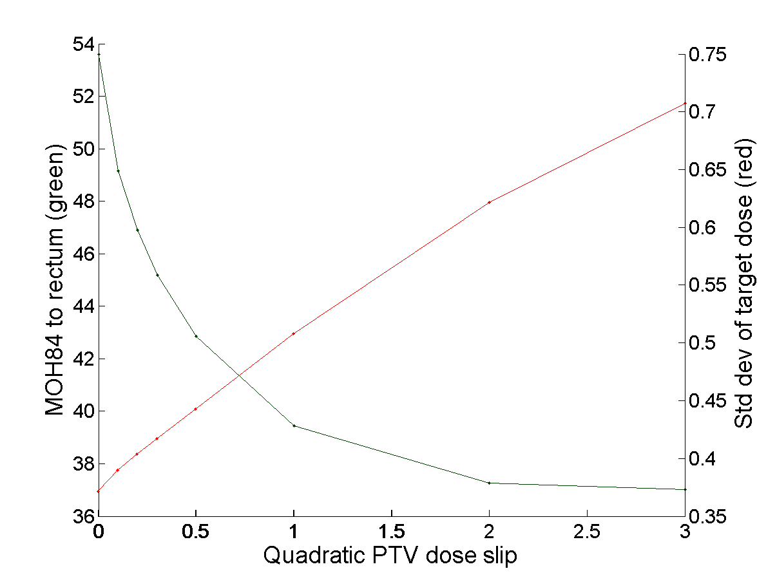
Slip tradeoff graph

Slide 61
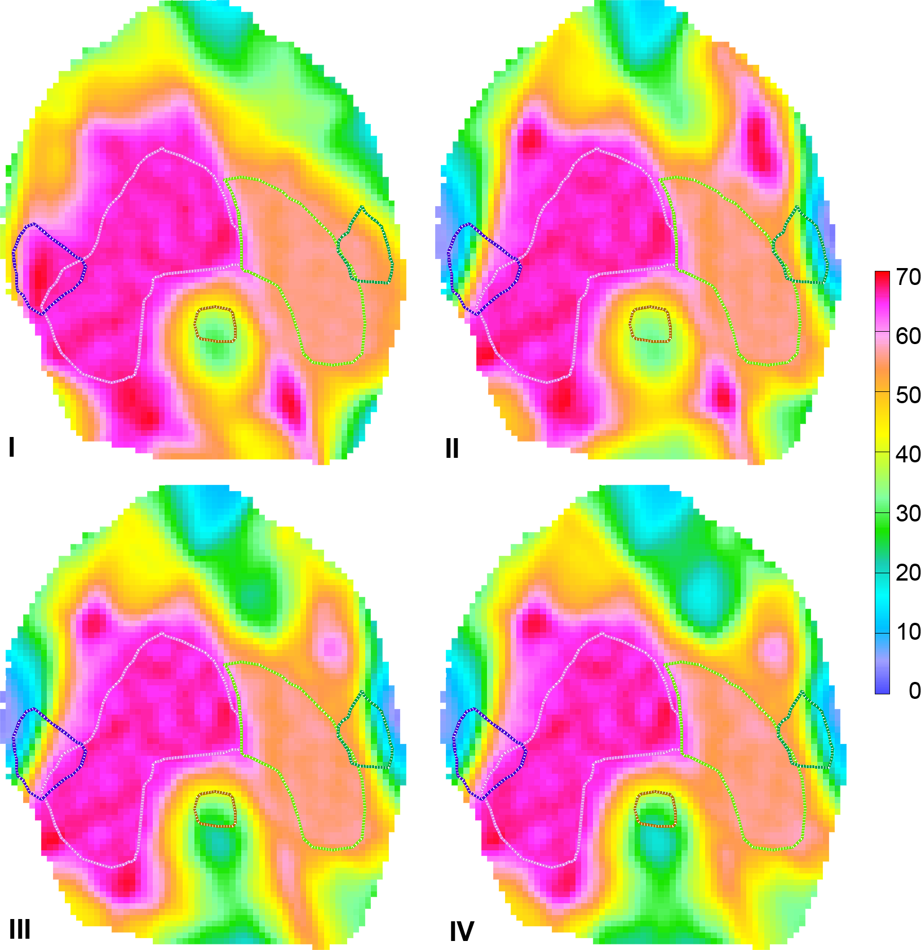
Figure 4. Transverse view of the dose distribution after step IV for a representative head and neck case. The outlined structures are (from left to right) right parotid gland, PTV1, spinal cord, PTV2, and left parotid gland. All dose values are given in Gy.

Slide 62
Prioritized planning within Pinnacle

Slide 63
Pinnacle has…
Typical DVH constraints
gEUD objectives
Constrained optimization

Slide 64
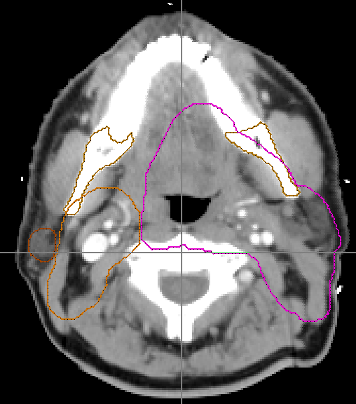
PTV 6000
PTV 5250

Slide 65
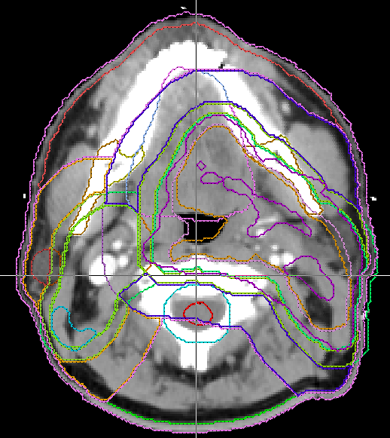

Slide 66
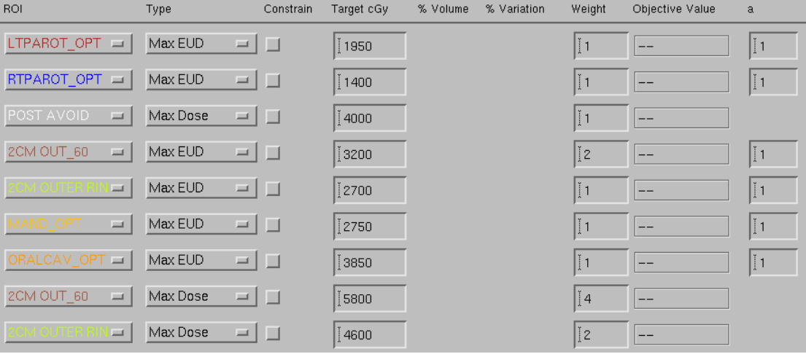
Required planning objectives [1/3]

Slide 67
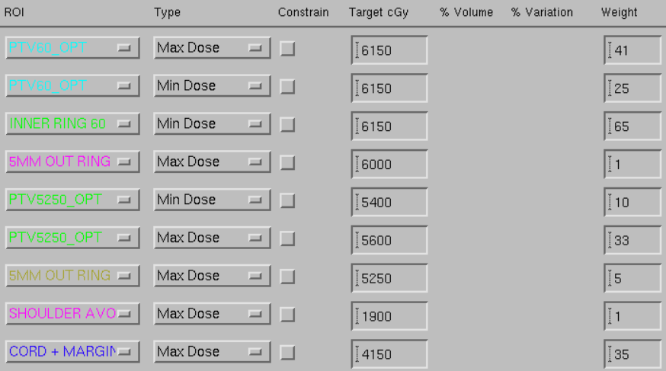
Required planning objectives [2/3]

Slide 68
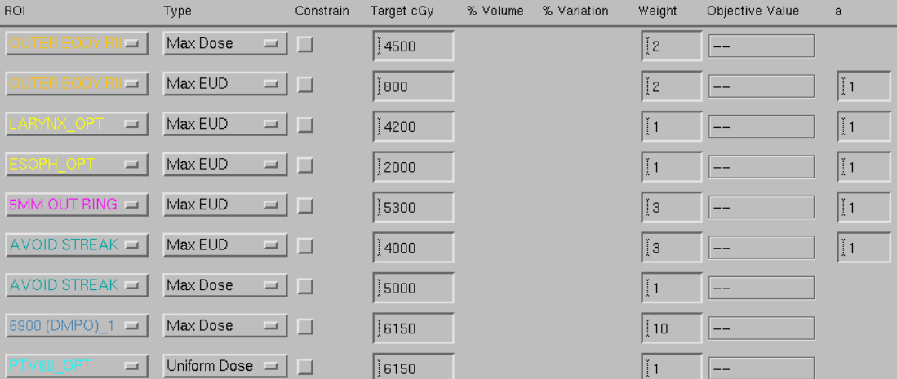
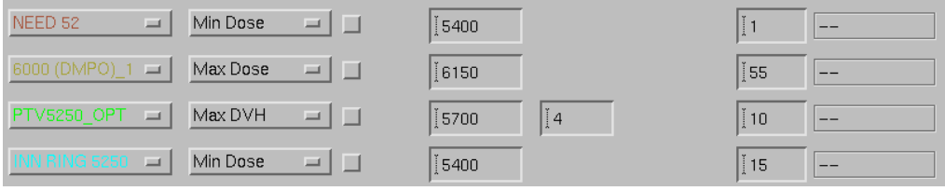
Required planning objectives [3/3]

Slide 69
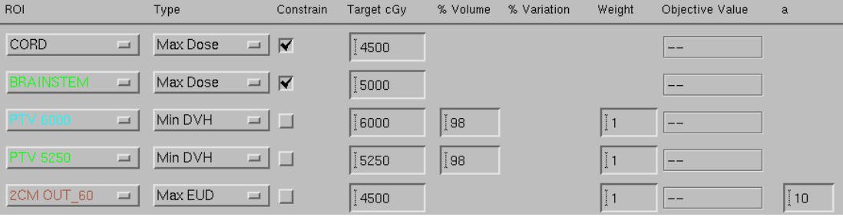
PriOpt, Step 1

Slide 70
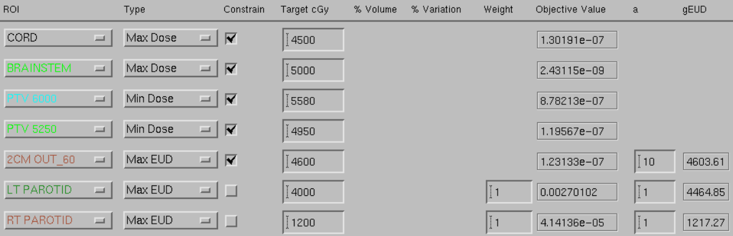
PriOpt, Step 2

Slide 71
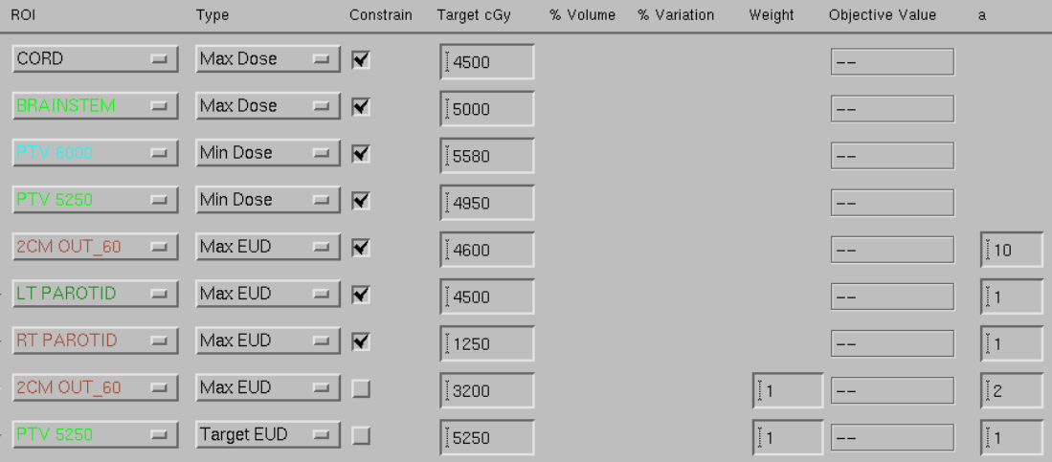
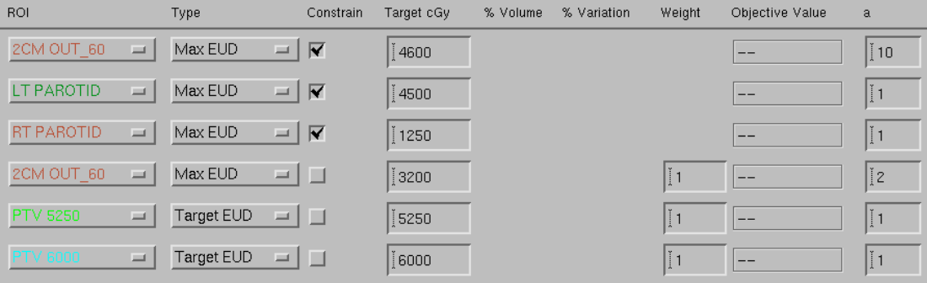
PriOpt, Step 3 (last step)

Slide 72
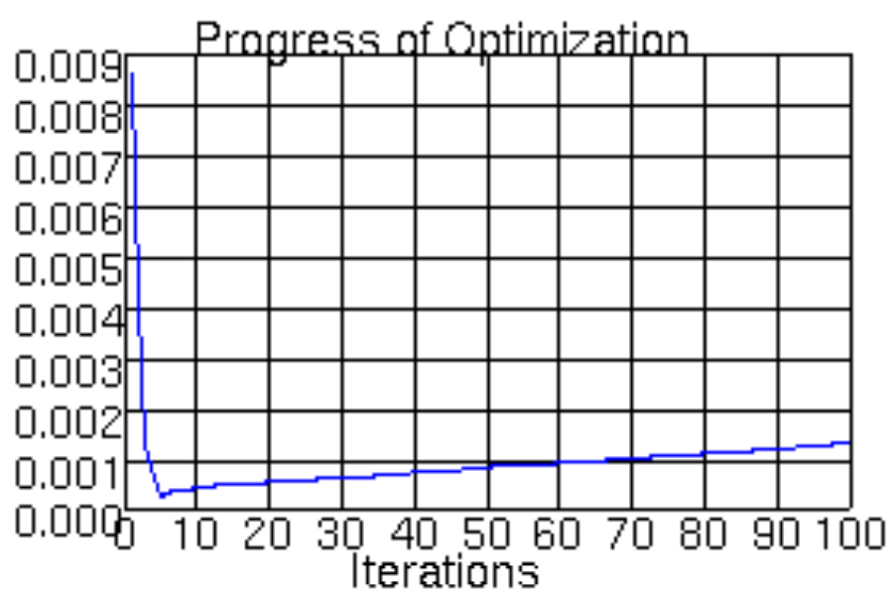
Slow!

Slide 73
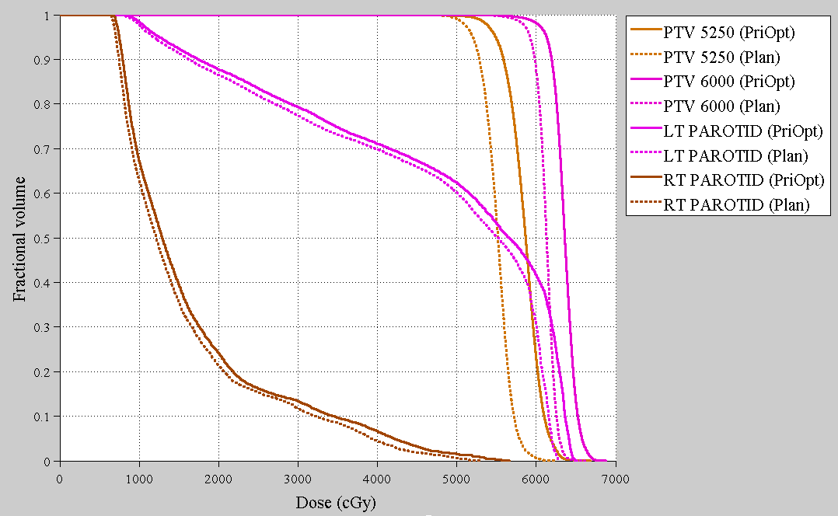

Slide 74
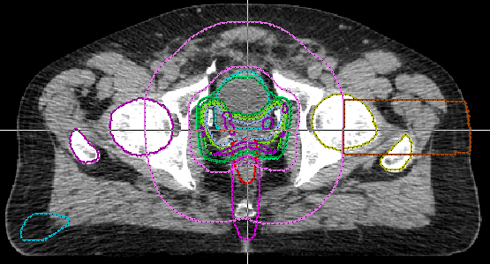

Slide 75
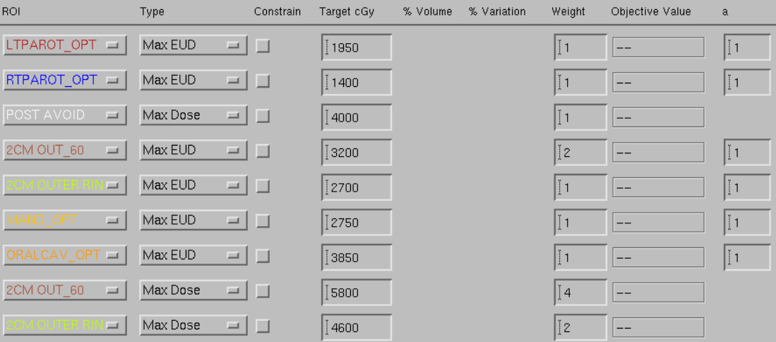
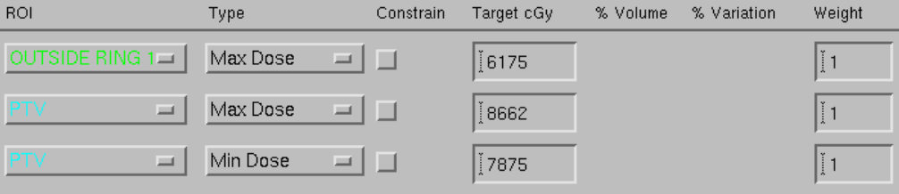
Prostate objectives

Slide 76
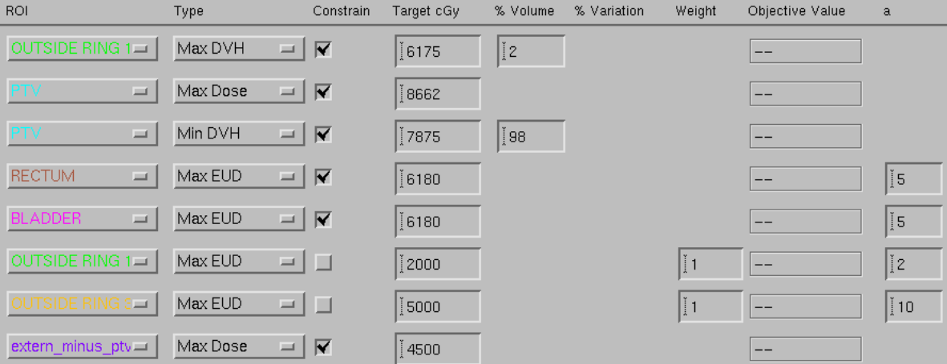
Prostate PriOpt Step 3 (final step)

Slide 77
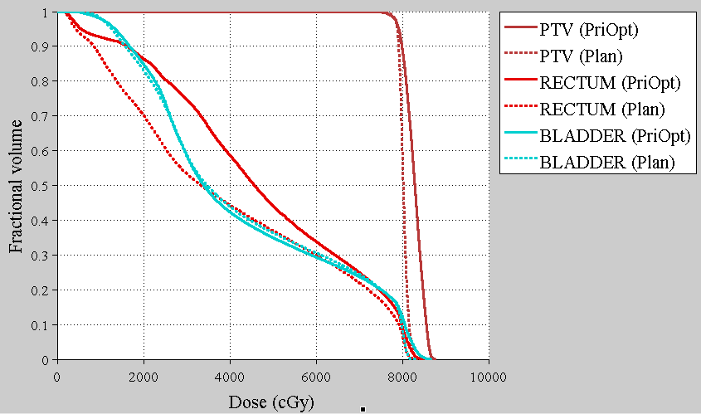

Slide 78
Issues
Can be slow
Automation (scripting) may be hampered by the need to keep the objective function from ‘blowing up’. That is, objectives shouldn’t be too far off what was available from earlier steps.

Slide 79
Problems with ‘PriOpt’
What if there could be a BIG gain in a lower priority outcome for a small loss in a higher priority outcome?
…the urge to make small changes (‘tweaking’)
Speed…

