Slide 1
Nonlinear dynamics of forced baroclinic critical layers
Chen Wang
Beijing Normal University
Beijing Normal University – Hong Kong Baptist University International College
wangchen@uic.edu.cn
Neil Balmforth
University of British Columbia

Slide 2
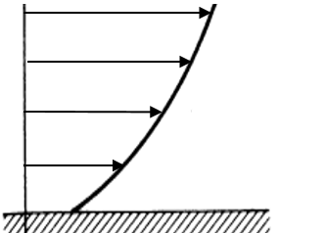
Critical level and critical layer
Critical level: singularities of waves in shear flows
Rayleigh equation
The classical critical level
Other critical levels
Viscosity, unsteadiness or nonlinearity resolves singularity
Critical layer: locally strong wave amplitudes

Slide 3
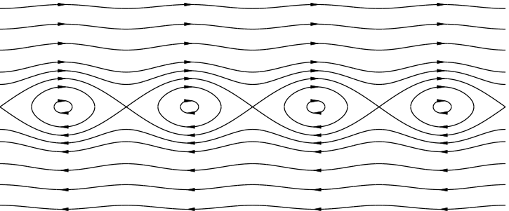
Vortices in critical layers
Kelvin’s cat’s eye
Critical layer of internal gravity waves (Thorpe 1981)
Kelvin, Lord 1880. On a disturbing infinity in Lord Rayleigh's solution for waves in a plane vortex stratum", Nature, 23 (576): 45–6
Thorpe, S.A., 1981. An experimental study of critical layers. J. Fluid Mech., 103, pp.321-344.

Slide 4
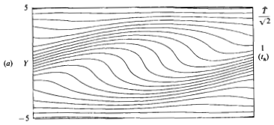
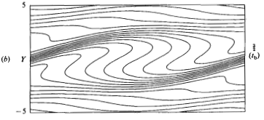
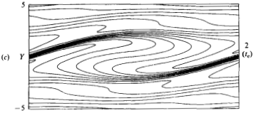
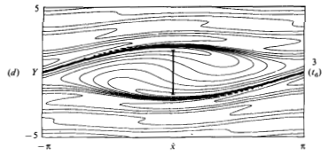
Vortices in critical layers
Rossby wave critical layer
Stewartson (1978), Warn & Warn (1978) Killworth & McIntyre (1985)
Matched asymptotic expansions
Stewartson, K. 1978. The evolution of the critical layer of a Rossby wave. Geophys. Astrophys. Fluid Dyn. 9:185–200.
Warn, T. and Warn, H. 1978. The evolution of a nonlinear critical level. Stud. Appl.Math, 59:37–71.
Killworth, P.D. and McINTYRE, M.E., 1985. Do Rossby-wave critical layers absorb, reflect, or over-reflect?. J. Fluid Mech., 161, 449-492.

Slide 5
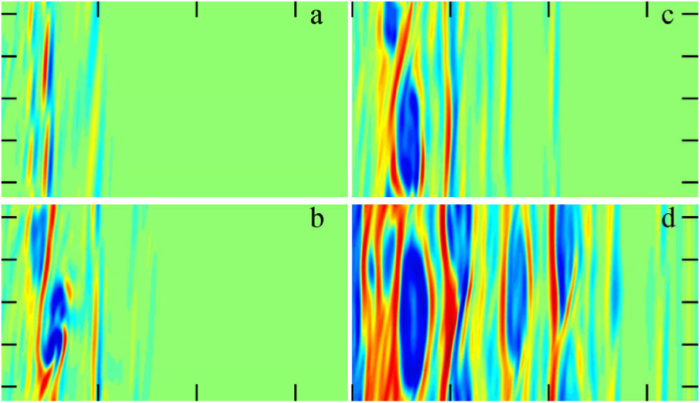
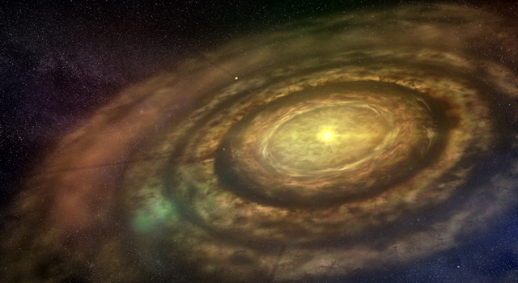
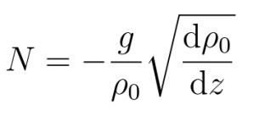
‘Zombie Vortices’
Marcus et al. (2013): vortices replicate by exciting critical layers
Baroclinic critical layers
Horizontal shear velocity
Vertical density stratification
Marcus, P. S., Pei, S., Jiang, C-H. & Hassanzadeh P. 2013 Three-Dimensional Vortices Generated by Self-Replication in Stably Stratified Rotating Shear Flows. Phys. Rev. Lett. 111, 084501

Slide 6
Potential application
Protoplanetary disk
Instability required for the disk to accretion mass onto the star
Magneto-rotational instability, gravitational instability, convective over instability, wind-driven accretion, horizontal shear instability, vertical shear instability, strato-rotational instability, zombie vortex instability…

Slide 7
Our work
An theoretical study of baroclinic critical layers and zombie vortices
Matched asymptotic expansions
Asymptotic solution
Reduced model

Slide 8
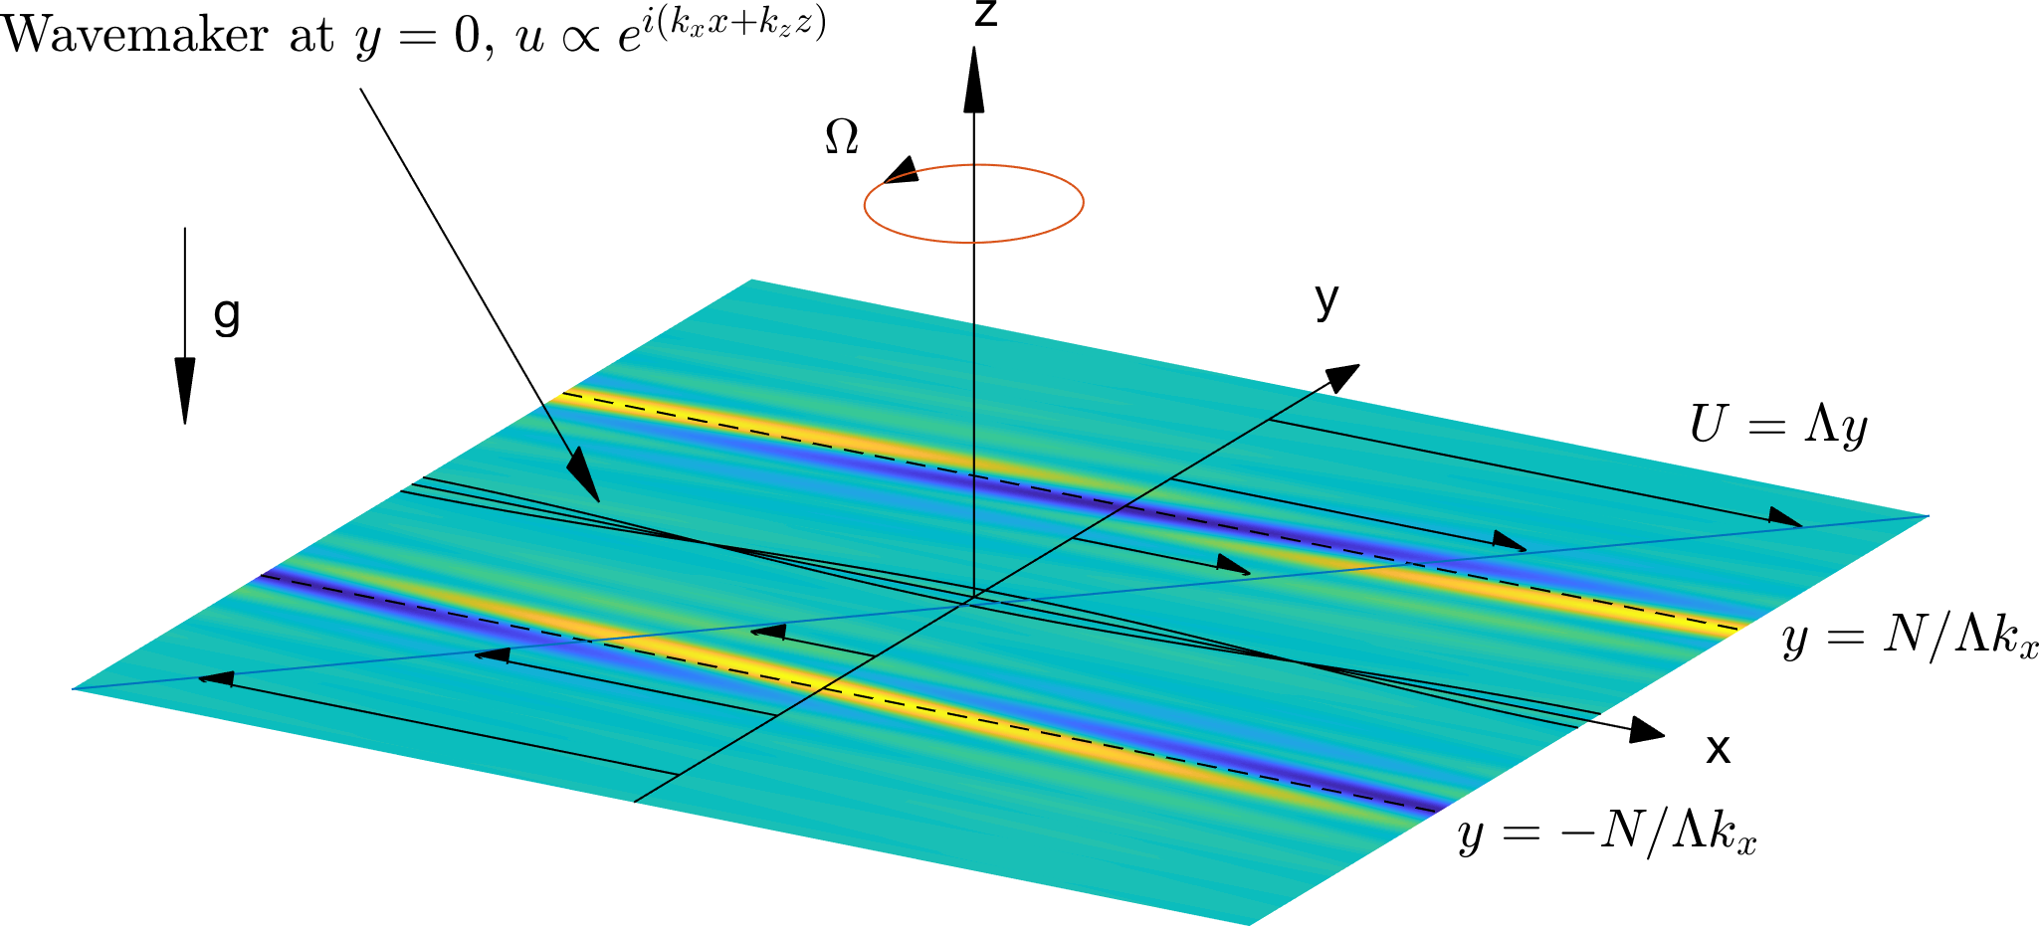
Model
Horizontal shear, vertical stratification, planetary rotation

Slide 9
Governing equations
Boussinesq approximation for disturbances
Initial state
Forcing condition

Slide 10
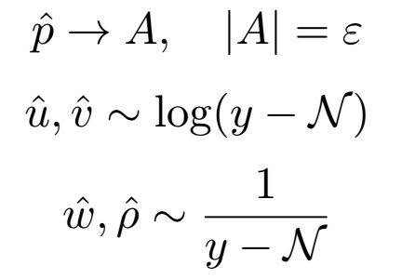
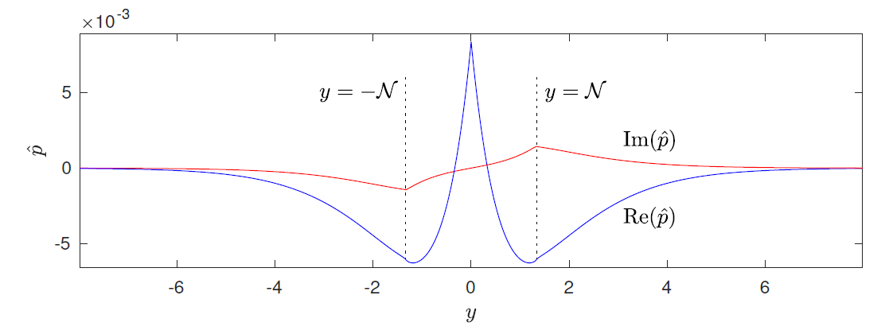
Linear waves in shear flow
Forcing establishes steady waves
Baroclinic critical levels:

Slide 11
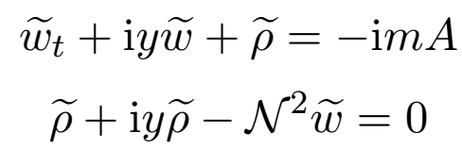
Linear critical layer
Time-dependent solution in the critical layer
Secular growth
Decreasing thickness
Mechanism of growth
Internal gravity wave
External forcing
Their resonance results in the growth

Slide 12
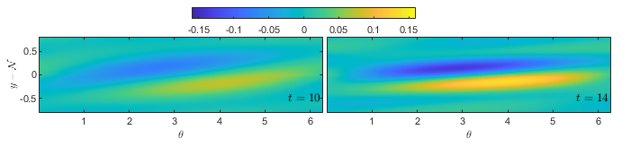
Linear critical layer
Conservation of potential vorticity
Vorticity grows in a similar manner

Slide 13
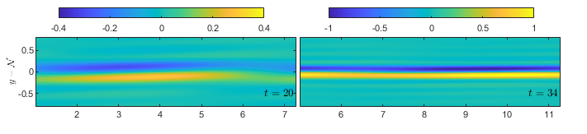
Mean-flow response
Mean flow driven by the forced wave
Vorticity field
Harmonics remain weak

Slide 14
Comparison to full simulation
Good agreements in early evolution
Subsequent nonlinear dynamics
Nonlinear feedback to fundamental wave
Secondary instability
Numerical simulation for the evolution of vorticity field, Wang (2016)
Wang C. and Balmforth N. 2021 Nonlinear dynamics of forced baroclinic critical layers, J. Fluid Mech., 883, A12.
Wang C. and Balmforth N. 2021 Nonlinear dynamics of forced baroclinic critical layers II, J. Fluid Mech., 917, A48.

Slide 15
Comparison to full simulation
Good agreements in early evolution
Subsequent nonlinear dynamics
Nonlinear feedback to fundamental wave
Secondary instability
Numerical simulation for the evolution of vorticity field, Wang (2016)
Wang C. and Balmforth N. 2021 Nonlinear dynamics of forced baroclinic critical layers, J. Fluid Mech., 883, A12.
Wang C. and Balmforth N. 2021 Nonlinear dynamics of forced baroclinic critical layers II, J. Fluid Mech., 917, A48.

Slide 16
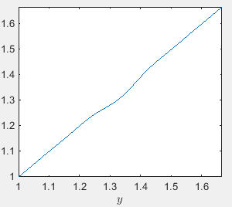
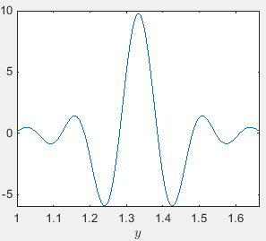
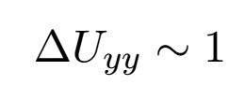
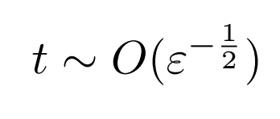
Secondary instability
Linear shear flow with a defect
Secondary instability arises when
Balmforth, N. J., del Castillo-Negrete D. & Young, W.R. Dynamics of vorticity defects in shear. J. Fluid Mech., 33:197–230, 1997.

Slide 17
Reduced model
Rescaling
Mean-flow defect

Slide 18
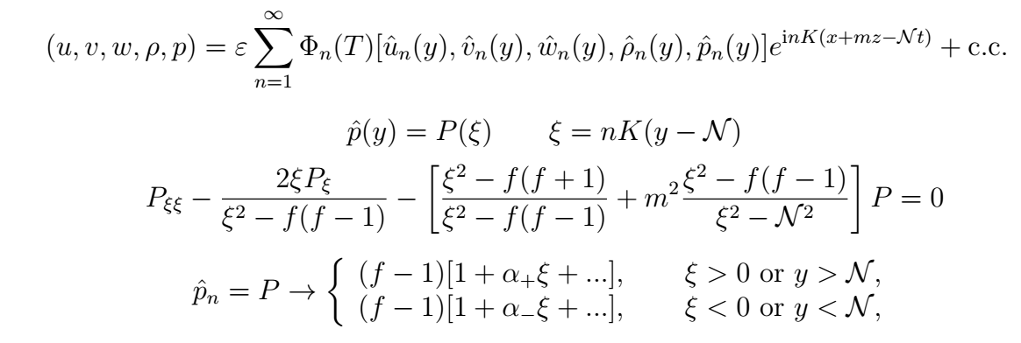
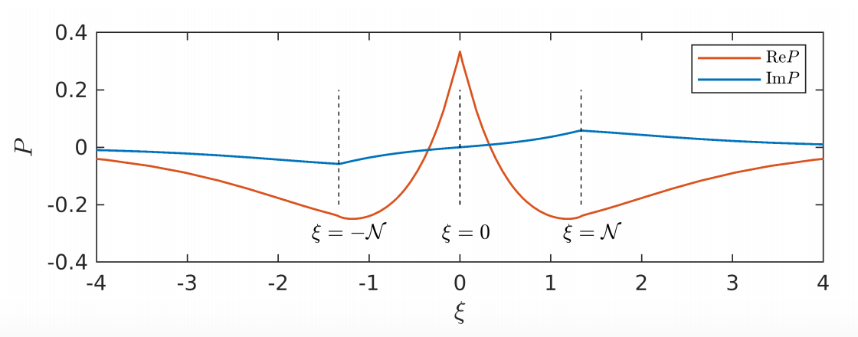
Reduced model
Outer region: quasi-steady waves

Slide 19
Reduced model
Inner solution
Two-dimensional horizontal shear instability
Vorticity equation
Matching condition

Slide 20
Linear instability
Non-dissipative flows
Normal mode solution (quasi-steady approximation, non-dissipative)
Time-dependent solution (non-dissipative)

Slide 21
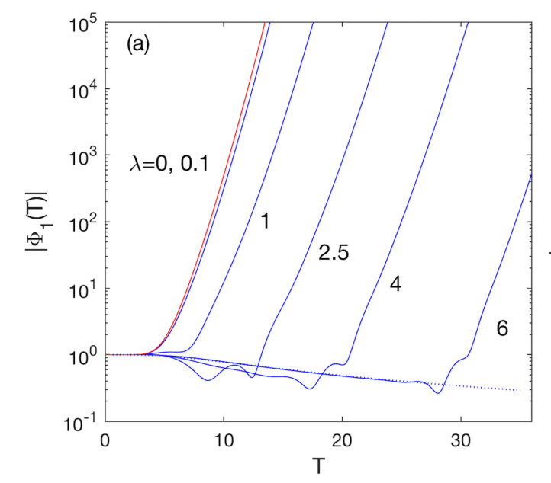
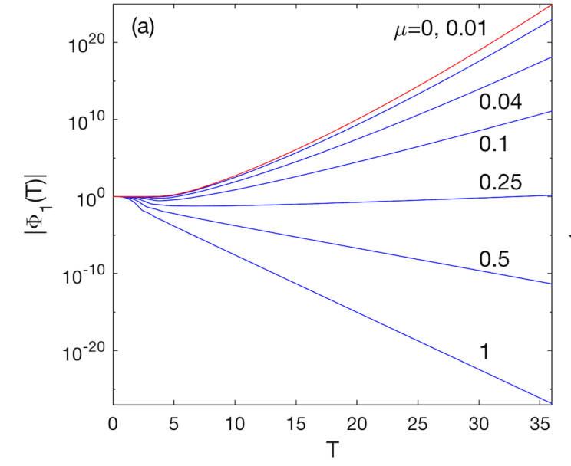
Linear instability
Dissipative flow
Thermal diffusion merely delays the instability
Viscosity has a dramatic stabilizing effect

Slide 22
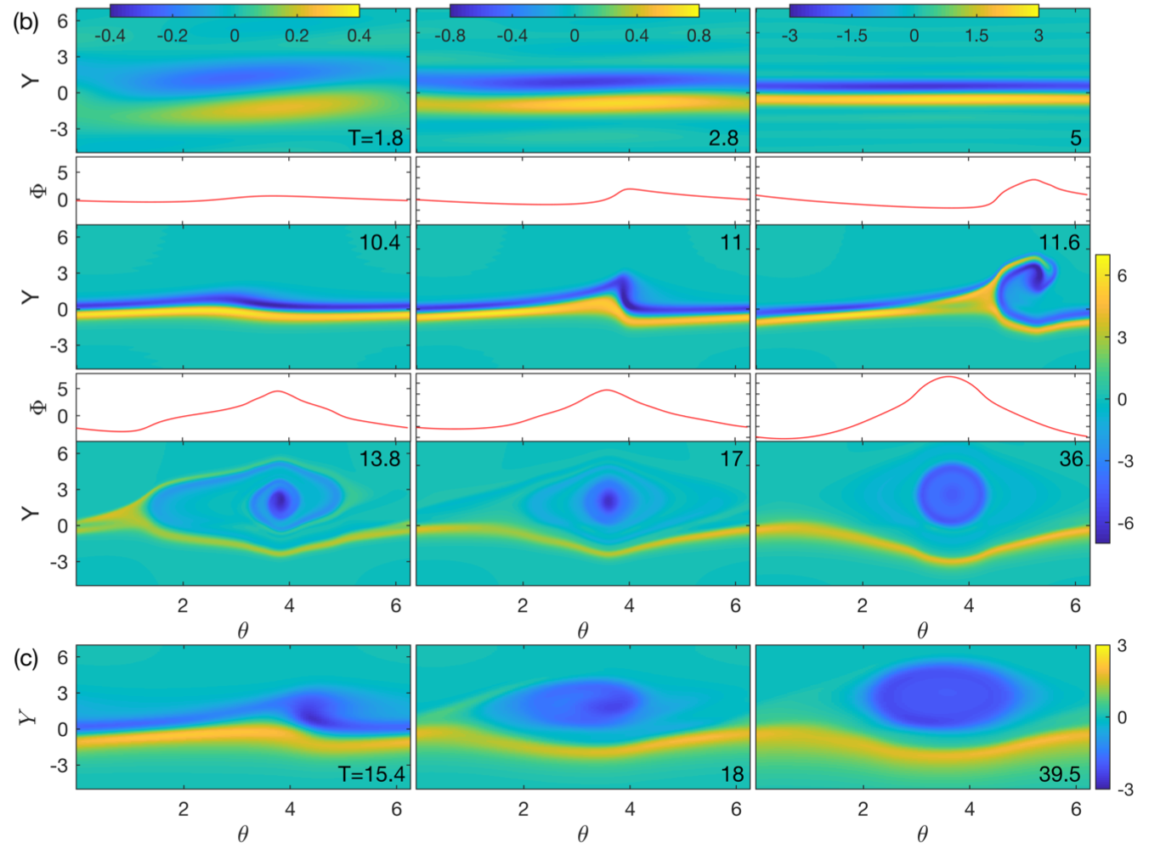
Nonlinear instability
Numerical method
Cheng & Knorr (1976)
Single mode excitation
Roll up
Bellows fade
Vortex + shear layer

Slide 23
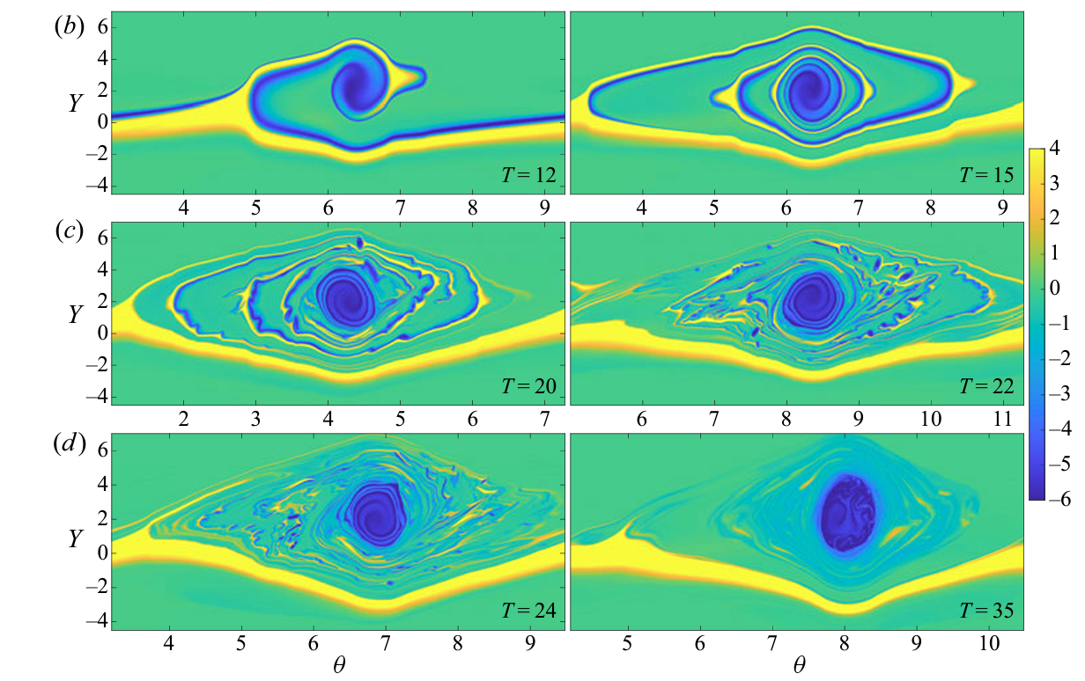
Nonlinear instability
An example of weak dissipation
Long thin billows
Tertiary instability

Slide 24
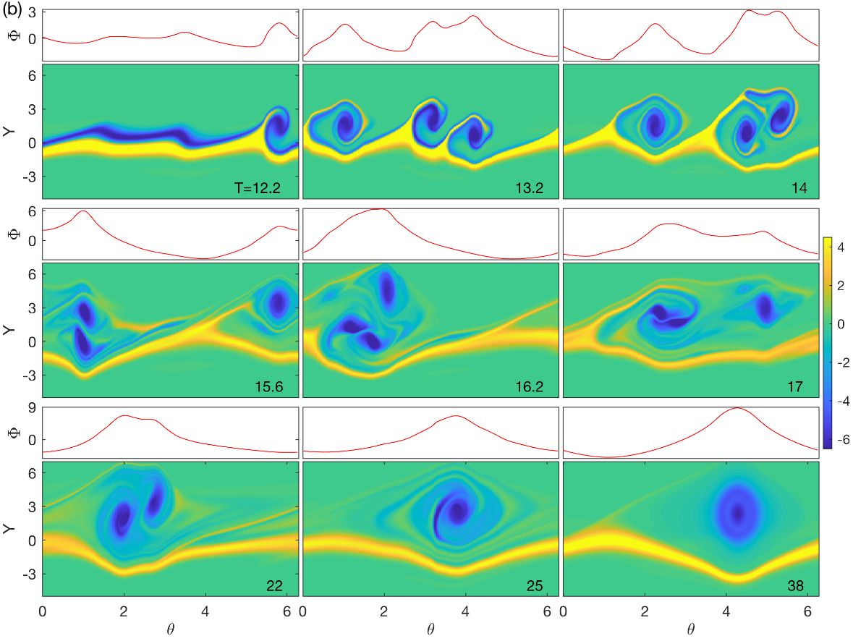
Nonlinear instability
Multiple mode excitation
Vortex paring
Vortex merging

Slide 25
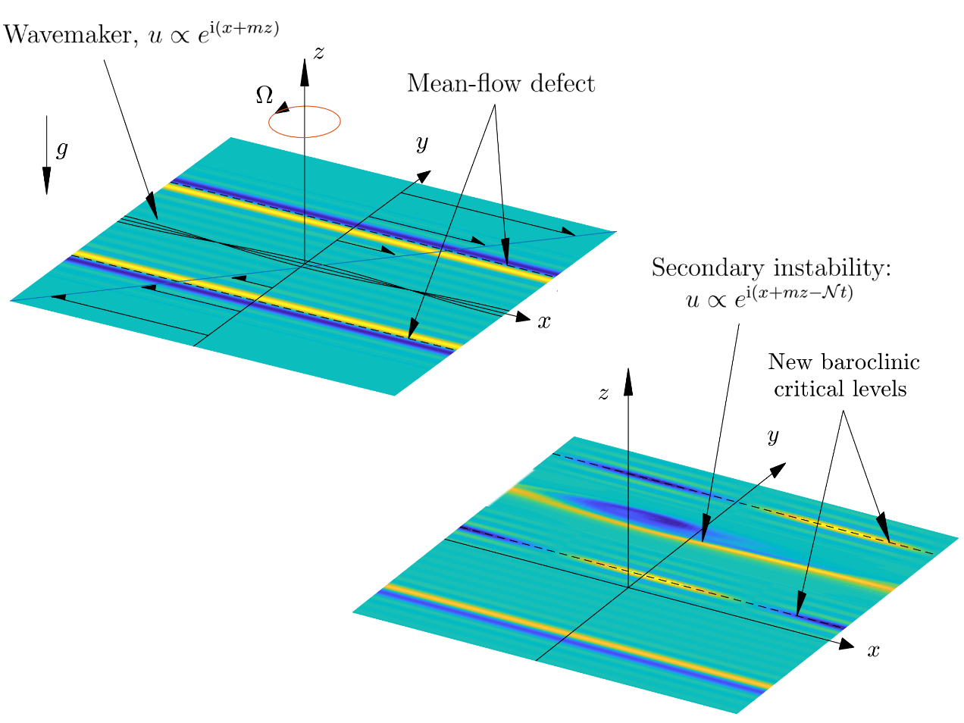
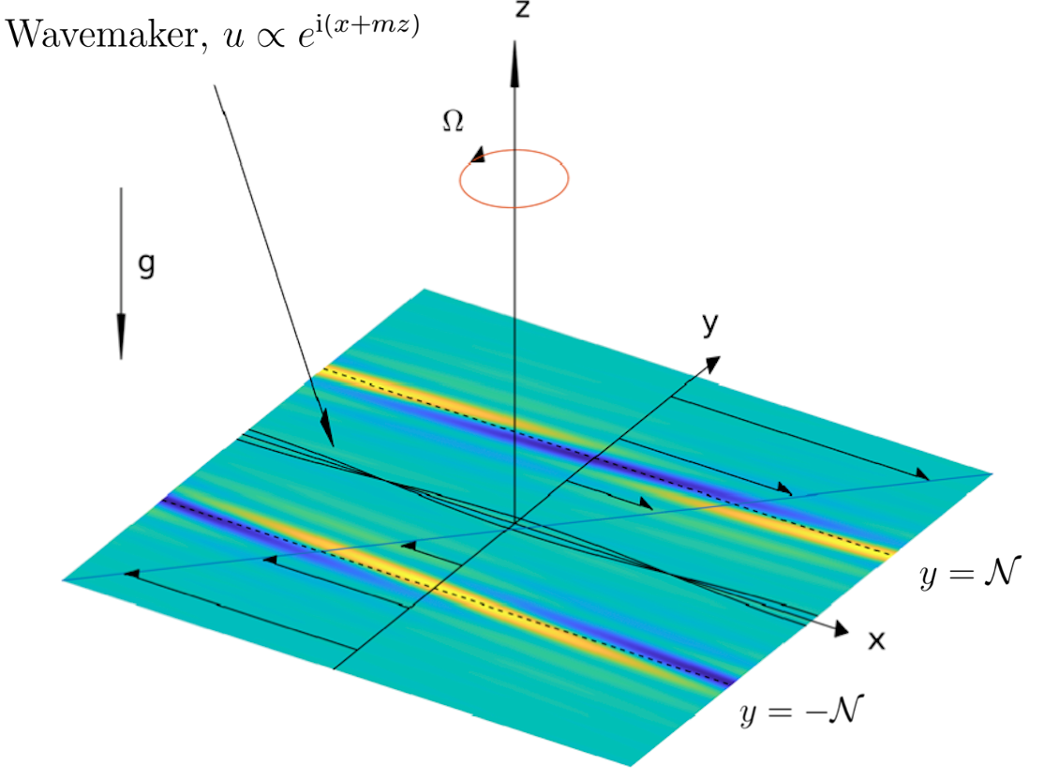
Replication
Secondary instability has a new phase velocity:
It can excite new critical levels at

Slide 26
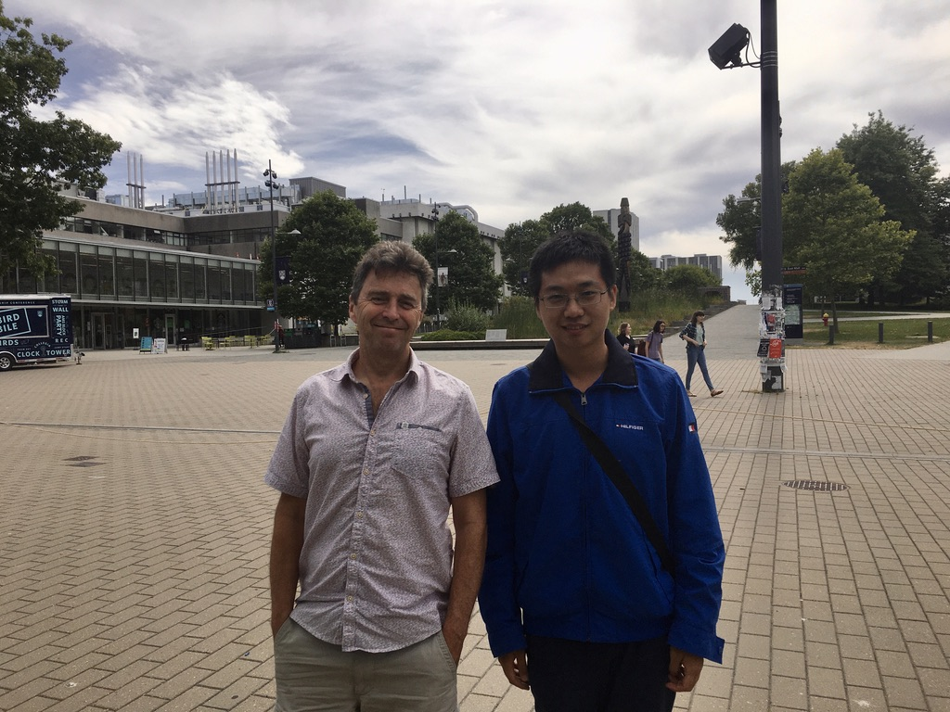
Thank you

Slide 27
Feedback to fundamental wave
Modified mean flow
Modified evolution equation
Starting time of nonlinearity
Wang, C. & Balmforth N. 2020 Nonlinear dynamics of forced baroclinic critical layers. J. Fluid Mech. 883, A12.

Slide 28
Secondary instability
Linear shear flow with a defect
Secondary instability arises when
Earlier !
Balmforth, N. J., del Castillo-Negrete D. & Young, W.R. Dynamics of vorticity defects in shear. J. Fluid Mech., 33:197–230, 1997.

Slide 29
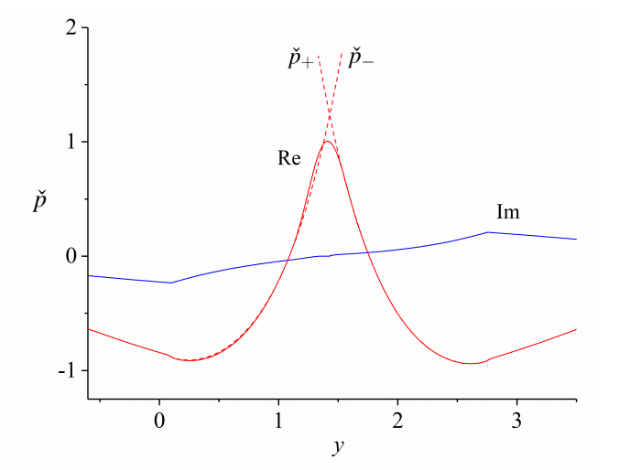
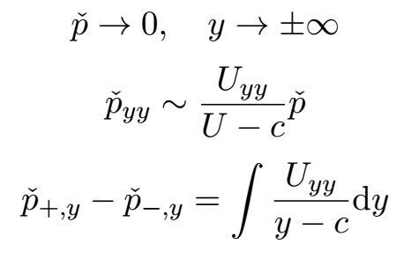
Instability Mechanism
Heuristic explanation by normal mode
Important properties

Slide 30
Reduced model
Rescaling
Mean-flow defect

Slide 31
Reduced model
Outer region: quasi-steady waves

Slide 32
Reduced model
Inner solution
Two-dimensional horizontal shear instability
Vorticity equation
Matching condition

Slide 33
Linear instability
Analyze one Fourier component
Linearized equations
Integral equation

Slide 34
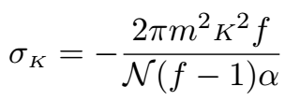
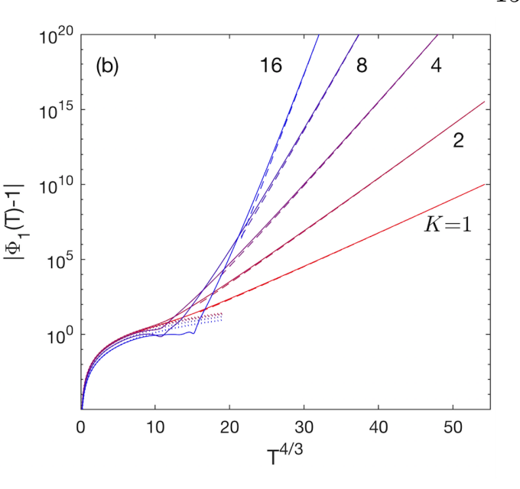
Linear instability
Non-dissipative limit
WKB solution
Non-normal mode growth
Growth rate divergence

Slide 35
Linear instability
Dissipative flow
Thermal diffusion merely delays the instability
Viscosity has a dramatic stabilizing effect

Slide 36
Nonlinear evolution
Numerical method: Cheng & Knorr (1976)
Initial conditions
Single mode excitation
Multiple mode excitation
Cheng, Chio-Zong & Knorr, Georg 1976 The integration of the Vlasov equation in configuration space. Journal of Computational Physics 22 (3), 330–351.

Slide 37
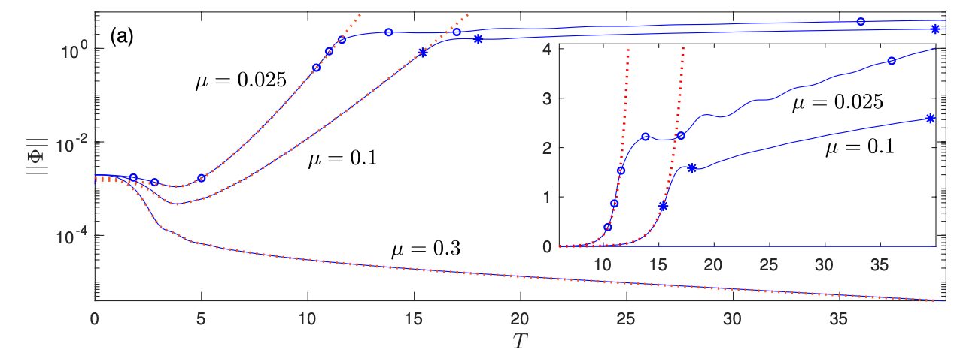
Nonlinear evolution
Evolution of stream function
Amplitude saturation & secular growth
Solid line: numerical solution of nonlinear evolution
Dotted line: linear instability

Slide 38
Nonlinear evolution
Evolution of vorticity
Medium & high viscosity: rollup into billows

Slide 39
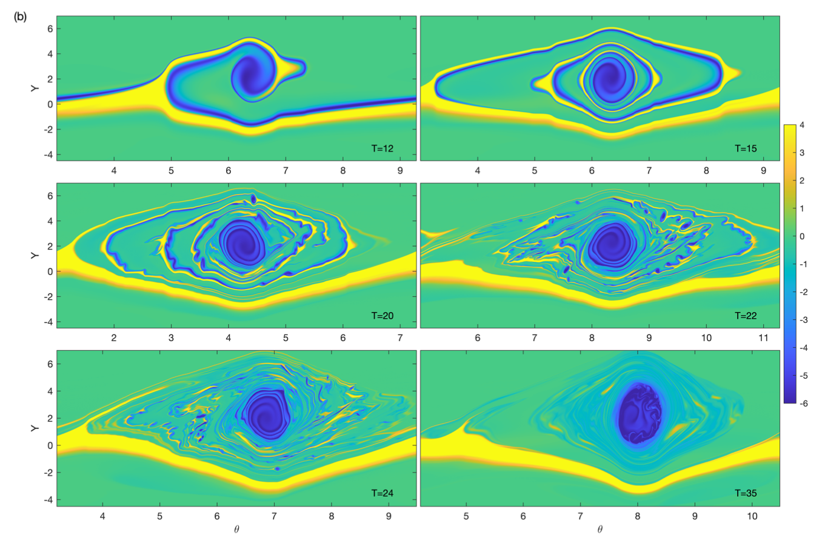
Nonlinear evolution
Evolution of vorticity
Low viscosity: rollup & tertiary instability

Slide 40
Nonlinear evolution
Evolution of vorticity
Multiple mode excitation: vortex pairing and merging

Slide 41
Replication
Excitation of new critical levels

Slide 42
Thank you

