Slide 1







Big Data, Downscaling, and Interdisciplinary Approaches to Understanding Extreme Events
CMO-BIRS Synthesis of Statistics, Data Mining and Environmental Sciences in Pursuit of Knowledge Discovery
Presenter: Lizzy Warner
PhD Student, Interdisciplinary Engineering
Sustainability and Data Sciences Laboratory
Civil and Environmental Engineering
www.northeastern.edu/sds
Northeastern University
Doctoral Student Research Analyst
Global Resilience Institute (GRI)
globalresilience.northeastern.edu

Slide 2
Grand Challenges
CMO-BIRS Synthesis of Statistics, Data Mining and Environmental Sciences in Pursuit of Knowledge Discovery

Slide 3

Sustainability and security are grand societal challenges for the sciences and engineering
Ghitis, Frida., 2017. Holland has solved this problem; Why can’t the US? CNN, 8/29.
Notes:
A vicious cycle of policy myopia, economic disincentives, and stagnation in novel engineering or best practices may be caused by lack of adequate understanding of the interactions among climate stressors, stressed infrastructure systems, and impacted communities and institutions. Societal consensus based on risk and resilient informed decisions and understanding can transform communities and infrastructures to a virtuous cycle of sustained growth.

Slide 4


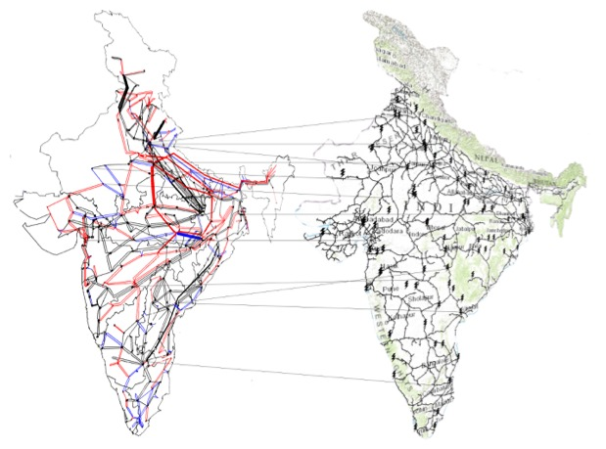
Interconnected natural-human-built systems may cause large-scale cascading failures
Heat waves
Surge in agriculture water demand
Increased stress on power-grid
1b
2
3
1a
Power Grid
Railway Network
Delayed monsoons
4
Bhatia U, Kumar D, Kodra E, Ganguly AR (2015) Network Science Based Quantification of Resilience Demonstrated on the Indian Railways Network. PLOS ONE 10(11): e0141890. https://doi.org/10.1371/journal.pone.0141890
5
Impacts on Indian Railways
2012 India Blackouts

Slide 5
Critical lifeline infrastructure failures and recovery need to consider networked dependence
US National Airspace System
2004 Indian Ocean Tsunami
2012 Indian Power Blackout
Simulated Cyber-Physical Attack
Earthquakes
Snowstorms
Technological failures
Indian Railway Network
Tsunami 2004
Power blackout 2012
Cyberphysical attacks
Ganguly AR, Flynn S, Bhatia U (2017) Critical Infrastructures Resilience: Policies and Principles. Routledge Publishing. ISBN-10: 1498758630
Bhatia U, Kumar D, Kodra E, Ganguly AR (2015) Network Science Based Quantification of Resilience Demonstrated on the Indian Railways Network. PLOS ONE 10(11): e0141890. https://doi.org/10.1371/journal.pone.0141890
Notes:
Interesting mathematical graph theory solutions that are applicable

Slide 6
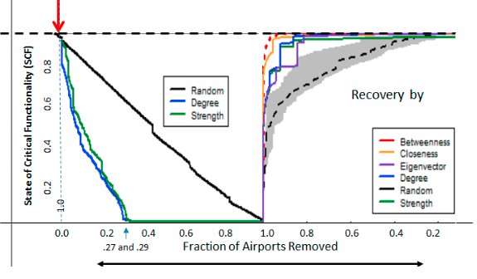
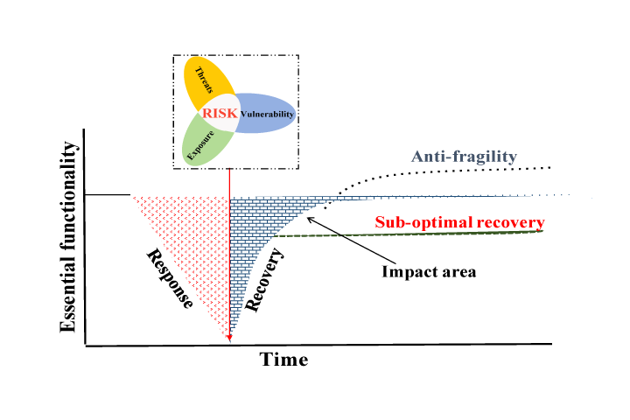
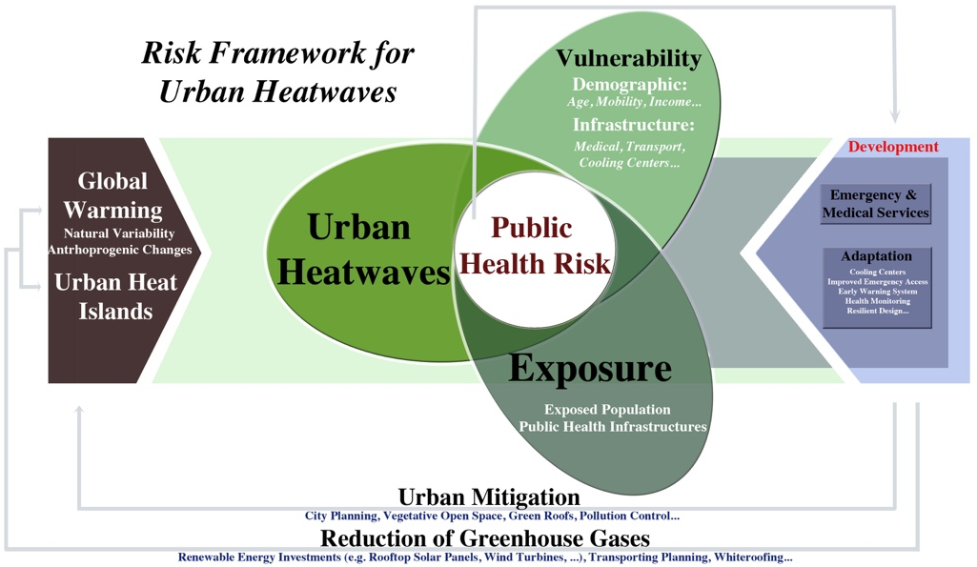
Response approach must use both risk and resiliency approaches
Probabilistic Risk Assessment
Recovery
Robustness
Network Science Based Response & Recovery
Recovery
Fard, B, Hassanzadeh H, Warner, M, Bhatia, U, and Ganguly, A (2016) Urban Climate Risk Framework for Informing Action Plans Heatwave Threats to Public Health for the Town of Brookline. AGU Thriving Earth Exchange.
Robustness
2004 Indian Ocean Tsunami
2012 Indian Power Blackout
Simulated Cyber-Physical Attack
Notes:
Explain centrality metrics a little, provide examples
Fig 1 (Top left): In system resilience framework, risk can be interpretedas the total reduction in critical functionality, while resilience is related toabsorption of the stress, rate of reduction in essential functionality, and re-covery of essential functionality after adverse. The post-recovery state of thesystem–measured in terms of essential functionality–can be better, equal to,or worse than pre-hazard state of the system.

Slide 7


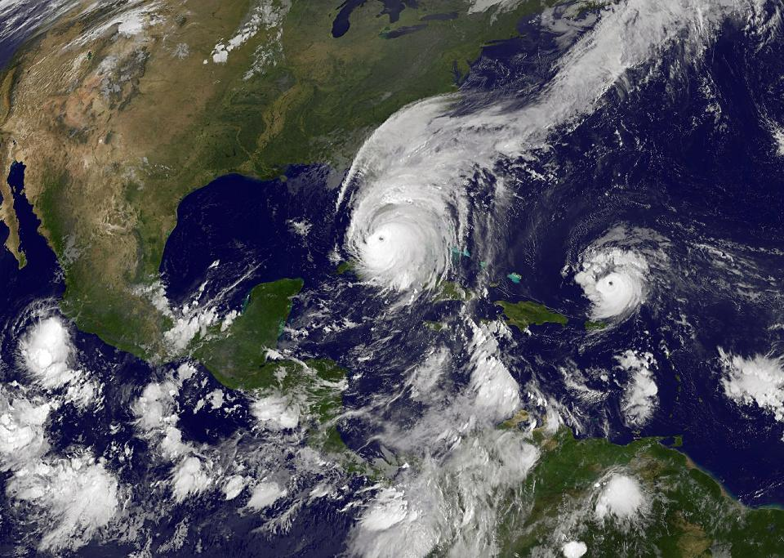


Black Swans and Grey Swans
Black Swan: Highly improbable events with disproportionate impacts
Grey Swan: Unprecedented but no longer surprising events (“predictive surprise”)
Notes:
Black swans and grey swans are stressors for why we need to think about resilience
9/11 black swan
Harvey grey swan

Slide 8
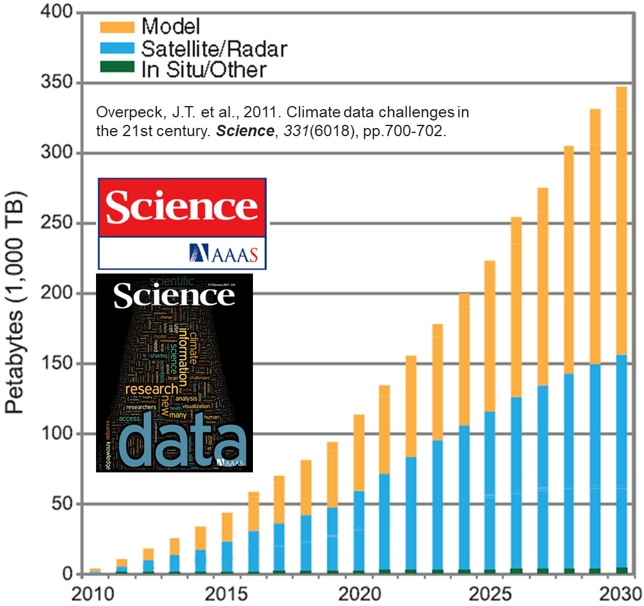
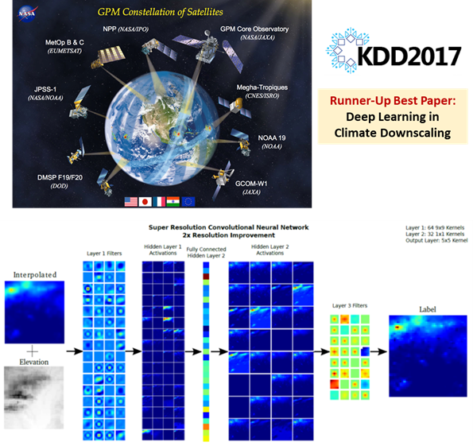

Machine Learning on Big Data needs to account for Non-Stationarity & Deep Uncertainty
T. Vandal, A. Ganguly, "Uncertainty Quantification for Statistical Downscaling using Bayesian Deep Learning" 7th International Workshop on Climate Informatics, 2017.
Caldwell, P.M. et al., 2014. Statistical significance of climate sensitivity predictors obtained by data mining. Geophysical Research Letters, 41, 5, 1803-1808.
Notes:
Bottom Right: From the left to right: Precipitation and Elevation sub-image pair, filters learned in layer 1, layer 1 activations, layer 2 filters, layer 2 activations, layer 3 filters, and HR precipitation label.
Read abstract of bottom left citation, very applicable to math and statistics

Slide 9
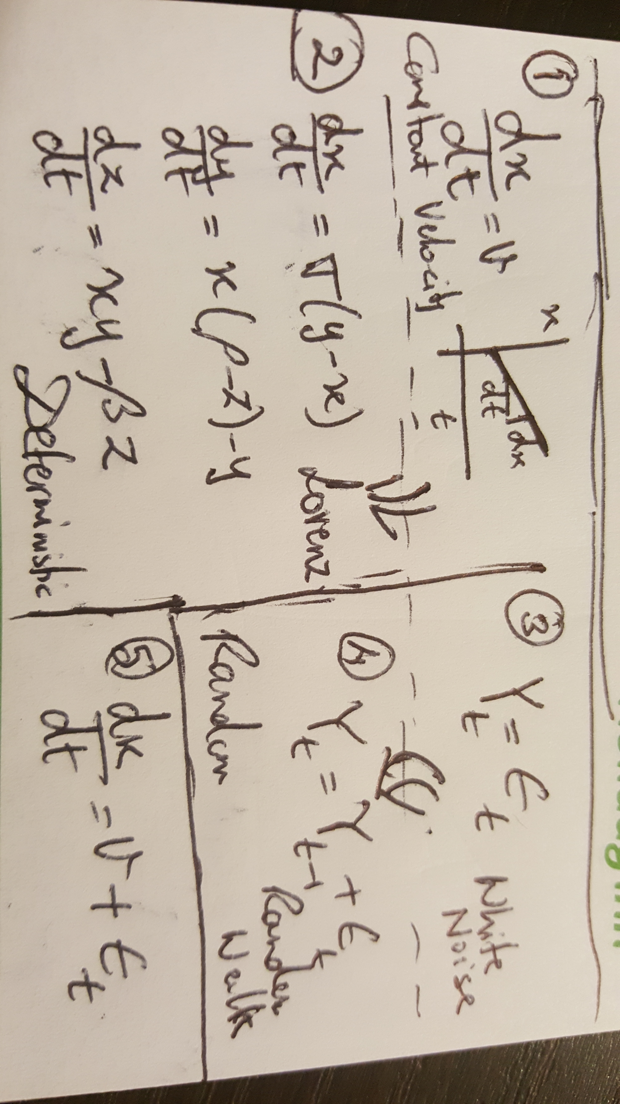
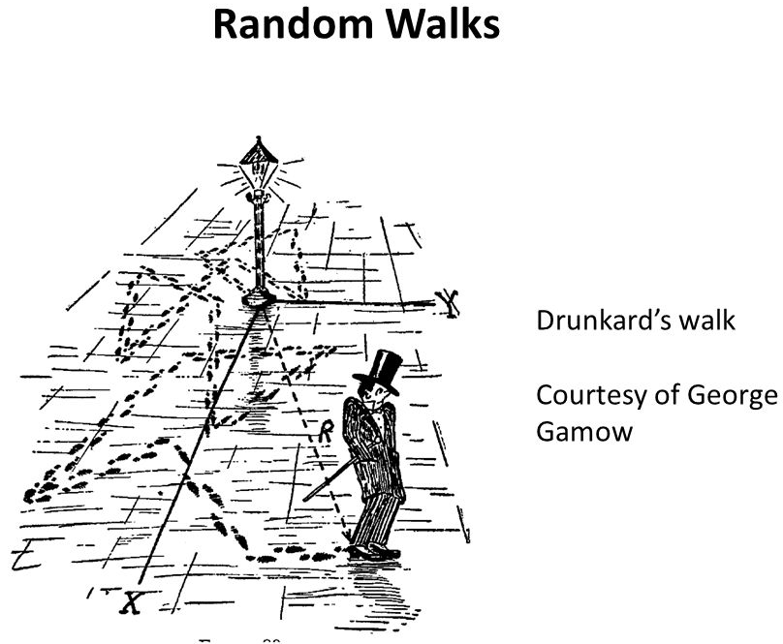
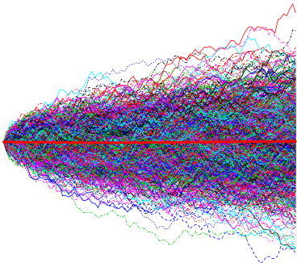

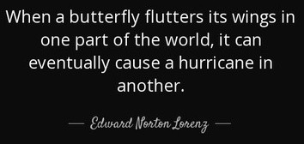
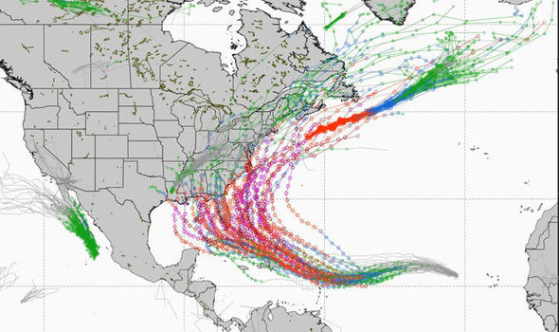
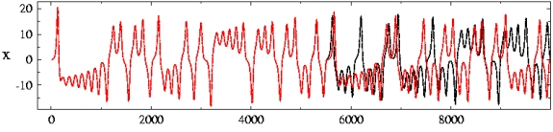
Deep Uncertainty as Chaotic Butterflies and Random Walkers in Idealized Systems
Notes:
Random walk is an example of stochastic uncertainty
These are deterministic systems but extremely sensitive to initial conditions
Intrinsic variability even with full understanding of the system

Slide 10

Non-Stationarity and Deep Uncertainty in 21st Century Climate Change Projections
Notes:
Green is projection, "what if" scenarios
Blue is model variability
Deep uncertainty from internal variability and RCPs
Fig 1 (Top left): Climate predictions at different time scales. A schematic representation of the relative importance of initial conditions and external forcings for climate projections. Annual to decadal predictions occupy the middle ground between the two
Fig 2 (Bottom Left): The fraction of variance explained by each source of uncertainty for (a) global mean decadal and annual mean temperature, (b) European (30°N to 75°N, 10°W to 40°E) decadal mean boreal winter (December to February) temperature, (c) East Asian (5°N to 45°N, 67.5°E to 130°E) decadal mean (June to August) precipitation and (d) European decadal mean winter precipitation
Fig 3 (Right): Sources of uncertainty in climate projections as a function of lead time based on an analysis of CMIP5 results. Projections of global mean decadal surface air temperature to 2100 together with a quantification of the uncertainty arising from internal variability (orange), model spread (blue) and RCP scenario spread (green).

Slide 11

Design of Experiments with (30) Multi Model and (30) Multi Initial Condition Ensembles
Notes:
First time we are getting large ensemble runs (NCAR)
Fig 1 (Left): Uncertainty in projection of change in temperature and precipitation. Projections of global mean surface air temperature (left) and precipitation (right), relative to 1961-1990, for decadal annual (top) and seasonal means (DJF [middle] and JJA [bottom]) from 30 initial conditions (orange) and 30 CMIP5 models (blue). Each individual thin line represents one realization of future climate, and the thick lines represent MICE (orange) and MME (blue) means. Projections from the common model (CESM-CAM5) are shown in green.
Fig 2 (Right): Relative dominance of different sources of uncertainty. The fraction of variance explained by model response variability (blue) and climate internal variability (orange) for decadal JJA mean temperature (top two rows) and precipitation (bottom two rows) at multiple 11 spatial aggregations (Global, Global Land, NHEX, Tropics, North America, and United States) and a few selected cities (Phoenix, Seattle, New York, and Mazatlan).
https://arxiv.org/pdf/1601.04730.pdf

Slide 12
Characterization of Irreducible Uncertainty vs. Uncertainty from Lack of Understanding
Model 1
Model 2
Model 3
Mean
Initial Condition A
Initial Condition B
Mean
Ganguly A, Kumar D, Ganguli P, Short G, and Klausner J (2015) Climate Adaptation Informatics: Water Stress on Power Production. Computer Science and Engineering 17(6): 10.1109/MCSE.2015.106
Changes in decadal-averaged precipitation minus evaporation (P–E) from three models and two initial conditions. Drier conditions in yellow to dark brown and wetter in green to blue
Notes:
Real world examples. Same process, different models.
Captures our lack of understanding because basic physics are still the same (fluid dynamics).
Initial conditions represent internal variability. Clear example of the context of non-stationarity and some variability both because of lack of understanding and extreme sensitivity
Mean can give an idea but also inconsistent: mutes out all changes on either side
Spatial patterns of changes in freshwater availability (mm/year) in the 2030s (2028 to 2032), relative to the 2010s (2008 to 2012), from an ensemble of three Coupled Model Intercomparison Project Phase 5 (CMIP5) climate models (the first three columns from left to right: CCSM4, GISS-E2H, and MIROC5) and two initial conditions (top and middle rows) under an representative concentration pathway (RCP8.5) emissions scenario over the contiguous US. The top and middle rows of the fourth column show the three-model ensemble means for the two initial conditions; the bottom rows of the first three columns show the two-member initial condition ensemble means corresponding to the three models. The bottom-right figure shows the overall mean of initial and model ensembles. The four most populous cities-New York, Chicago, Houston, and Los Angeles-are shown in a solid-colored circle (blue, red, white, and pink, respectively). The boundaries of the river forecast centers and the states within the continental US are shown as solid lines in deep blue and black. Darker shades of green followed by blue on the right of the scale show wetter conditions, while yellow, orange, and brown on the left show drier conditions.

Slide 13


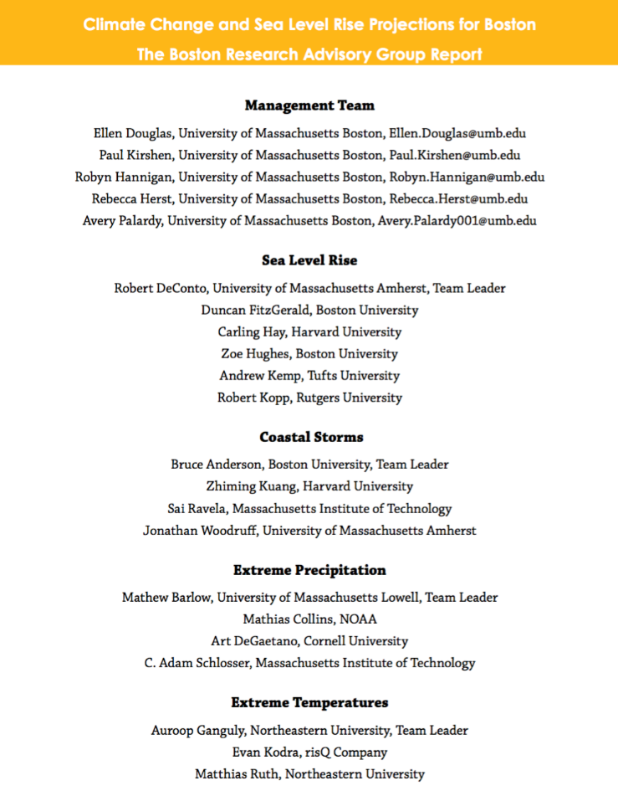
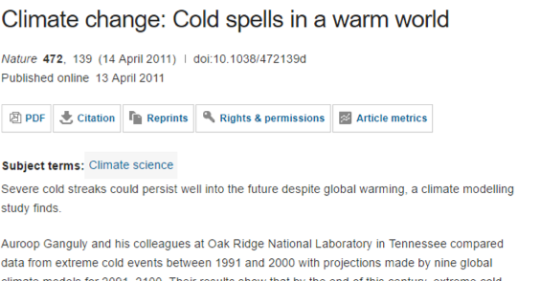
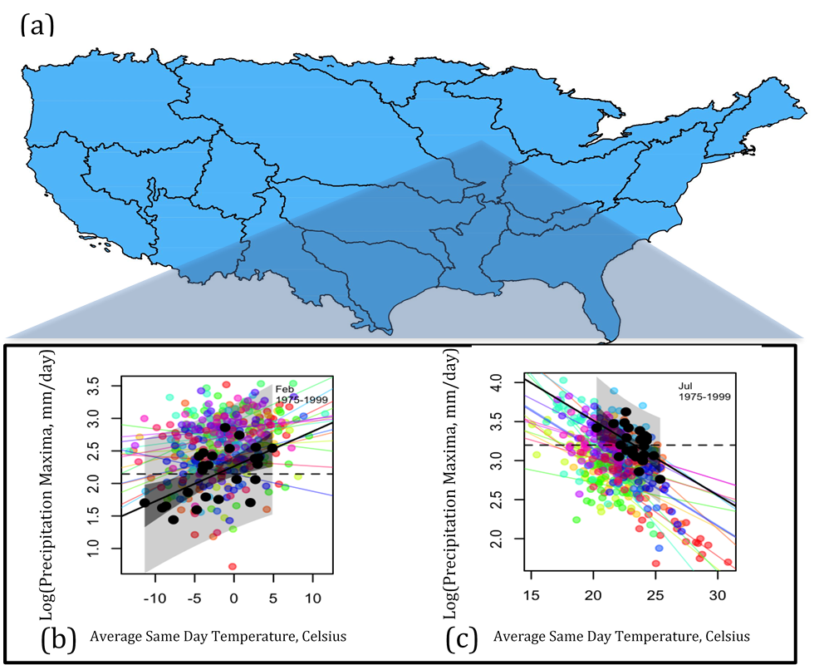
Changing weather extremes motivate science based technologies to inform communities
Extreme Events from “Big Spatial Data”
Physics-Guided Uncertainty Quantification
Islam, Shafiqul, and Kaveh Madani. Water Diplomacy in Action: Contingent Approaches to Managing Complex Water Problems. Anthem Press, 2017.
Ganguly A and Kodra E. Asymmetry of projected increases in extreme temperature distributions (2014). Scientific Reports 4(5884): doi:10.1038/srep05884
Notes:
Mention co-author (Snigdhansu Chatterjee) for statistical questions
Fig 1 (Top left): The outer panel (a) shows how increases strictly in the location parameters for either tail would impact the distribution of extremes, and similarly panels (b) and (c) show the same for scale and shape parameters. Changes in location parameters correspond to shifts in typical or average extreme events, scale to changes in the width of the distribution of extremes, and shape to the behavior of the uppermost extremes. Baseline GEV distributions are shown in black and shifted distributions are shown in blue and red for simulated seasonal minima and maxima statistics, respectively. The SI gives details on the construction of the 6 side graphs, which are built with randomly simulated data from GEV models.
Fig 2 (Bottom right): Clausius-Clapeyron scaling of precipitation extremes (a) watersheds in the Upper Mississippi Region of Continental YSGS; (b) each point is a natural log transformed monthly precipitation maximum (Y-axis) and the corresponding same day average surface temperature (X-axis) from Februaries of 1975-1999. Black dots are observations, and black shading represents 95 percent regression confidence bounds for the fit between temperature and precipitation. The opaque black shading represents 95% prediction intervals. Colorful dots represent the same statistics from 15 CMIP5 GCMs, and corresponding colored lines are their respective regression fits. (c) The same but for July

Slide 14
Solutions and Applications
CMO-BIRS Synthesis of Statistics, Data Mining and Environmental Sciences in Pursuit of Knowledge Discovery

Slide 15

Extreme weather events, water and climate are among the greatest risks of this century
The Global Risks Report 2017: 12th Edition
Higher Risk
Higher Risk
Resources
Nexus
Water
Floods
Droughts
Impacts
Climate
Lower Risk
Lower Risk
Likelihood

Slide 16

Cities and coastlines can benefit from climate risk analyses and built-natural system resilience
Urban Climate Extremes
Mishra V, Ganguly A, Nijssen B, and Lettenmaier D (2015). Changes in observed climate extremes in global urban areas. Environmental Research Letters 10(2): http://iopscience.iop.org/article/10.1088/1748-9326/10/2/024005/meta
Power Distribution Network
Subway Network
Sela L, Bhatia U, Zhuang J, Ganguly A (2017) Resilience strategies for interdependent multiscale lifeline infrastructure networks. Computer in Civil Engineering: https://doi.org/10.1061/9780784480847.033
Coastal Climate Processes
Category 3 Hurricane Impacts on Boston Subway
Indirect via Power Grid
37% Loss
Direct on Subway
(Loss of) Functionality
60% Loss
Simultaneous
82% Loss
Wang D, Gouhier T, Menge B, and Ganguly A (2015). Intensification and spatial homogenization of coastal upwelling under climate change. Nature 518: doi/10.1038/nature14235
Notes:
Fig 1 (Top left): Numbers in red (blue) show frequency of hot days (above 95th percentile) in urban/non-urban areas with positive (negative) changes while numbers in parenthesis show number of urban/non-urban areas with significant changes.
Fig 2 (Top Right) Complex network representation of (Left) Boston’s subway system with 121 nodes and 124 links and (Right) power distribution network with 121 nodes and 184 links. Unidirectional arrows connecting the two systems are an illustrative representation of the dependence of the transportation system on the power distribution system
Fig 3 (Bottom left): Aqua MODIS mean ocean chlorophyll a concentrations for 2002–2013 (colour scale; EBUS regions outlined with rectangular boxes) and mean QuikSCAT ocean surface vector winds for 1999–2009 (white arrows).

Slide 17





Network science based resilience methods can conceptually generalize to ecological systems
39 Ecosystems
Network Based Recovery
Bhatia U and Ganguly A (2015). Robustness and Recovery of Lifeline Infrastructure and Ecosystem Networks. AGU Fall Meeting.
Ecological Attributes & DYNAMICS
Notes:
Fig 4 (Bottom Right): Bipartite network of pollinator and plant network that can create a projection
System response measured as:
• Number of secondary extinction upon removal of the node
Secondary extinctions: triggered by the primary extinction of a key species
Identifying Keystones: Restoring species first that result in disproportionate gain in biodiversity.
Reintroduction of keystone species is accompanied by restoration of interactions required by keystone species to survive.
Species are prioritized for restoration on the basis of:• # species interactions• Species nestedness (describing the interactions between species)• Species betweenness

Slide 18
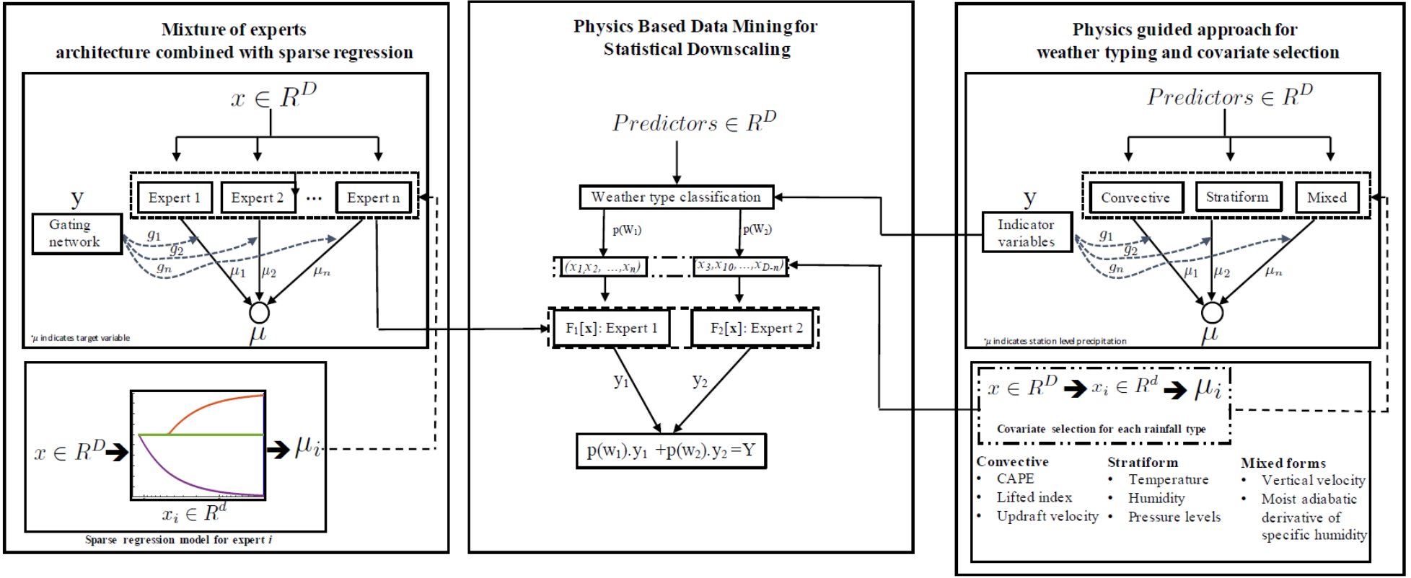
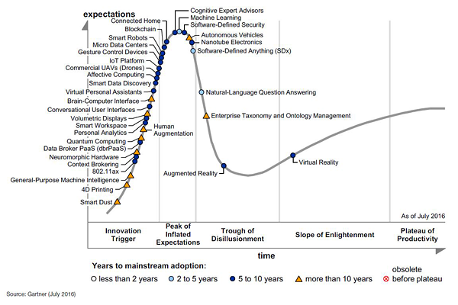
Methods to blend the power of physics and data via PHYSICS GUIDED DATA SCIENCE
Islam, Shafiqul, and Kaveh Madani. Water Diplomacy in Action: Contingent Approaches to Managing Complex Water Problems. Anthem Press, 2017.
Notes:
Work has happened in silos. This uses both to guide and inform each other.
Some concepts built jointly
Fig 1 (Top): Physics-guided data mining for statistical downscaling. In the context of precipitation, the rainfall types can broadly be classified as a) Convective b) Statiform; and c) Mixed form of the two. The indicator variables governing these processes may be used as a “gating function” to assign conditional probability of occurrence to the processes. These indicator variable may or may not form the subset of candidate predicators. The role of these variables is solely to assign the likelihood to all possible weather types. i.e. A possible solution framework with the inclusion of statistical transfer function from air temperature to precipitation extremes in the Bayesian framework which, in-turn, assigns the weight to GCMs based on three components: (a) skill based on past observation (b) consensus; and (c) skill in modelling physical processes and ancillary variables.
Fig 2 (Bottom Left): Gartner hype cycle: machine learning is at the peak of the cycle
Fig 3 (Bottom Right): This figure demonstrates that the C-C best serves as the guiding principle for this type of research, reinforcing the notion that other mechanisms that are less well understood may dominate in some regions and seasons. Opportunities exist to gauge the reliability of GCMs by measuring their ability to replicate the regional properties of an observational temperature-precipitation extremes relationship. This represents a prime example of where data-driven methods can be guided by our current understanding of physics.

Slide 19
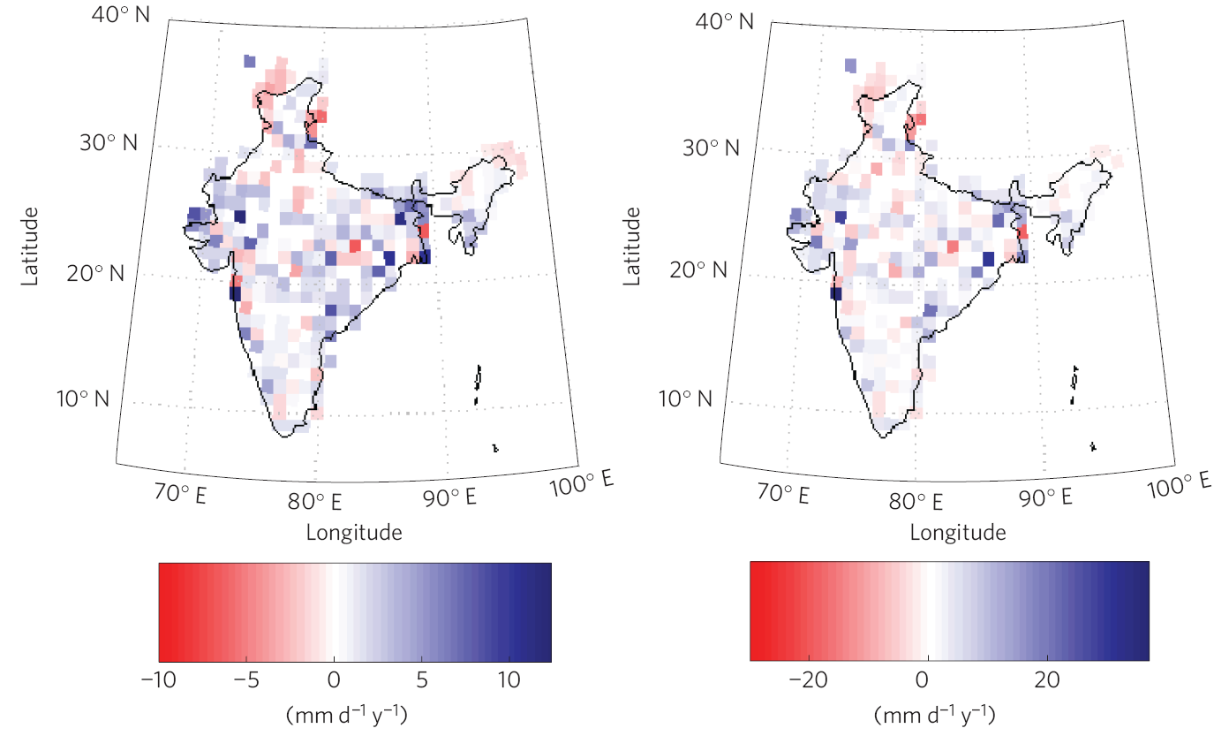
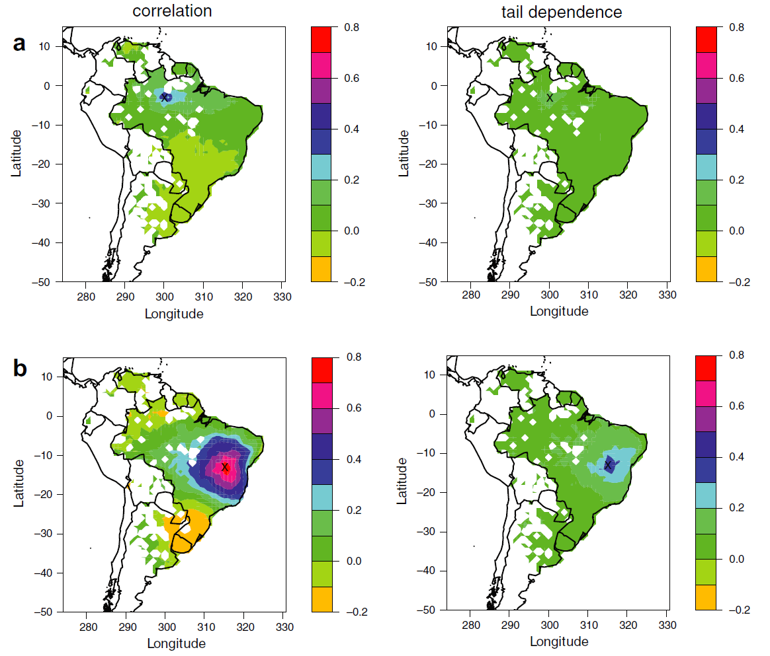
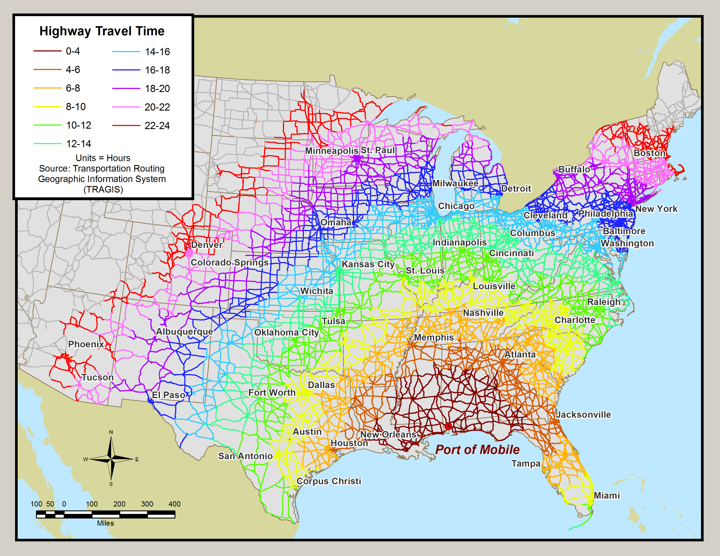

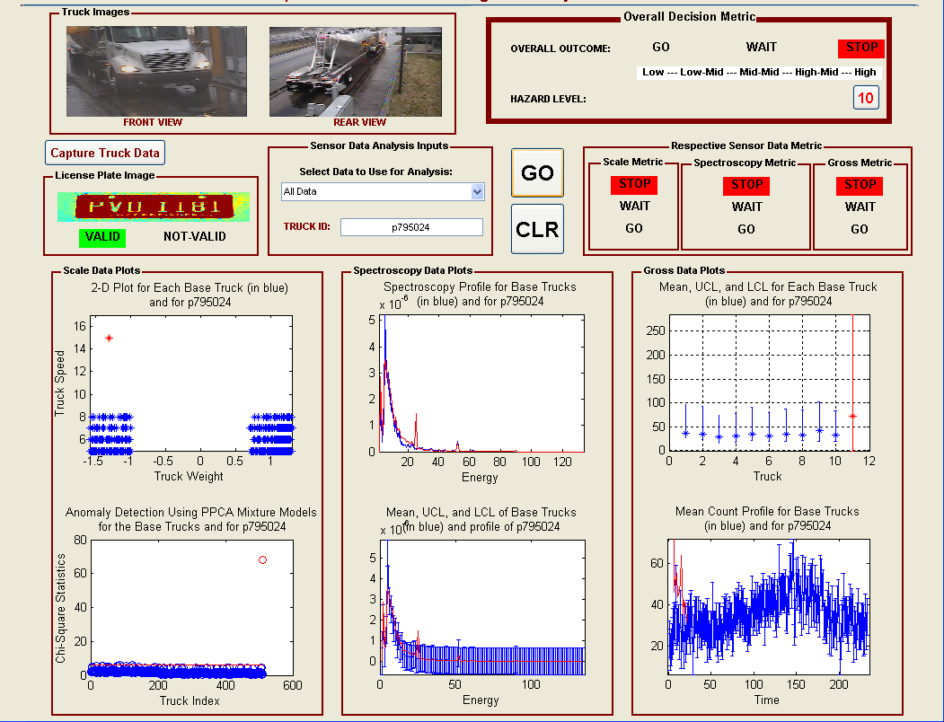
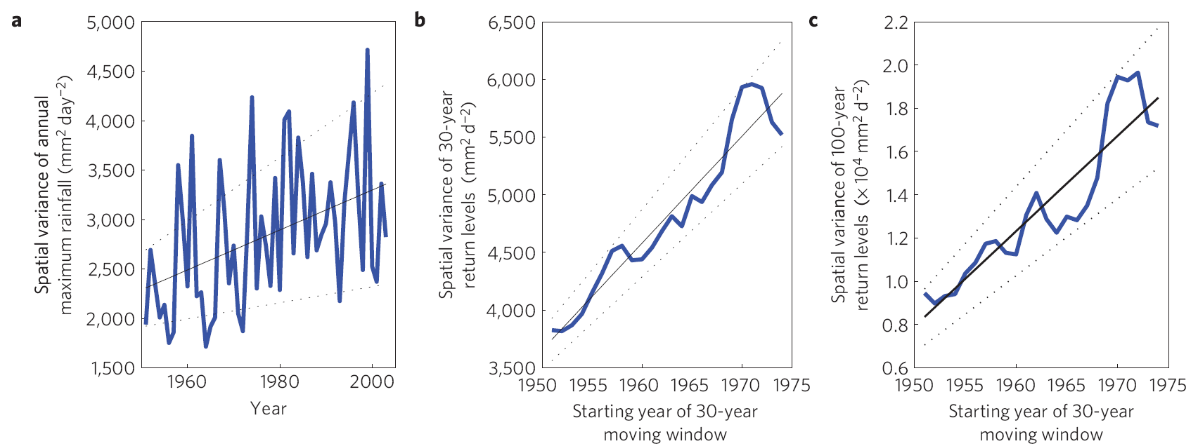
Advances in rare events learning motivated for the “BIG DATA – small data” problem
Ganguly A, Kodra E, Agrawal A, Banerjee A, et al (2014) Toward enhanced understanding and projections of climate extremes using physics-guided data mining techniques. Nonlinear Processes in Geophysics 21: doi:10.5194/npg-21-777-2014
Kuhn G, Khan S, Ganguly A, and Branstetter M (2007). Geospatial–temporal dependence among weekly precipitation extremes with applications to observations and climate model simulations in South America. Advances in Water Resources 30(12): https://doi.org/10.1016/j.advwatres.2007.05.006
Notes:
Other theme: start with large datasets but looking for unusual data
Cite the transportation paper
Fig 1) Statistical downscaling is complementary to dynamical downscaling and usually requires significantly fewer computational resources. Here we perform statistical downscaling by relating fine resolution rainfall observations with a large set of climate model-simulated variables and using the relation first to validate on unseen data and then for precise projections in the future. The results show how an ensemble of five runs of the Canadian Centre for Climate Modelling and Analysis (CCCMA) Coupled Global Climate Model 3.1 (CGCM3.1). T47 GCM is validated for 20th century simulations, and then applied to the Special Report on Emissions Scenarios (SRES) A2 scenario for 2070–2099 (bottom two maps in d). Geographical heterogeneity in the trends of rainfall extremes over India, shown in a recent observation-based study, is suggested after downscaling but not directly from the global model runs (Ghosh et al., 2011)
Fig 2 (Middle top): Observed data: correlation and tail dependence between one specific grid (marked with a cross) in the (a) Amazon basin; (b) Brazilian highlands; (c) Mato Grasso Plateau; Left column: correlation. Right column: tail dependence.
Fig 3 (Right): The extensive experimentation using 75 simulated cases grouped into 11 scenarios indicates the potentials of the approach in detecting anomalies under various conditions. The different conditions investigated are: physical shielding of the SNM with a metal object; using a smaller percentage of the SNM within legitimate cargo; shielding of the SNM with legitimate commercial cargo; shielding of the SNM with legitimate NORMs of different compositions.The results of the various detection processes indicate that the use of gross count data alone (as it is currently being done) may not be sufficient for detecting trucks that are sources of security hazards on the highways. This supports previous conclusions in the literature that energy (spectroscopy) data are also needed for effective discrimination between SNMs and NORMs in commercial trucks. In general, concomitantly using both types of radiation data could provide more insights than separately using each of them; our approach can be used for both data types. Finally, in all considered cases, we see that our approach performs better than the mean- and total count-based methods; furthermore, the transformation of the original data to WCs significantly improves the performance of our approach.
Fig 4 (bottom left): Trends in the spatial variability of rainfall extremes based on all grids over India with 1951–2003 data for annual maximum rainfall (a), and 30-year (b) and 100-year (c) return levels.

Slide 20
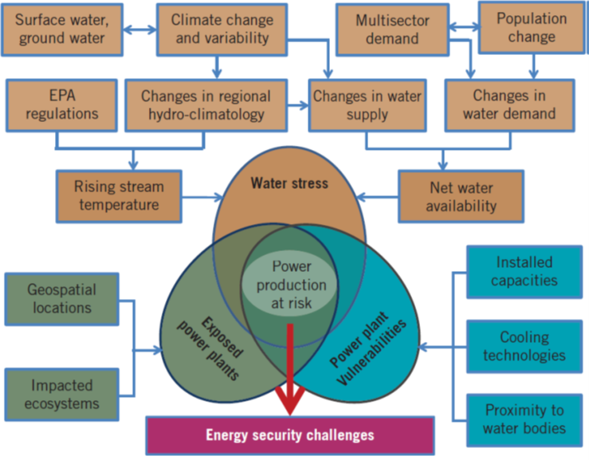
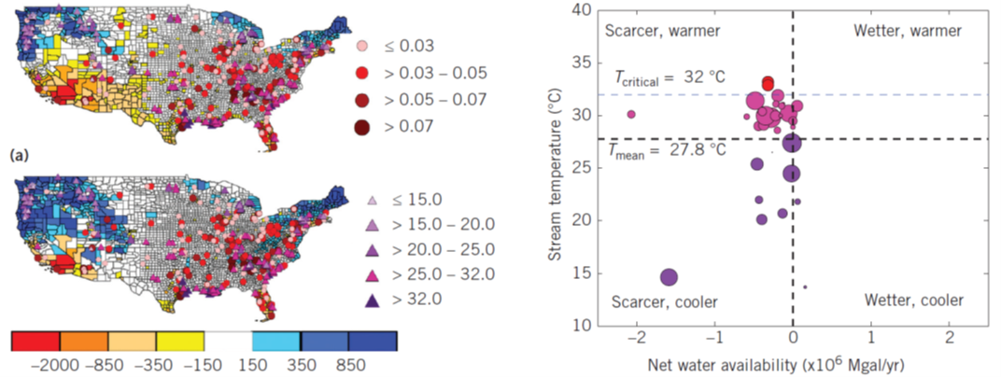
Power Production at Risk from Scarcer and Warmer Waters with Climate and Population
Ganguli P, Kumar D, and Ganguly A (2017). US Power Production at Risk from Water Stress in a Changing Climate. Nature Scientific Reports 7: doi:10.1038/s41598-017-12133-9
Ganguly A, Kumar D, Ganguli P, Short G, and Klausner J (2015) Climate Adaptation Informatics: Water Stress on Power Production. Computer Science and Engineering 17(6): 10.1109/MCSE.2015.106
Notes:
Power production but relates to power grids and distribution
Fig 1) Schematic of the interaction among hazards (water stress), exposure (power plants), and vulnerability (production capacities) resulting in power production at risk. The figure is a significantly adapted version of the Figure SPM.l of the Intergovernmental Panel on Climate Change Working Group II's fifth assessment report's summary for policymakers (page 3) on impacts, adaptation, and vulnerability.
Fig 2) Spatial patterns of net water availability (1,000 Mgal/year) in the 2030s (2028 to 2032) for two plausible future conditions: (a) ensemble minimum and (b) ensemble median. The six-member ensemble includes two initial conditions and three models. Wet-cooled thermoelectric power plants (with capacity 2 0.02 Quad/year are shown as solid circles, where the sizes of the circles represent generation capacities (Quad/year) of the power plants (https://en.wikipedia.org/wiki/Quad_(unit)). Projected maximum stream temperatures (OC) in the 2030s at the US Geological Survey (USGS) stream gauge locations are shown as triangles. (c) A scatter plot shows US power production at risk owing to projections of decreasing water availability and increasing stream temperature. Bubble sizes represent power plants' existing capacities, with colors representing the power production at risk. The horizontal line at the top shows the allowable temperature threshold for water temperature to be released to water bodies.

Slide 21
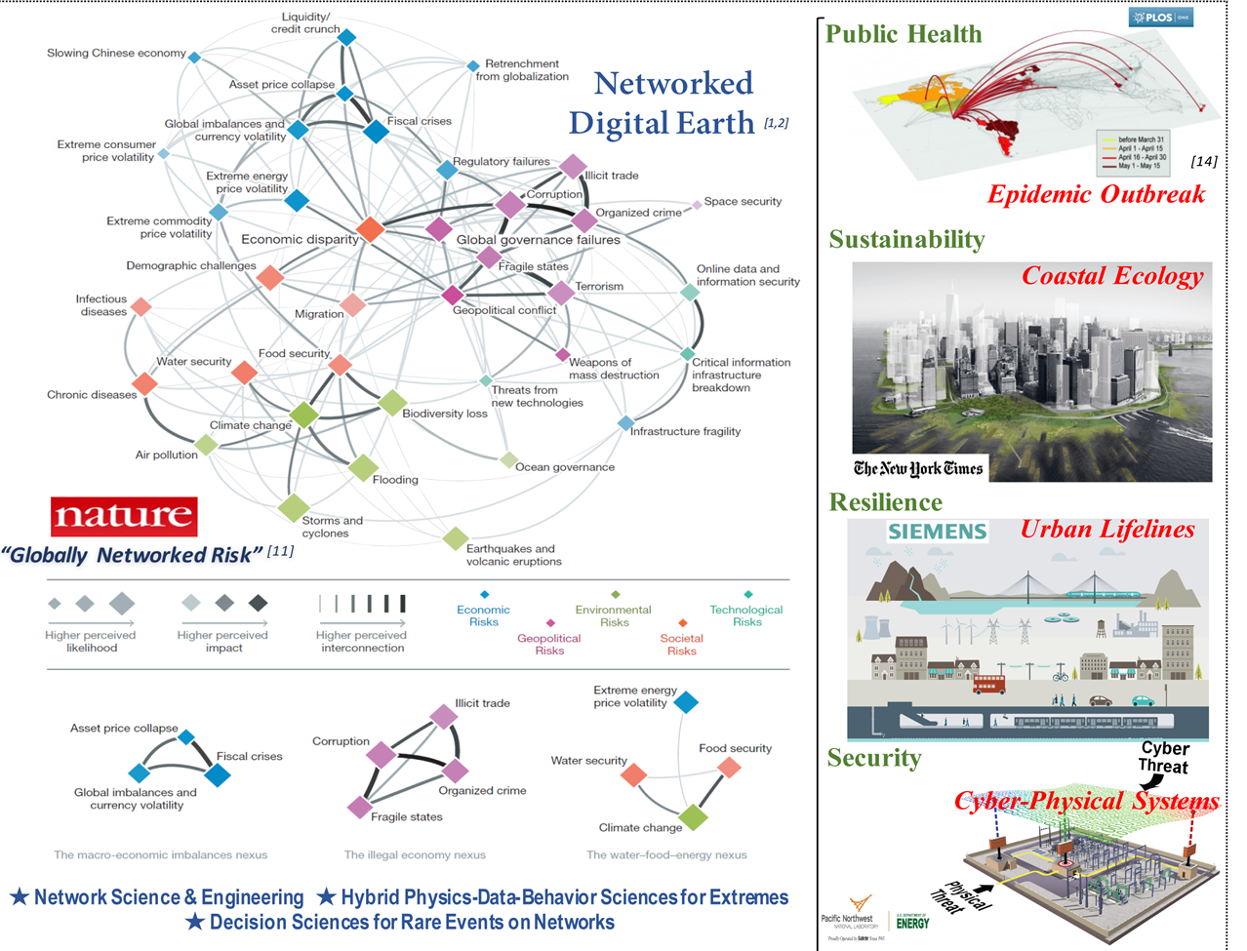
We propose the Networked Digital Earth for harnessing complexity and designing policy

Slide 22












CONTRIBUTORS: SDS Lab (and risQ) Members
Auroop Ganguly
PI, Professor
RisQ CoFounder
Udit Bhatia
PhD Candidate
TJ Vandal
PhD Candidate
Lizzy Warner
PhD Student
Bharat Sharma
PhD Student
Kevin Clark
PhD Candidate, Volpe
Babak Fard
PhD Candidate
Shashank Konduri
PhD Candidate
Kate Duffy
PhD Student
Colin Sullivan
RisQ COO
Evan Kodra
Alumnus, RisQ CEO
Hanieh Hassanzadeh
Post-Doc RA
And a special thanks to all SDS Lab alumni as well as collaborators from outside institutions
Notes:
Alumni (+ Oakridge) mention and more information link (university website and lab website)

Slide 23
Big Data, Downscaling, and Interdisciplinary Approaches to Understanding Extreme Events
CMO-BIRS Synthesis of Statistics, Data Mining and Environmental Sciences in Pursuit of Knowledge Discovery
Presenter: Lizzy Warner
PhD Student, Interdisciplinary Engineering
Sustainability and Data Sciences Laboratory
www.northeastern.edu/sds
Northeastern University
Doctoral Student Research Analyst
Global Resilience Institute (GRI)
globalresilience.northeastern.edu

