Slide 1
Lower Bound on the Step Complexity of Anonymous Binary Consensus
Hagit Attiya Technion
Ohad Ben-Baruch Ben-Gurion University
Danny Hendler Ben-Gurion University

Slide 2

Obstruction-free binary consensus
Every process starts with 0 or 1 input
Agreement: all deciding processes agree on same value
Validity: returned value is the input of some process
Obstruction-freedom: Every eventually step-contention free process must return
Notes:
Consensus is one of the most fundamental problems in distributed computing.
We will focus on obstruction free binary consensus:
Every process starts with input 0 or 1. All deciding processes must agree on the same value, which must be a input of one of the processes. In addition, the obstruction-free property requires that a process running solo (without any other process interfering it) starting from any configuration will finish its run.

Slide 3
Time complexity measure
Worst case number of steps is infinite
Fischer, Lynch, Paterson, JACM ’85
Solo step complexity
Attiya, Guerraoui, Hendler, Kuznetsov, JACM '09
Maximum number of steps performed by a process running solo (from any configuration) until it decides
Notes:
In 85, FLP proved that there exists no wait-free algorithm solving consensus using read and write only. This implies that the worst case number of steps a process may take is infinite, and is therefore not a meaningful complexity measure.
As an alternative we will consider the solo step complexity, presented by Attiya et al, where we count the maximum number of steps performed by a process running solo (from any configuration) until it decides.

Slide 4
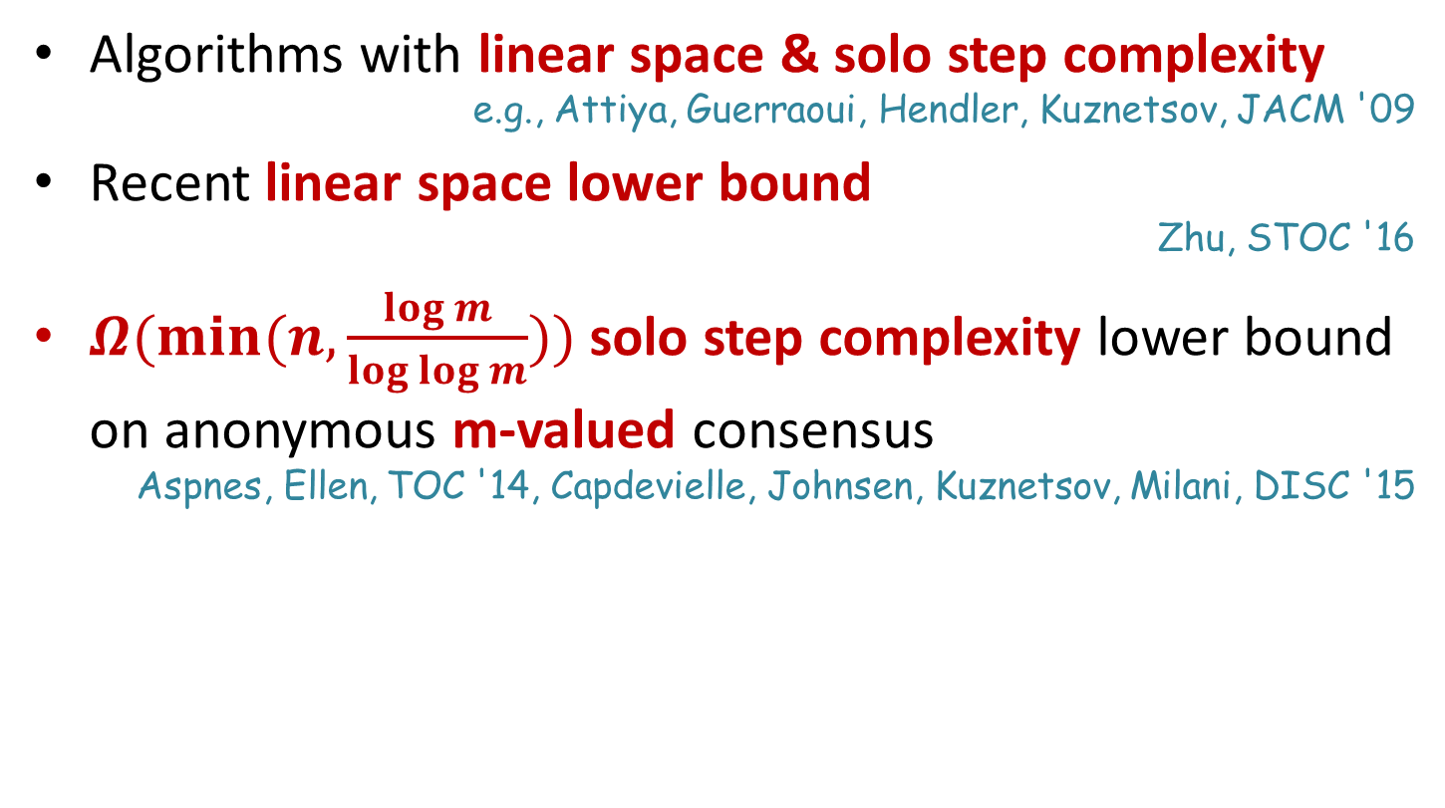
What’s Known?
Algorithms with linear space & solo step complexity
e.g., Attiya, Guerraoui, Hendler, Kuznetsov, JACM '09
Recent linear space lower bound
Zhu, STOC '16
$Ω(min⁡(n, \frac{\log{m}}{\log{\log{m}}}))$ solo step complexity lower bound on anonymous m-valued consensus
Aspnes, Ellen, TOC '14, Capdevielle, Johnsen, Kuznetsov, Milani, DISC '15
Notes:
What do we know about the complexity of obstruction-free consensus?
There exists algorithms with linear space & solo step complexity.
This is tight is terms of space, due to a recent linear space lower bound by Zhu.
Aspens and Ellen presented a lower bound for the solo step complexity of min(…), for anonymous obstruction-free consensus, where the input domain is of size m. This lower bound degenerates to a trivial one in the binary case.

Slide 5

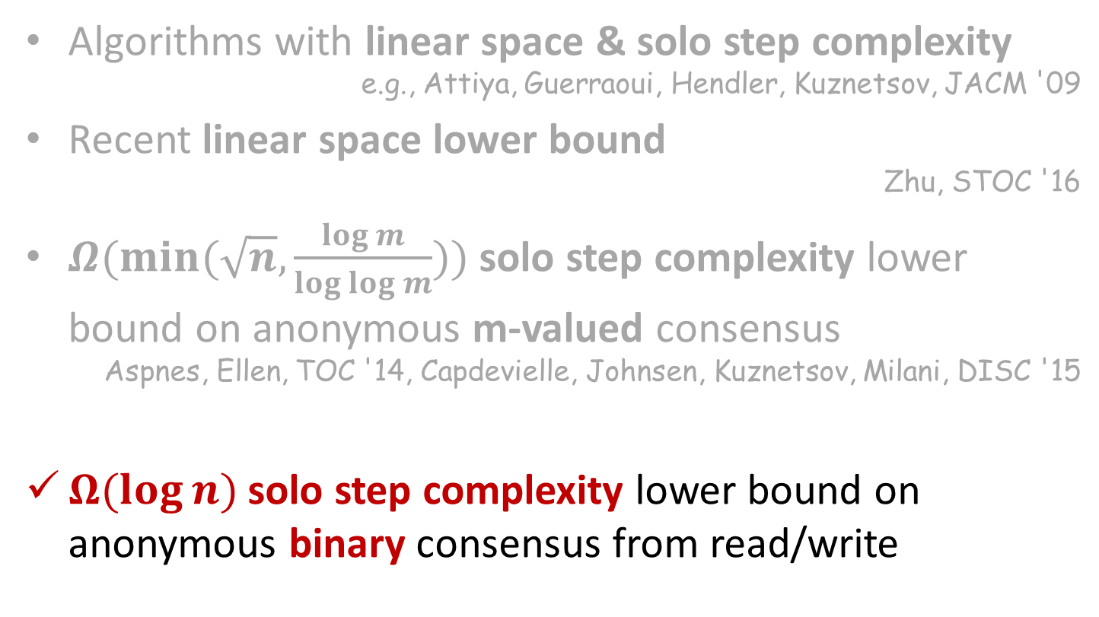
Our Contributions
Algorithms with linear space & solo step complexity
e.g., Attiya, Guerraoui, Hendler, Kuznetsov, JACM '09
Recent linear space lower bound
Zhu, STOC '16
$Ω(min⁡(\sqrt{n}, \frac{\log{m}}{\log{\log{m}}}))$ solo step complexity lower bound on anonymous m-valued consensus
Aspnes, Ellen, TOC '14, Capdevielle, Johnsen, Kuznetsov, Milani, DISC '15
$Ω(\log{n})$ solo step complexity lower bound on anonymous binary consensus from read/write
Notes:
We will present a lower bound of log n for the case of anonymous binary consensus

Slide 6
Talk Outline
Preliminaries
Space lower bound
Time lower bound
Summary
Notes:
We will start with a simple $Ω\left(\sqrt{n}\right)$ space lower bound.
The construction in the space lower bound will be used later to obtain the time lower bound.

Slide 7

Proof Idea
Construct a sequence of executions ${\left\{\text{α}\text{i}\text{γ}\text{i}\right\}}_{1}^{L}$
with longer and longer block writes $\text{γ}\text{i}$
Notes:
The main idea is to construct a sequence of executions $α_{i}γ_{i}$, where $γ_{i}$ are larger and larger block writes

Slide 8
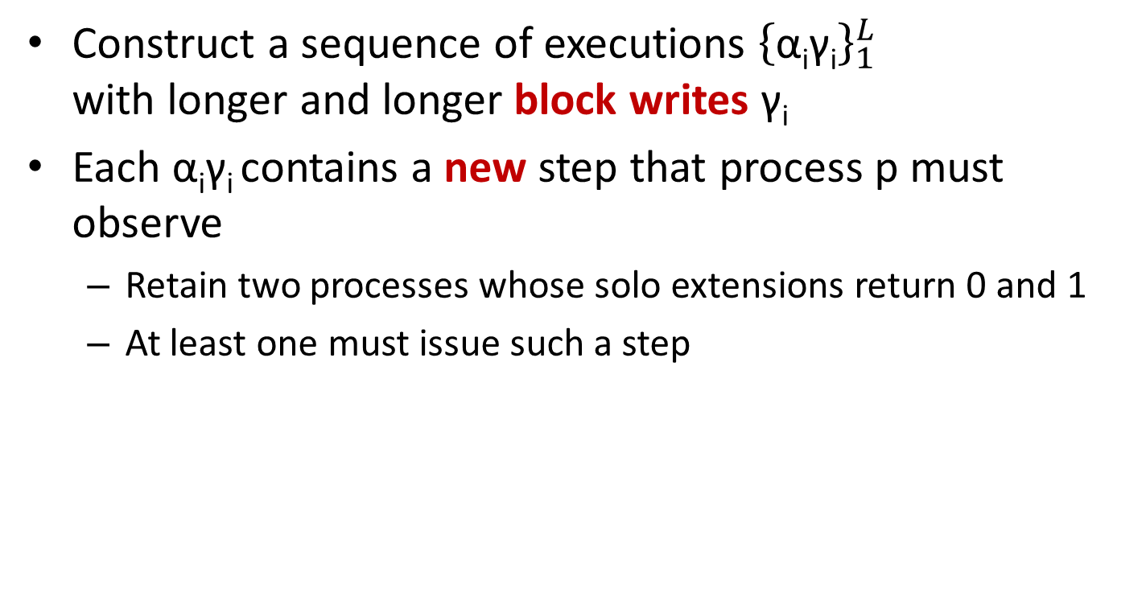
Proof Idea
Construct a sequence of executions ${\left\{\text{α}\text{i}\text{γ}\text{i}\right\}}_{1}^{L}$
with longer and longer block writes $\text{γ}\text{i}$
Each $\text{α}\text{i}\text{γ}\text{i}$contains a new step that process p must observe
  Retain two processes whose solo extensions return 0 and 1
  At least one must issue such a step
Notes:
For that, we fix a process p, and each execution contains a new step that process p must observe.
In order to achieve that, we retain two other processes whose solo extensions return 0 and 1, and therefore at least one of them must issue such a step.

Slide 9

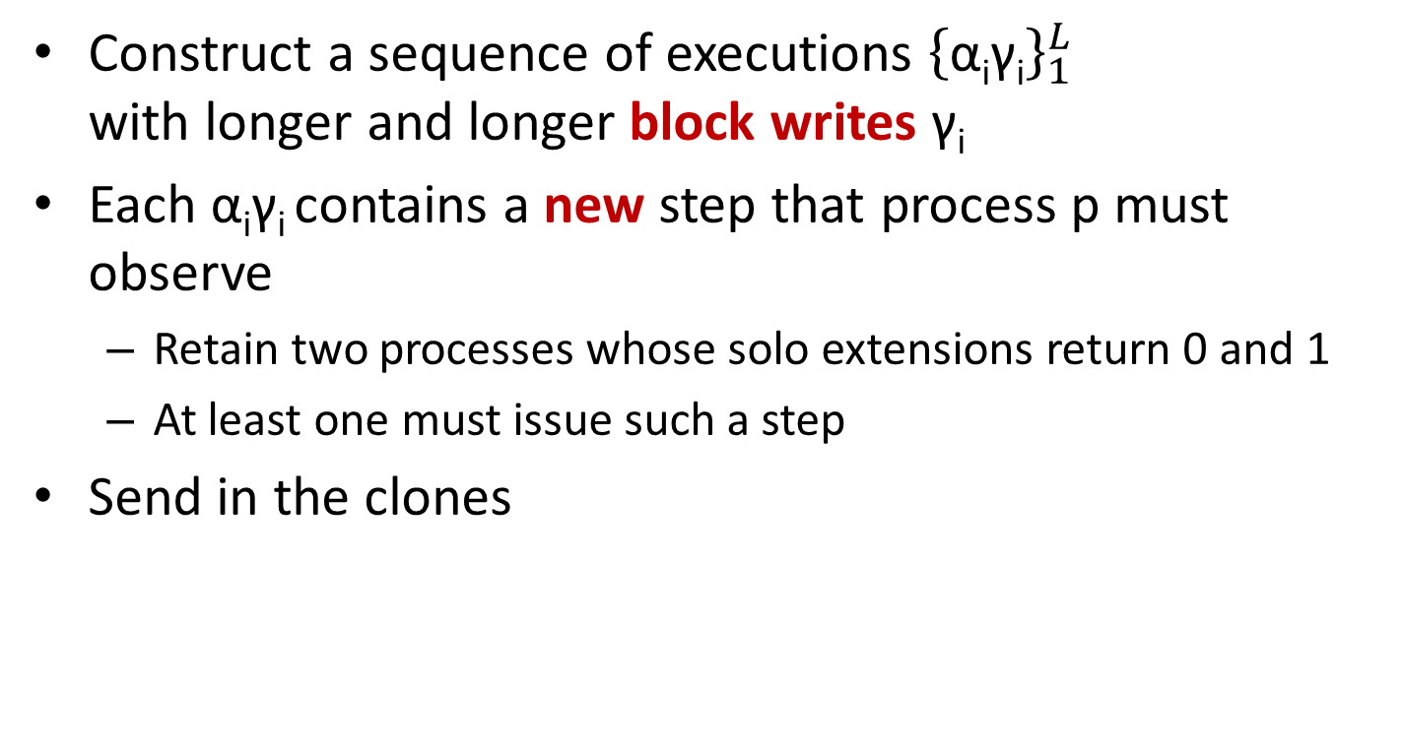
Proof Idea
Construct a sequence of executions ${\left\{\text{α}\text{i}\text{γ}\text{i}\right\}}_{1}^{L}$
with longer and longer block writes $\text{γ}\text{i}$
Each $\text{α}\text{i}\text{γ}\text{i}$contains a new step that process p must observe
  Retain two processes whose solo extensions return 0 and 1
  At least one must issue such a step
Send in the clones
Notes:
The algorithm is anonymous, meaning that processes do not have access to process-identifiers and consequently, the steps they perform depend only on
their initial inputs and on the responses they receive from the operations they apply.
Therefore, different processes with the same input run the same algorithm, and thus they can run in lockstep with each other. we call such processes clones.
We will use clones in the construction.

Slide 10
Construction Sketch: Base Case
Fix process p with input 0
Notes:
Along the construction we fix a process p with input 0

Slide 11
Construction Sketch: Base Case
Fix process p with input 0
p runs solo, returns 0
C₀
Notes:
p solo run will return 0.

Slide 12

Construction Sketch: Base Case
Fix process p with input 0
Let $q$ be a process with input 1
p runs solo, returns 0
C₀
Notes:
Let q be a process with input 1.

Slide 13
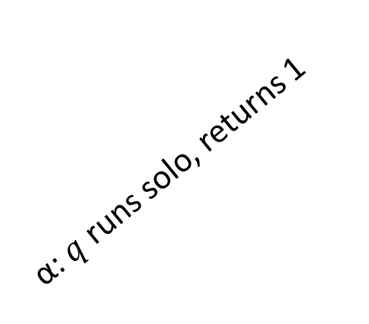
Construction Sketch: Base Case
Fix process p with input 0
Let $q$ be a process with input 1
C₁
α: $q$ runs solo, returns 1
p runs solo, returns 0
C₀
Notes:
Then a solo run $α$ by q will return 1

Slide 14
Construction Sketch: Base Case
Fix process p with input 0
Let $q$ be a process with input 1
C₁
p runs solo, returns 1
α: $q$ runs solo, returns 1
p runs solo, returns 0
C₀
Notes:
By the agreement property, a solo run of p after $α$ will return 1 as well

Slide 15
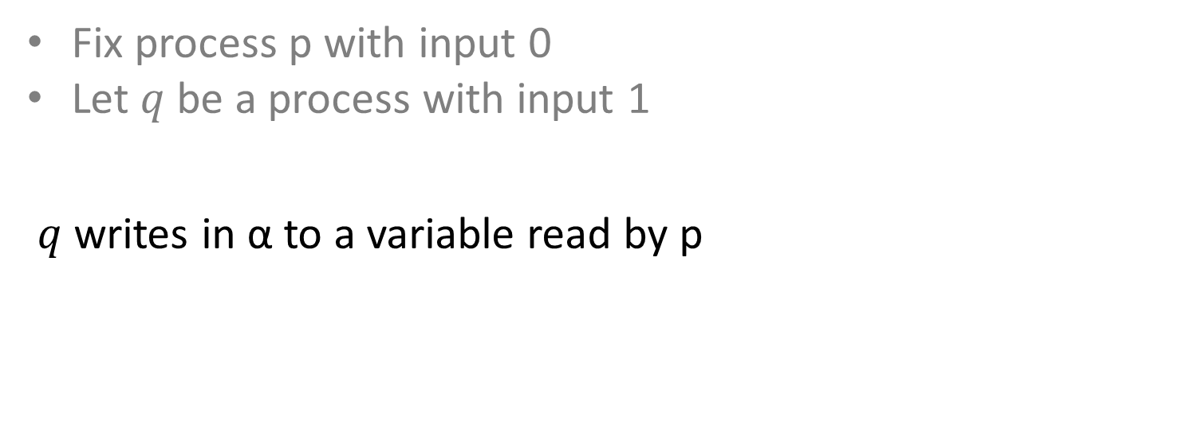
Construction Sketch: Base Case
Fix process p with input 0
Let $q$ be a process with input 1
$q$writes in α to a variable read by p
C₁
p runs solo, returns 1
α: $q$ runs solo, returns 1
p runs solo, returns 0
C₀
Notes:
Therefore $q$ must write in $α$ to a variable read by p

Slide 16
Construction Sketch: Base Case
Fix process p with input 0
Let $q$ be a process with input 1
$q$writes in α to a variable read by p
C₁
α= α'e α''
p runs solo, returns 1
α: $q$ runs solo, returns 1
e
p runs solo, returns 0
C₀
R₁
Notes:
Let e be the first such write.
Then e writes to a variable $R_{1}$ read by p in its solo run.

Slide 17
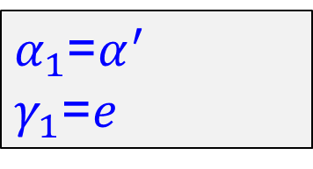
Construction Sketch: Base Case
Fix process p with input 0
Let $q$ be a process with input 1
$q$writes in α to a variable read by p
$α_{1}$=$α^{′}$
$γ_{1}$=$e$
C₁
α= α'e α''
p runs solo, returns 1
α: $q$ runs solo, returns 1
e
p runs solo, returns 0
C₀
R₁
Notes:
We define $α_{1}$ to be $α′$, the prefix of $α$ until the write $e$, and $γ_{1}$ to be $e$. Then $γ_{1}$ is a block write of size 1.

Slide 18
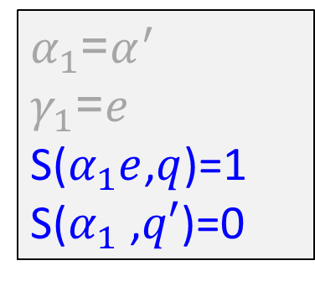
Construction Sketch: Base Case
Fix process p with input 0
Let $q$ be a process with input 1
$q$writes in α to a variable read by p
$α_{1}$=$α^{′}$
$γ_{1}$=$e$
S($α_{1}e$,$q$)=1
S($α_{1}$ ,$q′$)=0
C₁
α= α'e α''
p runs solo, returns 1
α: $q$ runs solo, returns 1
e
A clone of p
p runs solo, returns 0
C₀
R₁
Notes:
The function S denote the solo valency of a process after an execution, that is the value returned by this process if it is to perform a solo run starting from that execution.
For example, a solo run of $q$ starting at $α_{1}e$ will return 1, as this is the execution $α$, while a clone of $p$ running from $α_{1}$ will return 0, since $e$ is the first write to a variable read by p. This also shows that $α_{1}$ is bivalent.

Slide 19
2nd Construction Step
Fix process p with input 0
Let $q$ be a process with input 1
$q$writes in α to a variable read by p
$α_{1}$=$α^{′}$
$γ_{1}$=$e$
S($α_{1}e$,$q$)=1
S($α_{1}$ ,$q′$)=0
C₁
α= α'e α''
p runs solo, returns 1
α: $q$ runs solo, returns 1
e
A clone of p
p runs solo, returns 0
C₀
R₁
Notes:
For the second step, we want to “force” a write to another variable read by p

Slide 20

2nd Construction Step
Let S($α_{1}$e,p) = v
$α_{1}$=$α^{′}$
$γ_{1}$=$e$
S($α_{1}e$,$q$)=1
S($α_{1}$ ,$q′$)=0
e
α₁
e
S(C₁,p)=v
C₀
C'₀
C₁
R₁
Notes:
Let v be the return value of p in a solo run after $α_{1}e$

Slide 21

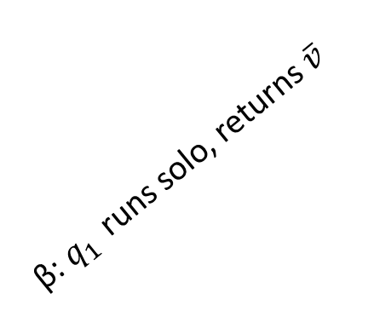
2nd Construction Step
Let S($α_{1}$e,p) = v
We can select $q_{1}$ whose solo run returns $\overline{v}$
$α_{1}$=$α^{′}$
$γ_{1}$=$e$
S($α_{1}e$,$q$)=1
S($α_{1}$ ,$q′$)=0
C₂
β: $q_{1 }$ runs solo, returns $\overline{v}$
e
α₁
e
S(C₁,p)=v
C₀
C'₀
C₁
R₁
Notes:
Then we select the process $q_{1}$ with the other return value, and the run $β$ in which it returns $\overline{v}$.

Slide 22

2nd Construction Step
Let S($α_{1}$e,p) = v
We can select $q_{1 }$ whose solo run returns $\overline{v}$
p's solo run from C₂ returns $\overline{v}$ as well
$α_{1}$=$α^{′}$
$γ_{1}$=$e$
S($α_{1}e$,$q$)=1
S($α_{1}$ ,$q′$)=0
C₂
β: $q_{1 }$ runs solo, returns $\overline{v}$
e
α₁
e
S(C₁,p)=v
C₀
C'₀
C₁
R₁
Notes:
By the agreement property, p solo run after $β$ will also return $\overline{v}$

Slide 23

2nd Construction Step
Let S($α_{1}$e,p) = v
We can select $q_{1 }$ whose solo run returns $\overline{v}$
p's solo run from C₂ returns $\overline{v}$ as well
$α_{1}$=$α^{′}$
$γ_{1}$=$e$
S($α_{1}e$,$q$)=1
S($α_{1}$ ,$q′$)=0
p runs solo, returns $\overline{v}$
C₂
β: $q_{1 }$ runs solo, returns $\overline{v}$
e
α₁
e
S(C₁,p)=v
C₀
C'₀
C₁
R₁
Notes:
Therefore p must read in its run a variable written in $β$

Slide 24
2nd Construction Step
Let S($α_{1}$e,p) = v
We can select $q_{1 }$ whose solo run returns $\overline{v}$
p's solo run from C₂ returns $\overline{v}$ as well
Can we infer that β writes to a register other than R₁?
$α_{1}$=$α^{′}$
$γ_{1}$=$e$
S($α_{1}e$,$q$)=1
S($α_{1}$ ,$q′$)=0
p runs solo, returns $\overline{v}$
C₂
β: $q_{1 }$ runs solo, returns $\overline{v}$
e
α₁
e
S(C₁,p)=v
C₀
C'₀
C₁
R₁
Notes:
We would now like to claim that $q_{1 }$ must write to a variable other than R1, but what if β starts with event e?
In this case, further writes to R1 in β may convey information to p so p may know it no longer has to return v by reading only R1.

Slide 25
2nd Construction Step
Let S($α_{1}$e,p) = v
We can select $q_{1 }$ whose solo run returns $\overline{v}$
p's solo run from C₂ returns $\overline{v}$ as well
Can we infer that β writes to a register other than R₁?
If β starts with e, we re-issue e after β using a clone
$α_{1}$=$α^{′}$
$γ_{1}$=$e$
S($α_{1}e$,$q$)=1
S($α_{1}$ ,$q′$)=0
p runs solo, returns $\overline{v}$
C₂
β: $q_{1 }$ runs solo, returns $\overline{v}$
e
α₁
e
S(C₁,p)=v
C₀
C'₀
C₁
R₁
Notes:
In this case, we can use a clone of $q_{1 }$ to reissue e after β, thus proving that β must write to some R2 as well.

Slide 26
2nd Construction Step
Let S($α_{1}$e,p) = v
We can select $q_{1 }$ whose solo run returns $\overline{v}$
p's solo run from C₂ returns $\overline{v}$ as well
Can we infer that β writes to a register other than R₁?
If β starts with e, we re-issue e after β using a clone
$α_{1}$=$α^{′}$
$γ_{1}$=$e$
S($α_{1}e$,$q$)=1
S($α_{1}$ ,$q′$)=0
p runs solo, returns $\overline{v}$
e by clone
C₂
β: $q_{1 }$ runs solo, returns $\overline{v}$
p
~
e
α₁
e
S(C₁,p)=v
C₀
C'₀
C₁
R₁
Notes:
If β only writes to R1, then C2 and C1 are indistinguishable to p, in contradiction to the different values returned by p after each configuration.

Slide 27
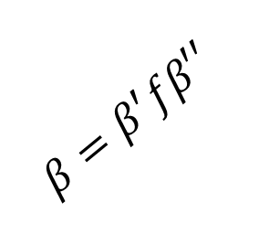
2nd Construction Step
Let S($α_{1}$e,p) = v
We can select $q_{1 }$ whose solo run returns $\overline{v}$
p's solo run from C₂ returns $\overline{v}$ as well
Can we infer that β writes to a register other than R₁?
If β starts with e, we re-issue e after β using a clone
$α_{1}$=$α^{′}$
$γ_{1}$=$e$
S($α_{1}e$,$q$)=1
S($α_{1}$ ,$q′$)=0
p runs solo, returns $\overline{v}$
e by clone
C₂
$$β=β^{′}fβ′′$$
β: $q_{1 }$ runs solo, returns $\overline{v}$
p
~
f
e
α₁
e
S(C₁,p)=v
C₀
C'₀
C₁
R₂
R₁
Notes:
Therefore, q must write to a different variable R2 in $β$ such that p reads R2 even after covering R1 with the write e.

Slide 28
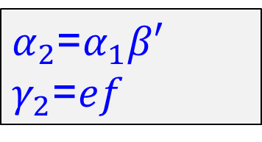
2nd Construction Step
Let S($α_{1}$e,p) = v
We can select $q_{1 }$ whose solo run returns $\overline{v}$
p's solo run from C₂ returns $\overline{v}$ as well
Can we infer that β writes to a register other than R₁?
If β starts with e, we re-issue e after β using a clone
$α_{2}$=$α_{1}β′$
$γ_{2}$=$ef$
p runs solo, returns $\overline{v}$
e by clone
C₂
$$β=β^{′}fβ′′$$
β: $q_{1 }$ runs solo, returns $\overline{v}$
p
~
f
e
α₁
e
S(C₁,p)=v
C₀
C'₀
C₁
R₂
R₁
Notes:
Therefore, q must write to a different variable R2 in $β$ such that p reads R2 even after covering R1 with the write e.

Slide 29
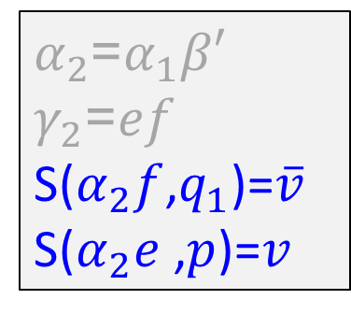
2nd Construction Step
Let S($α_{1}$e,p) = v
We can select $q_{1 }$ whose solo run returns $\overline{v}$
p's solo run from C₂ returns $\overline{v}$ as well
Can we infer that β writes to a register other than R₁?
If β starts with e, we re-issue e after β using a clone
$α_{2}$=$α_{1}β′$
$γ_{2}$=$ef$
S($α_{2}f$,$q_{1}$)=$\overline{v}$
S($α_{2}e$ ,$p$)=$v$
p runs solo, returns $\overline{v}$
e by clone
C₂
$$β=β^{′}fβ′′$$
β: $q_{1 }$ runs solo, returns $\overline{v}$
p
~
f
e
α₁
e
S(C₁,p)=v
C₀
C'₀
C₁
R₂
R₁
Notes:
Therefore, q must write to a different variable R2 in $β$ such that p reads R2 even after covering R1 with the write e.

Slide 30
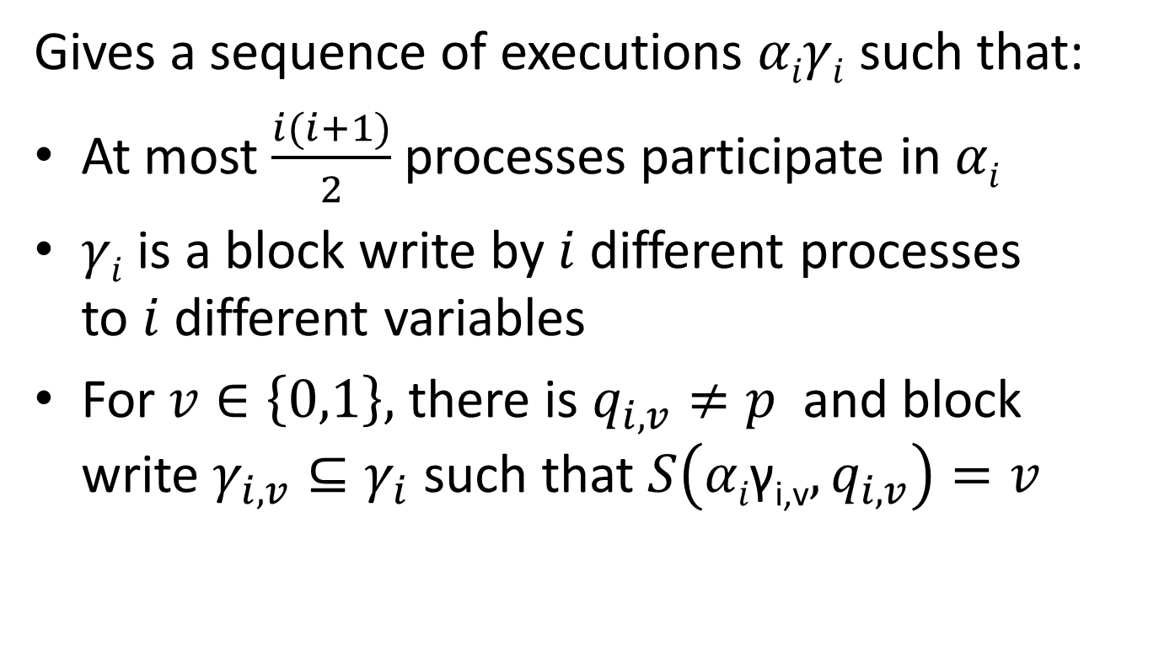
Inductive Construction
Gives a sequence of executions $αiγi$ such that:
At most $\frac{i(i+1)}{2}$ processes participate in $αi$
$γi$ is a block write by $i$ different processes
to $i$ different variables
For $v∈\left\{0,1\right\},$ there is $q_{i,v}≠p$ and block write $γ_{i,v}⊆γ_{i}$ such that $S\left(αi\text{γ}\text{i}\text{,}\text{v},q_{i,v}\right)=v$
Notes:
The induction construction continues this way, generating a sequence of executions $α_{i}γ_{i}$ such that:
1 This is due to the clones we use – at first one clone to reissue the write to R1, then 2 clones to reissue the write to R1 and R2, and so on… This also implies that our construction can proceed for $\sqrt{n}$ steps.
2 Therefore, in the last step we have a block write to $√n$ different variables, proving the space lower bound.
Notice that we have $√n$ different writes that p must observe, but this does not mean p has to read all of them in a single execution, so this does not give a time lower bound yet.
3 $α_{i}$ is bivalent – and thus the construction can proceed.

Slide 31
Talk Outline
Preliminaries
Space lower bound
Time lower bound
Summary
Notes:
We now see how the sequence of executions constructed in the space lower bound also implies a time lower bound

Slide 32
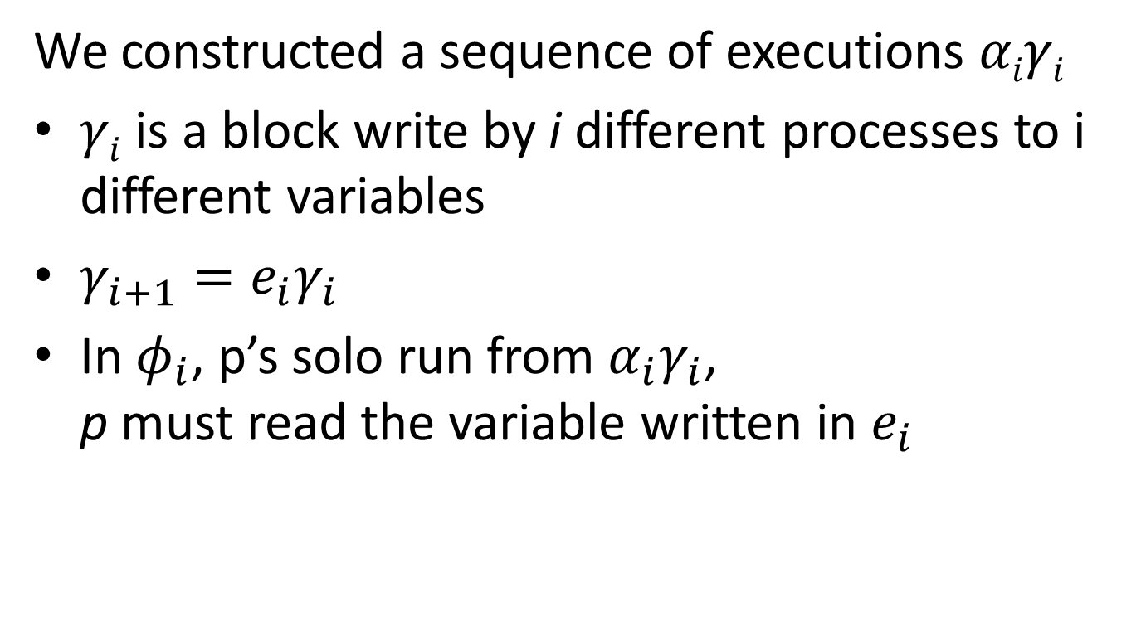
Time Lower Bound
We constructed a sequence of executions $αiγi$
$γi$ is a block write by i different processes to i different variables
$γ_{i+1}=e_{i}γ_{i}$
In $φ_{i}$, p’s solo run from $α_{i}γ_{i}$,
p must read the variable written in $e_{i}$
Notes:
So, we have a sequence of executions $α_{1}γ_{i}$ such that:
1. $γ_{i}$ is a block write of size i
2. $γ_{i+1}$ is the block write $γ_{i}$ with another write $e_{i}$
3. We look at the solo run of p starting at $α_{i}γ_{i}$. We denote this run by $φ_{i}$. Then $e_{i}$ is selected to be such that p must read the variable written in $e_{i}$ along its solo run $φ_{i}$.

Slide 33

Time Lower Bound
We constructed a sequence of executions $αiγi$
$γi$ is a block write by i different processes to i different variables
$γ_{i+1}=e_{i}γ_{i}$
In $φ_{i}$, p’s solo run from $α_{i}γ_{i}$,
p must read the variable written in $e_{i}$
Theorem: one of the $φ_{i}$ has length $\log{\sqrt{n}}=\frac{1}{2}\log{n}$
Notes:
We will prove that one of the $φ_{i}$ is of size $log \sqrt{n}.$

Slide 34









Time Lower Bound
$γ_{i}$ - a block write of size i
$φ_{i}$ - p’s solo run from $α_{i}γ_{i}$
$$p$$
$$γ_{i}$$
$$q_{i}$$
$$φ_{i}$$
1
2
3
4
5
6
Notes:
Lets look on one of the steps in the construction presented.
We have an execution $α_{i}$, and a block write $γ_{i}$ pending after it. $φ_{i}$ is the solo run of p after $α_{i}$. We number the variables in $φ_{i}$ according to their first access in $φ_{i}$, that is, in the solo run of p it first access variable 1, then variable 2, and so on… Some of these variables are covered by $γ_{i}$. For example, variable number 3 is covered, while variable number 2 is not covered.

Slide 35



Time Lower Bound
$q_{i}$ runs until about to write to an uncovered register along the solo run of $p$
$$p$$
$$γ_{i}$$
$$q_{i}$$
$$φ_{i}$$
1
2
3
4
5
6
Notes:
The construction allows a new process $q_{i}$ run until it is about to perform a write $e_{i}$ to a variable read by p, and not covered by $γ_{i}$. So $q_{i}$ will write to one of the variables 2, 4 or 6.
How does this new write will effect the solo run of p?

Slide 36

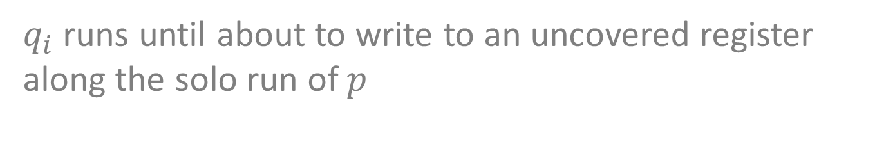


Time Lower Bound
$q_{i}$ runs until about to write to an uncovered register along the solo run of $p$
If we are “lucky”, then $p$’s solo run is extended
$$p$$
$$γ_{i}$$
$$q_{i}$$
$$e_{i}$$
$$φ_{i+1}$$
1
2
3
4
5
6
Notes:
If we are lucky, this write does not effect the other variables accessed in $φ_{i}$. For example, $q_{i}$ will write to variable number 6, and thus p will still accesses all the 6 variables even after the write. This also means that $φ_{i+1}$ is longer then $φ_{i}$.
If this is the case, this will generate a good lower bound, as $φ_{i}$ are getting longer and longer.

Slide 37


Time Lower Bound
$q_{i}$ runs until about to write to an uncovered register along the solo run of $p$
We may be unlucky…
$$p$$
$$γ_{i}$$
$$q_{i}$$
$$e_{i}$$
$$φ_{i+1}$$
1
2
3
4
5
6
3
Notes:
However, it might not be the case. It might be that reading the value written by $e_{i}$ causes p to avoid reading some of the variables of $φ_{i}$. For example, $q_{i}$ writes to variable 2, and this cause p to no longer accesse variables 3-6, but instead read one new variable.
In this case the write $e_{i}$ maked $φ_{i+1}$, the new solo run of p, shorter than $φ_{i}$. Then, we can no longer say that the solo run of p is getting longer and longer, and thus it is not clear how to derive a lower bound.

Slide 38
Time Lower Bound
$q_{i}$ runs until about to write to an uncovered register along the solo run of $p$
We may be unlucky…
Backtracking covering
Ellen, Hendler, Shavit, FOCS '05
$$p$$
$$γ_{i}$$
$$q_{i}$$
$$e_{i}$$
$$φ_{i+1}$$
1
2
3
4
5
6
3
Notes:
The backtracking covering technique is used to derive a lower bound even when this scenario occurs.

Slide 39


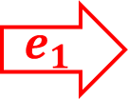





Backtracking Example
p accesses only 3 variables.
How many executions $α_{i}γ_{i}$ can we have?!
$$1$$
$$2$$
$$3$$
$$p$$
$$R_{1}$$
$$R_{2}$$
$$R_{3}$$
Notes:
The intuition behind the lower bound is that if the sequence of executions constructed is long, then we have a sequence of writes to uncovered variables along p’s solo run, and therefore one of p’s solo run must be long.
Consider the following example: assume p access only 3 variables in any of its solo runs. The numbers above represent the order in which it access the variables – in this case it will first access R1, then R2, and then R3.

Slide 40
Backtracking Example
p accesses only 3 variables.
How many executions $α_{i}γ_{i}$ can we have?!
$$1$$
$$2$$
$$3$$
$$p$$
$$e_{1}$$
$$R_{1}$$
$$R_{2}$$
$$R_{3}$$
Notes:
$e_{1}$ writes to a variable along the solo path of p. Assume it is the first variable.
This write may change the solo run of p. However, notice that the first variable p will access will always remain R1.

Slide 41

Backtracking Example
p accesses only 3 variables.
How many executions $α_{i}γ_{i}$ can we have?!
$$1$$
$$2$$
$$3$$
$$p$$
$$e_{1}$$
$$R_{1}$$
$$R_{2}$$
$$R_{3}$$
$$R_{4}$$
Notes:
Assume the solo run changes such that p access $R_{4}$ instead of $R_{3}$

Slide 42
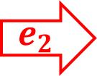
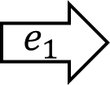

Backtracking Example
p accesses only 3 variables.
How many executions $α_{i}γ_{i}$ can we have?!
$$1$$
$$2$$
$$3$$
$$p$$
$$e_{1}$$
$$R_{1}$$
$$e_{2}$$
$$R_{2}$$
$$R_{3}$$
$$R_{4}$$
Notes:
Now, $e_{2}$ write to an uncovered variable along the new solo run. For example, it writes to $R_{2}$.
Again, this write may cause p to change its solo run. However, p will notice the different only when it will read R2, and thus this write can not affect the variables preceding it – in this case R1.
In addition, notice that the second variable p will access will remain R2 even after the write.

Slide 43

Backtracking Example
p accesses only 3 variables.
How many executions $α_{i}γ_{i}$ can we have?!
$$1$$
$$2$$
$$3$$
$$p$$
$$e_{1}$$
$$R_{1}$$
$$e_{2}$$
$$R_{2}$$
$$R_{3}$$
$$R_{4}$$
$$R_{5}$$
Notes:
So p now access R5 instead of R4.

Slide 44
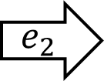
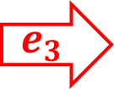
Backtracking Example
p accesses only 3 variables.
How many executions $α_{i}γ_{i}$ can we have?!
$$1$$
$$2$$
$$3$$
$$p$$
$$e_{1}$$
$$R_{1}$$
$$e_{2}$$
$$R_{2}$$
$$R_{3}$$
$$R_{4}$$
$$e_{3}$$
$$R_{5}$$
Notes:
Now, the next write must be the $R_{5}.$ After that, there are no more uncovered variables along the solo run of p, and we can not proceed with the construction.

Slide 45
Backtracking Example
p accesses only 3 variables.
How many executions $α_{i}γ_{i}$ can we have?!
$$1$$
$$2$$
$$3$$
$$p$$
$$R_{1}$$
$$R_{2}$$
$$R_{3}$$
Notes:
It is easy to see that performing the writes in the same order as binary counting from 0 to 7, is the most efficient way, and the only way to accommodate 7 such executions.

Slide 46

Backtracking Example
p accesses only 3 variables.
How many executions $α_{i}γ_{i}$ can we have?!
$$1$$
$$2$$
$$3$$
$$p$$
$$R_{1}$$
$$R_{2}$$
$$e_{1}$$
$$R_{3}$$
Notes:
The first write in the sequence, $e_{1}$, will go to R3, the last variable p access in its solo run

Slide 47
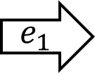
Backtracking Example
p accesses only 3 variables.
How many executions $α_{i}γ_{i}$ can we have?!
$$1$$
$$2$$
$$3$$
$$p$$
$$R_{1}$$
$$e_{2}$$
$$R_{2}$$
$$e_{1}$$
$$R_{3}$$
Notes:
$e_{2}$ will write to variable R2

Slide 48

Backtracking Example
p accesses only 3 variables.
How many executions $α_{i}γ_{i}$ can we have?!
$$1$$
$$2$$
$$3$$
$$p$$
$$R_{1}$$
$$e_{2}$$
$$R_{2}$$
$$e_{1}$$
$$R_{3}$$
$$R_{4}$$
Notes:
This write will also change the solo run of p such that it no longer access R3, but a new variable R4 instead

Slide 49

Backtracking Example
p accesses only 3 variables.
How many executions $α_{i}γ_{i}$ can we have?!
$$1$$
$$2$$
$$3$$
$$p$$
$$R_{1}$$
$$e_{2}$$
$$R_{2}$$
$$e_{1}$$
$$R_{3}$$
$$e_{3}$$
$$R_{4}$$
Notes:
Next write will be to the new variable R4

Slide 50
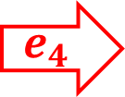
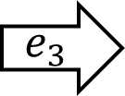
Backtracking Example
p accesses only 3 variables.
How many executions $α_{i}γ_{i}$ can we have?!
$$1$$
$$2$$
$$3$$
$$p$$
$$e_{4}$$
$$R_{1}$$
$$e_{2}$$
$$R_{2}$$
$$e_{1}$$
$$R_{3}$$
$$e_{3}$$
$$R_{4}$$
Notes:
We continue this way – the writes will be performed at the same order as a binary counting.
So now $e_{4}$ will write R1, the first variable accessed by p.

Slide 51


Backtracking Example
p accesses only 3 variables.
How many executions $α_{i}γ_{i}$ can we have?!
$$1$$
$$2$$
$$3$$
$$p$$
$$e_{4}$$
$$R_{1}$$
$$e_{2}$$
$$R_{2}$$
$$e_{1}$$
$$R_{3}$$
$$e_{3}$$
$$R_{4}$$
$$R_{5}$$
$$R_{6}$$
Notes:
This will cause p to change its solo run, and access two new variables

Slide 52

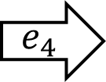
Backtracking Example
p accesses only 3 variables.
How many executions $α_{i}γ_{i}$ can we have?!
$$1$$
$$2$$
$$3$$
$$p$$
$$e_{4}$$
$$R_{1}$$
$$e_{2}$$
$$R_{2}$$
$$e_{1}$$
$$R_{3}$$
$$e_{3}$$
$$R_{4}$$
$$R_{5}$$
$$e_{5}$$
$$R_{6}$$
Notes:
And we continue this way…

Slide 53
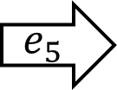
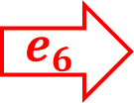
Backtracking Example
p accesses only 3 variables.
How many executions $α_{i}γ_{i}$ can we have?!
$$1$$
$$2$$
$$3$$
$$p$$
$$e_{4}$$
$$R_{1}$$
$$e_{2}$$
$$R_{2}$$
$$e_{1}$$
$$R_{3}$$
$$e_{3}$$
$$R_{4}$$
$$e_{6}$$
$$R_{5}$$
$$e_{5}$$
$$R_{6}$$

Slide 54

Backtracking Example
p accesses only 3 variables.
How many executions $α_{i}γ_{i}$ can we have?!
$$1$$
$$2$$
$$3$$
$$p$$
$$e_{4}$$
$$R_{1}$$
$$e_{2}$$
$$R_{2}$$
$$e_{1}$$
$$R_{3}$$
$$e_{3}$$
$$R_{4}$$
$$e_{6}$$
$$R_{5}$$
$$e_{5}$$
$$R_{6}$$
$$R_{7}$$

Slide 55
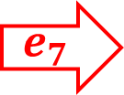
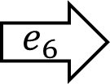
Backtracking Example
p accesses only 3 variables.
How many executions $α_{i}γ_{i}$ can we have?!
$$1$$
$$2$$
$$3$$
$$p$$
$$e_{4}$$
$$R_{1}$$
$$e_{2}$$
$$R_{2}$$
$$e_{1}$$
$$R_{3}$$
$$e_{3}$$
$$R_{4}$$
$$e_{6}$$
$$R_{5}$$
$$e_{5}$$
$$R_{6}$$
$$e_{7}$$
$$R_{7}$$
Notes:
The last write $e_{7}$ must be to R7.
Notice that at this point the construction can not precede, as the next step needs to write to an uncovered variable along the solo run of p., but all the variables along the solo run of p are covered.
We can conclude that if we have a sequence of executions of length 8, it can not be that all the solo runs of p accesses only 3 variables, and there must be at least one solo run that access 4 variables.

Slide 56
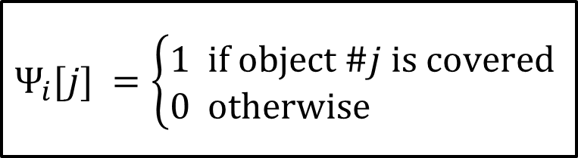
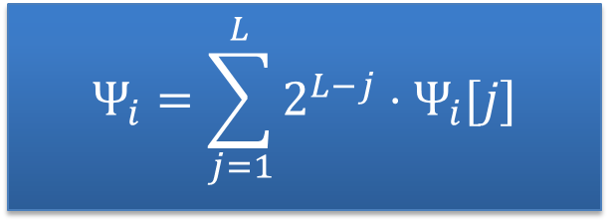
Backtracking Covering
Associate a potential function with each solo run:
$$Ψ_{i}=\sum_{j=1}^{L}{2^{L−j}⋅Ψ_{i}[j]}$$
$$Ψ_{i}[j] =\left\{\begin{aligned}&1 \text{if} \text{object} \#j \text{is} \text{covered} \\ &0 \text{otherwise}\end{aligned}\right.$$
$$p$$
$$γ_{i}$$
$$q_{i}$$
1
0
1
0
1
0
$$φ_{i}$$
1
2
3
4
5
6
Notes:
To formally capture it, we associate a potential function $Ψ$ with each solo run:
The variables along $φ_{i}$ are representing a binary number – 1 if the variable is covered by $γ_{i}$, and 0 otherwise.
In this example, 1 is covered and therefore its value is 1, and 2 is not covered, and therefore its value is 0.

Slide 57

Backtracking Covering
$Ψ$ increases with $i$
$$Ψ_{i}=\sum_{j=1}^{L}{2^{L−j}⋅Ψ_{i}[j]}$$
$$Ψ_{i}[j] =\left\{\begin{aligned}&1 \text{if} \text{object} \#j \text{is} \text{covered} \\ &0 \text{otherwise}\end{aligned}\right.$$
$$p$$
$$γ_{i}$$
$$q_{i}$$
$$e_{i}$$
1
0
1
0
1
0
$$φ_{i}$$
1
2
3
4
5
6
Notes:
The main idea is that $Ψ$ is monotone increasing:
The write $e_{i}$ may change the solo run of p.

Slide 58


Backtracking Covering
$Ψ$ increases with $i$
$$Ψ_{i}=\sum_{j=1}^{L}{2^{L−j}⋅Ψ_{i}[j]}$$
$$Ψ_{i}[j] =\left\{\begin{aligned}&1 \text{if} \text{object} \#j \text{is} \text{covered} \\ &0 \text{otherwise}\end{aligned}\right.$$
$$p$$
$$γ_{i}$$
$$q_{i}$$
$$e_{i}$$
1
0
1
0
1
0
$$φ_{i+1}$$
1
2
3
4
5
6
3
Notes:
So p no longer access variables 3 to 6, but a different variable.

Slide 59
Backtracking Covering
$Ψ$ increases with $i$
$$Ψ_{i}=\sum_{j=1}^{L}{2^{L−j}⋅Ψ_{i}[j]}$$
$$Ψ_{i}[j] =\left\{\begin{aligned}&1 \text{if} \text{object} \#j \text{is} \text{covered} \\ &0 \text{otherwise}\end{aligned}\right.$$
$$p$$
$$γ_{i}$$
$$q_{i}$$
$$e_{i}$$
1
0
1
0
1
0
0
$$φ_{i+1}$$
1
2
3
4
5
6
3
Notes:
This change the function $Ψ$ – now the third bit is 0, while before it was one. So the write $e_{i}$ causing bits to flip from 1 to 0.

Slide 60
Backtracking Covering
$Ψ$ increases with $i$
$$Ψ_{i}=\sum_{j=1}^{L}{2^{L−j}⋅Ψ_{i}[j]}$$
$$Ψ_{i}[j] =\left\{\begin{aligned}&1 \text{if} \text{object} \#j \text{is} \text{covered} \\ &0 \text{otherwise}\end{aligned}\right.$$
$$p$$
$$γ_{i}$$
$$q_{i}$$
$$e_{i}$$
1
1
1
0
1
0
0
$$φ_{i+1}$$
1
2
3
4
5
6
3
Notes:
However, this may occur only if $e_{i}$ writes to a variable that precedes them in $φ_{i}$, in our case to variable number 2, thus causing it to flip from 0 to 1.
Therefore $Ψ_{i+1}$ is bigger then $Ψ_{i}$

Slide 61
Backtracking Covering
$Ψ_{1}≥1$ implies $Ψ_{\sqrt{n}}≥\sqrt{n}$
$$Ψ_{i}=\sum_{j=1}^{L}{2^{L−j}⋅Ψ_{i}[j]}$$
$$Ψ_{i}[j] =\left\{\begin{aligned}&1 \text{if} \text{object} \#j \text{is} \text{covered} \\ &0 \text{otherwise}\end{aligned}\right.$$
$$p$$
$$γ_{i}$$
$$q_{i}$$
$$e_{i}$$
1
1
1
0
1
0
0
$$φ_{i+1}$$
1
2
3
4
5
6
3
Notes:
If we assume towards a contradiction, that all of p’s solo run are of length less then $\frac{1}{2}\log{n }$, then it is enough to take $Ψ$ to be a $\frac{1}{2}\log{n}$ digits number, and thus $Ψ$ value can not exceed $\sqrt{n}−1$.
However, $Ψ_{1}$ is at least one, and $Ψ$ is monotone increasing, and therefore its value on the last step must be at least $\sqrt{n}$ in contradiction.
So it must be that at least one of the $φ_{i}$ is of size at least $\frac{1}{2}\log{n}$, and this conclude the time lower bound..

Slide 62
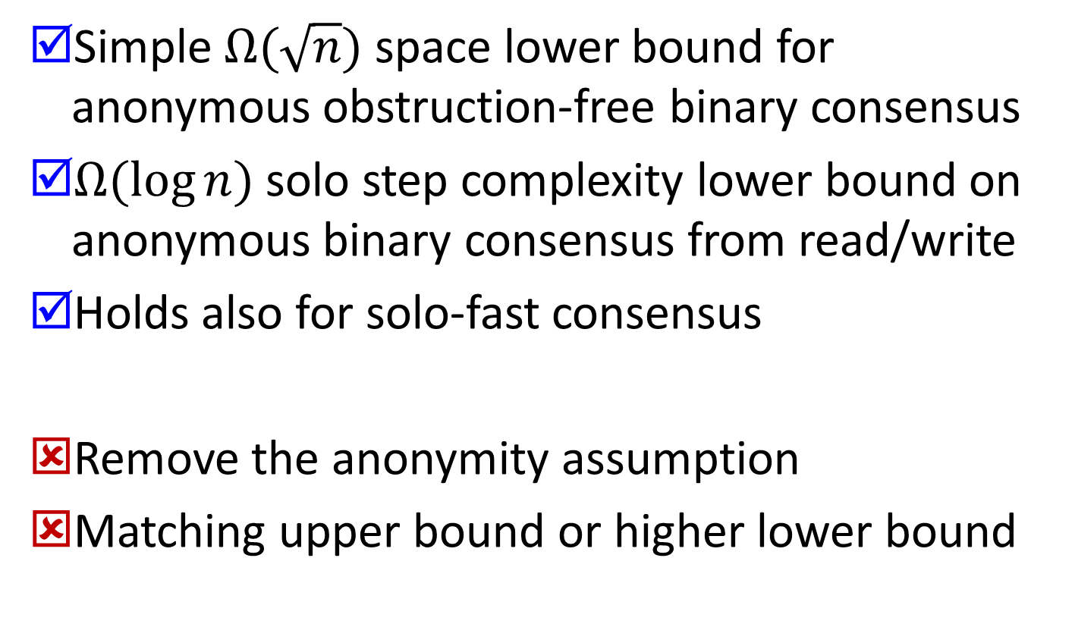
Wrap-up
Simple $Ω(\sqrt{n})$ space lower bound for anonymous obstruction-free binary consensus
$Ω(\log{n})$ solo step complexity lower bound on anonymous binary consensus from read/write
Holds also for solo-fast consensus
Remove the anonymity assumption
Matching upper bound or higher lower bound
Notes:
In the paper we show that our result holds also for solo-fast algorithms, in which a process only reads and writes when it runs solo, but may resort to any other primitives, like compare&swap, when it encounters contention.
For future work:
We would like to find a lower bound for the general case, without the anonymity assumption.
In addition, there is a gap between the lower bound and the best known upper bound. We would like to close that gap, either by improving the lower bound, or by finding a matching upper bound.

Slide 63

Thank you
Questions?

