Slide 1
Horizon thermodynamics of Lovelock black holes
David Kubizňák
(Perimeter Institute)
Pressure of all matter fields
vs.
Black Holes' New Horizons
Casa Matemática Oaxaca, BIRS, Oaxaca, Mexico
May 15 – 20, 2016

Slide 2
Plan of the talk
Gravitational dynamics & thermodynamics
Horizon thermodynamics
Some remarks
  Free energy & universal thermodynamic behavior
  Lovelock gravity: triple points, isolated critical point
  Why cohomogeneity one?
  Beyond spherical symmetry
Summary
Based on:
Devin Hansen, DK, Robert Mann, Universality of P-V criticality in Horizon Thermodynamics, ArXiv: 1603.05689.
Devin Hansen, DK, Robert Mann, Criticality and Surface Tension in Rotating Horizon Thermodynamics, 1604.06312.

Slide 3
I) Gravitational dynamics and thermodynamics: some references
Black hole thermodynamics: How do the completely classical Einstein equations know about QFT?
Sakharov (1967): spacetime emerges as a MF approximation of underlying microscopics, similar to how hydrodynamics emerges from molecular physics.
Can we understand gravity from thermodynamic viewpoint?
R. G. Cai, Connections between gravitational dynamics and thermodynamics, J. Phys. Conf. Ser. 484 (2014) 012003.

Slide 4
Local Rindler horizon: Jacobson’s argument
T. Jacobson, Thermodynamics of space-time: The Einstein equation of state, Phys. Rev. Lett. 75 (1995) 1260, gr-qc/9504004.
Are Einstein equations an equation of state?
new developments: Maulik’s talk
Black hole horizon: “horizon thermodynamics”
Apparent horizon in FRW
T. Padmanabhan, Classical and quantum thermodynamics of horizons in spherically symmetric space-times, Class. Quant. Grav. 19 (2002) 5387.
D. Kothawala, S. Sarkar, and T. Padmanabhan, Einstein's equations as a thermodynamic identity: The Cases of stationary axisymmetric horizons and evolving spherically symmetric horizons, Phys. Lett. B652 (2007) 338.
M. Akbar and R.-G. Cai, Thermodynamic Behavior of Friedmann Equations at Apparent Horizon of FRW Universe, Phys. Rev. D75 (2007) 084003, hep-th/0609128.

Slide 5
II) Horizon thermodynamics
Consider a spherically symmetric spacetime
Identify total pressure P with component
of energy-momentum tensor evaluated on the horizon
Then the radial grav. field equation rewrites as Universal and cohomogeneity-1:
with an horizon determined from
Horizon equation of state:
Horizon first law:

Slide 6
Black holes in Einstein gravity
The radial Einstein equation
Horizon is a regular null surface
Temperature reads
Identify the total pressure as
We recover the Horizon Equation of State:
with volume

Slide 7
Horizon first law
Starting from the horizon equation of state
let’s identify the entropy as quarter of the area
Multiply
So we recovered
the horizon first law:

Slide 8
Horizon thermodynamics in Einstein gravity
Input:
The radial Einstein equation where P is identified with Trr component of stress tensor
Identification of T, S, and V by other criteria
Output:
Identification of horizon energy E
Universal (matter independent) horizon equations that depend only on the gravitational theory considered
(Misner-Sharp mass evaluated on the horizon)
End of story!

Slide 9
III) Some remarks
  a) Free energy & Universal thermodynamic behavior
Define the Gibbs free energy (Legendre transform of E)
Can plot it parametrically using the equation of state

Slide 10
Only 3 qualitative different cases (considering all possible matter fields - values of P)
P<0: RN case
P=0: AF case
P>0: AdS case (possibly with Q)
H-P transition interpretation?

Slide 11
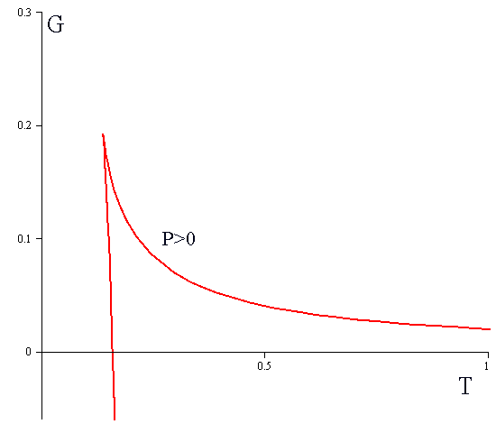
“Universal”
Q=0
vs.
charged
Different ensembles (can. vs. grand can.)
Effectively reduces to “vacuum” diagrams
Different black holes & environments
Universal but the concrete physical interpretation depends on the matter content

Slide 12
b) Generalization to Lovelock gravity
Lovelock higher curvature gravity
Input:
Impose spherically symmetric ansatz
Write the radial Lovelock equation where P is identified with Trr component of stress tensor
Identify the temperature T via Euclidean trick
Identify the true entropy S (Wald)
Specify the black hole volume

Slide 13
Output:
Identification of horizon energy E
Universal (matter independent) horizon equations that depend only on the gravitational theory considered
(Misner-Sharp energy evaluated on the horizon, an energy to warp the spacetime and embed the black hole horizon)

Slide 14
Einstein gravity (d=4)

Slide 15
Swallow tails (Gauss-Bonnet gravity d=5)

Slide 16
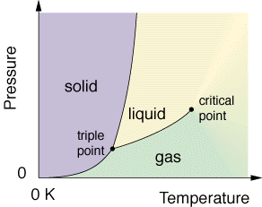
Triple point (4th-order Lovelock)

Slide 17
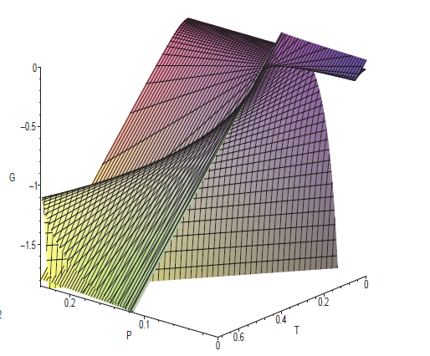
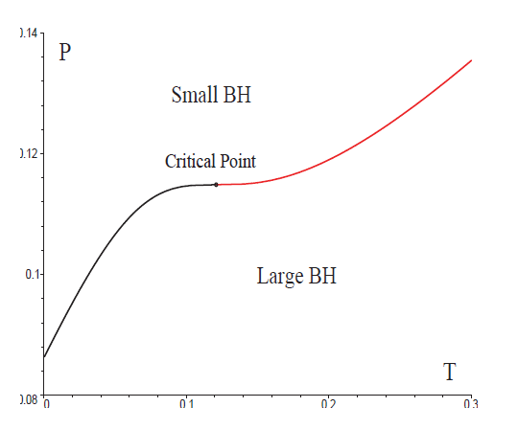
Isolated critical point (3rd order and higher)
Special tuned Lovelock couplings
Odd-order J
hyperbolic horizons (k=-1)
B. Dolan, A. Kostouki, DK, R. Mann, arXiv:1407.4783.

Slide 18
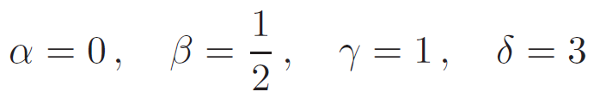



Critical exponents:
Comments:
cf. mean field theory critical exponents
satisfies Widom relation and Rushbrooke inequality
Prigogine-Defay ratio
…indicates more than one order parameter?

Slide 19
  c) Why cohomogeneity one?
Consider first vacuum Schwarzschild solution
Next take a general solution with general f(r) and g(r)
Radial EE + actual Hawking temperature
rewrites as horizon equation of state
Horizon first law = above (vacuum) first law in terms of true Hawking temperature and Tm.

Slide 20
d) Beyond spherical symmetry
Ansatz
Identify
(cohomogeneity two)

Slide 21
Rewrite the radial Einstein equation
where we identified
as
horizon energy and angular momentum (of vacuum BH)
“surface tension”

Slide 22
Rotating horizon thermodynamics
Horizon equation of state:
Horizon first law:
Cohomogeneity two relation
Universal regarding the matter content but ansatz has limited applications
Provided a volume V of black hole is “freely” specified (not-unique) in canonical ensemble (J=const) we can rewrite these as cohomogeneity one
Horizon equation of state:
Horizon first law:

Slide 23
Swallow tail: rotating Einstein (P>0)

Slide 24
IV) Summary
We reviewed the proposal of horizon thermodynamics showing the “equivalence” of thermodynamic first law and radial Einstein equation and extended it to rotating black hole spacetimes.
The horizon first law is cohomogeneity one (two in the rotating case)
Essentially an “equivalence class” of vacuum first laws (written from a perspective of an observer who measures true temperature)

Slide 25
This implies universal thermodynamic behaviour (independent of matter content) that depends only on the gravitational theory in consideration.
Interesting phase transitions are observed in Lovelock case (isolated critical point, triple points,..).
Compared to the extended phase space thermodynamics of AdS black holes adjusting P more natural?
What about a more general rotating ansatz? What is the physical meaning of surface tension sigma?

